Slide 1

Year 5
Science: Friction

Slide 2

Can you remember what a force is?
push
pull
twist
Science.

Slide 3
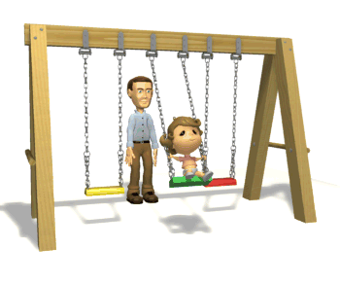
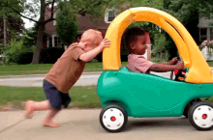
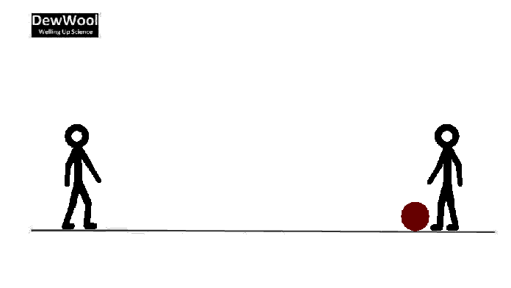
What can a force do?
move
speed
direction
Science.

Slide 4
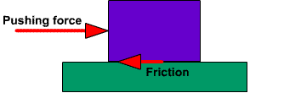
Friction
Science.

Slide 5
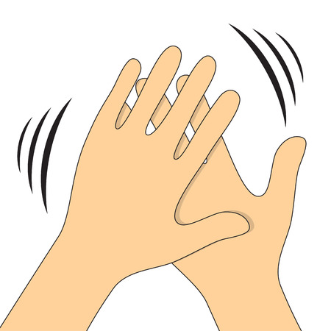
Friction
Science.

Slide 6
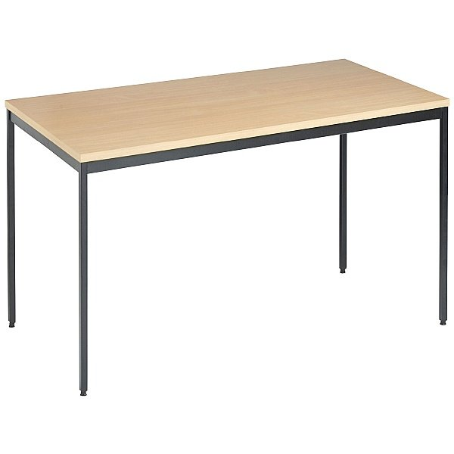
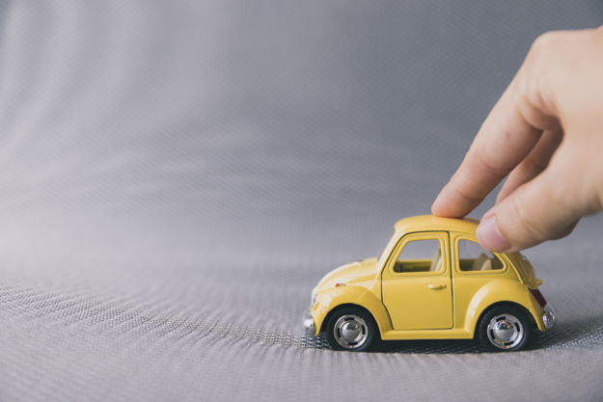
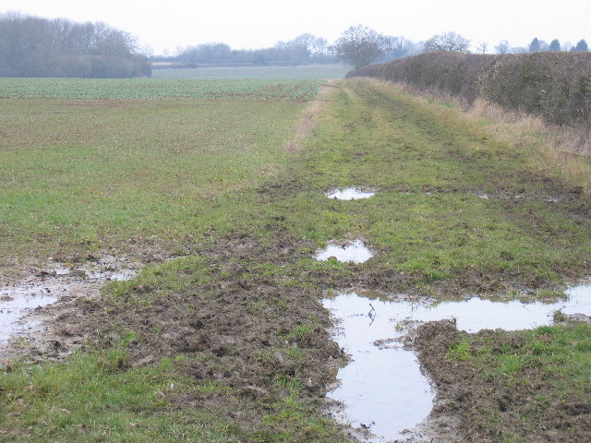
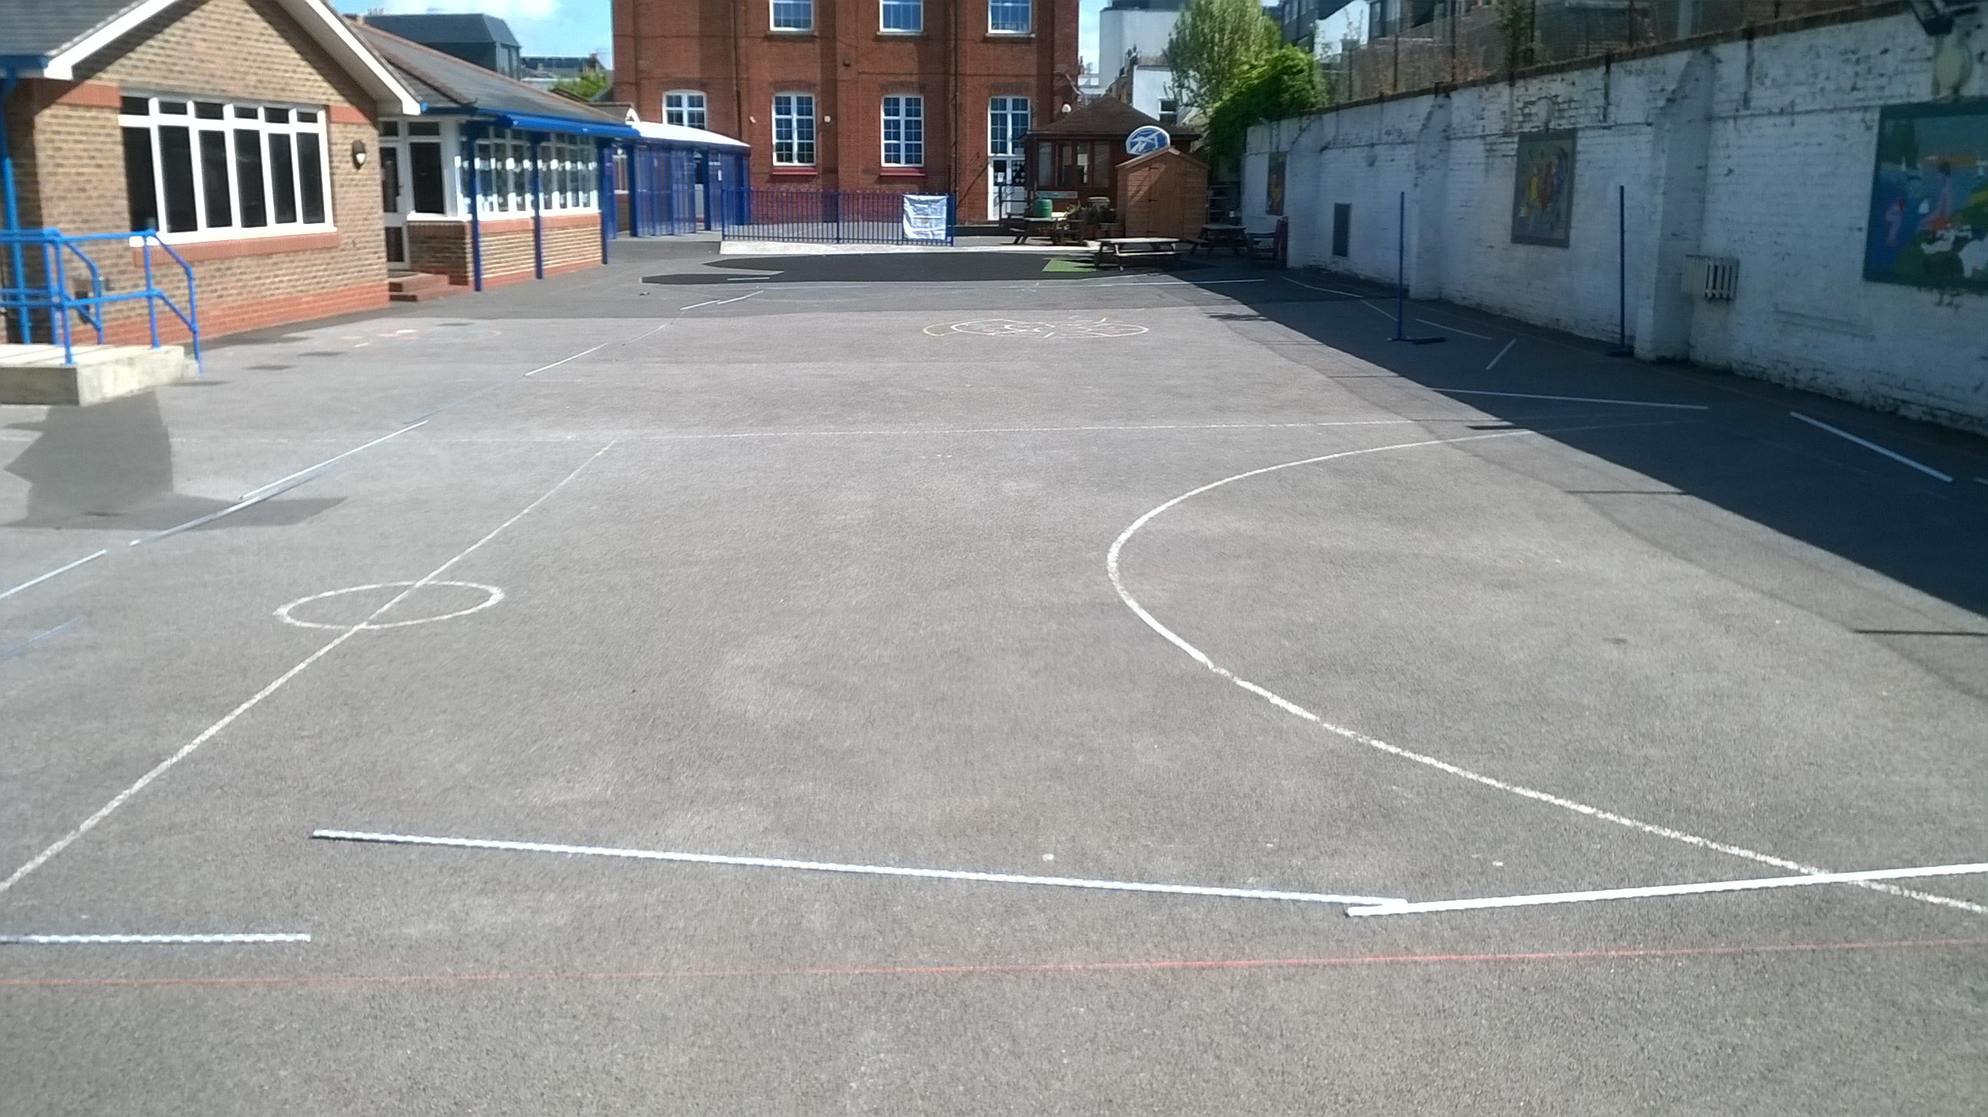

Make a prediction.
Science.

Slide 7
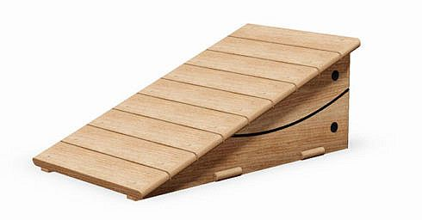
How could I make it a fair test?
Science.

Slide 8
What do you think my results mean?
Surface | Distance the car travelled
Grass | 10cm
Table top | 57cm
Playground tarmac | 39cm
sand | 18cm
On which surface did the car travel the furthest?
On which surface did the car not travel very far?
Science.

Slide 9
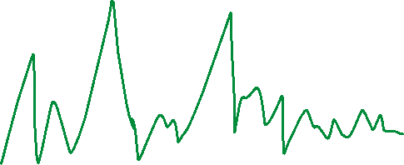
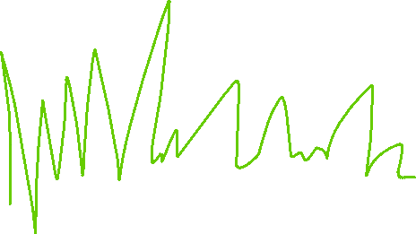
What do you think my results mean?
Science.

Slide 10
Time for a quiz.
What is a force?
Push
Pull
Twist
Science.

Slide 11
Time for a quiz.
True or false?
Friction is a force which pushes in the same direction as a moving object.
False!
Friction always pushes in the opposite direction to the way the object is moving.
Science.

Slide 12
Time for a quiz.
True or false?
Friction slows objects down.
True!
Friction always slows objects down and it never speeds them up.
Science.

Slide 13
Time for a quiz.
True or false?
There is more friction on smooth surfaces.
False!
There is less friction on smooth surfaces so objects move quicker and easier on them.
Science.

Slide 14
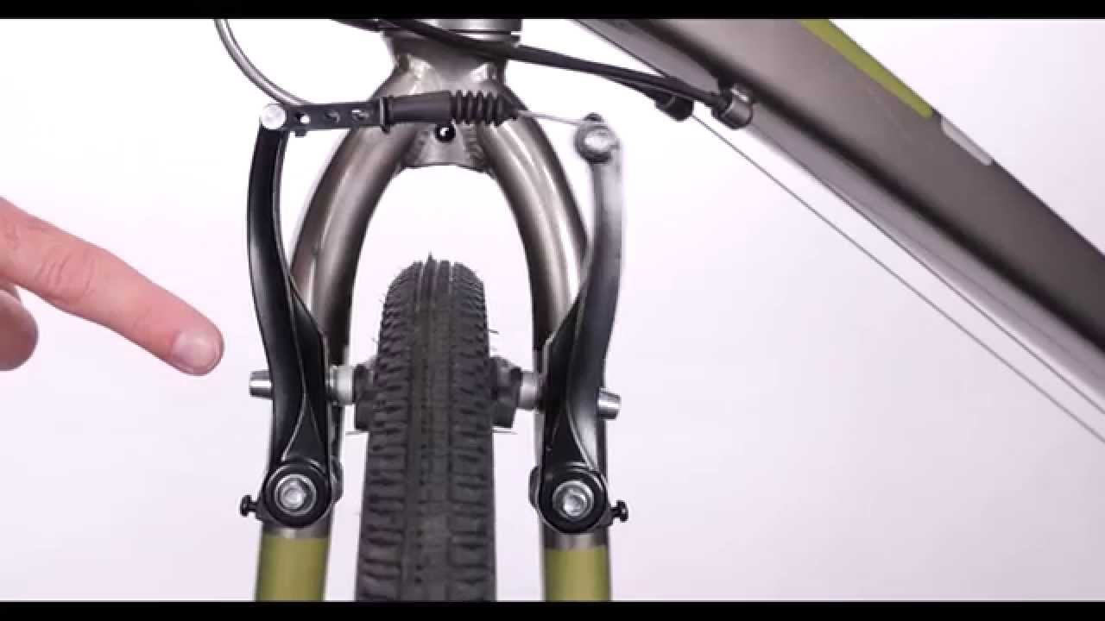
Is friction useful?
Science.

Slide 15
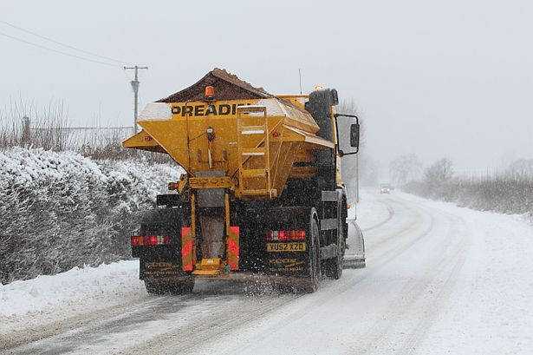
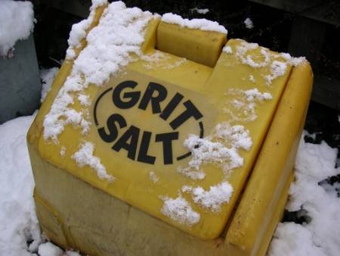
Is friction useful?
Science.

