Slide 1
Learning intention: To learn to represent numbers in different ways.

Slide 2
Today we are going to be looking at representing numbers to 100 using Base 10.
1
10

Slide 3
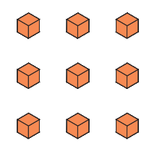
Look, I have 9 ones. That means I have 9.
9

Slide 4
I have 3 tens. That means I have 30.
30

Slide 5
I have 4 tens and 5 ones. That means I have 45.
45

Slide 6
Which number is this?

Slide 7
Which number is this?

Slide 8
Which number is this?

Slide 9
Which number is this?

Slide 10
Which number is this?

Slide 11
Answers
Slide 6 – 63
Slide 7 – 71
Slide 8 – 34
Slide 9 – 52
Slide 10 - 27

