Slide 1
Set 2 Sounds
oo
Notes:
Lets practise our set 2 sounds, today;’s sound is oo

Slide 2
Notes:
What do you think this mam is saying to the child? Yes, look at a book

Slide 3
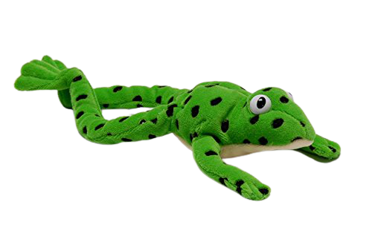
Notes:
Lets fred talk! T-oo-k, took, sh-oo-k, shook, f-oo-t, foot

Slide 4
Notes:
This is our new sound oo. It has 2 letters but 1 sound, it’s a special friend

Slide 5
Notes:
Lets practice oo. My turn first…..

Slide 6
Notes:
Now its your turn, practice oo when the picture moves on the screen

Slide 7
book
_
.
.
foot
_
.
.
look
_
.
.
Notes:
Lets read some green words! First lets use fred talk then read the word

Slide 8
Notes:
Let’s practice writing our sound - oo

Slide 9
Notes:
Let’s practice writing words with the oo sound in them book shook cook

