Slide 1
Houses (now and then)
Notes:
Today we’re going to be looking at older houses and newer houses. When you walk along the streets past houses, some of them look old, some new, and sometimes it is hard to tell. We’re going to look at different types of homes and which ones you could maybe call old or new and why.

Slide 2
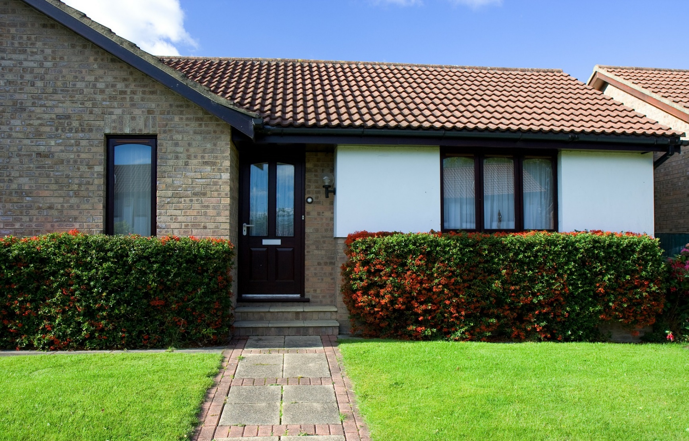
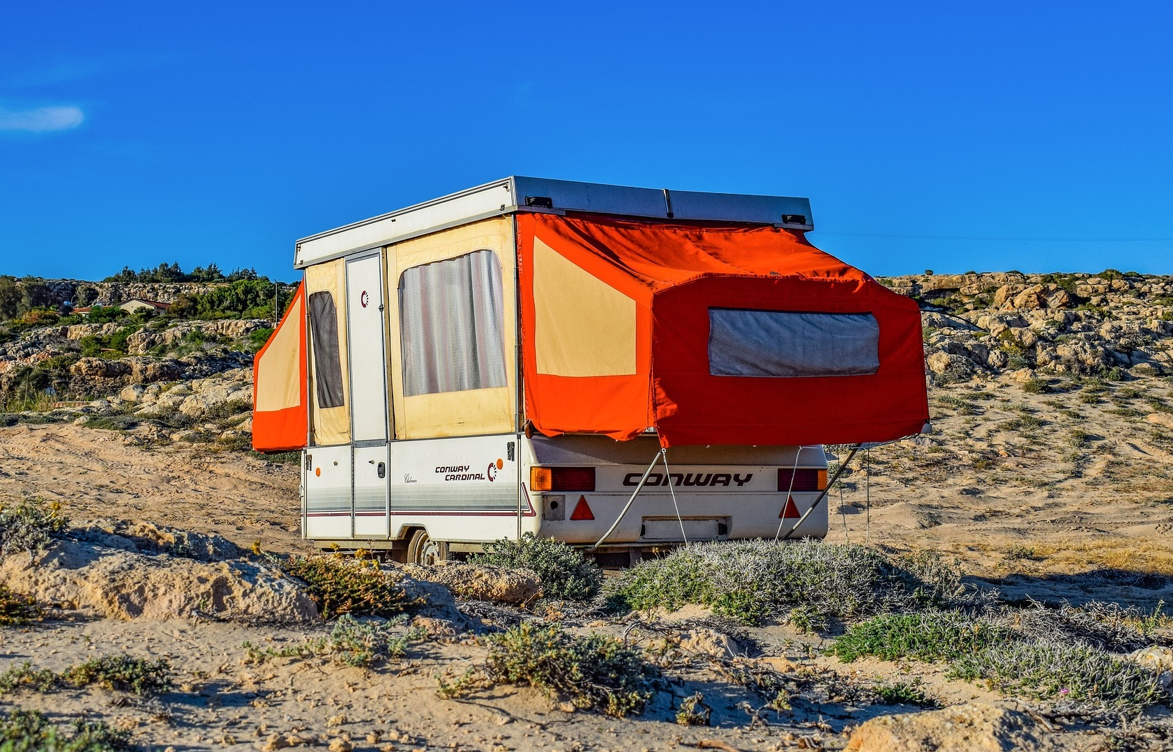
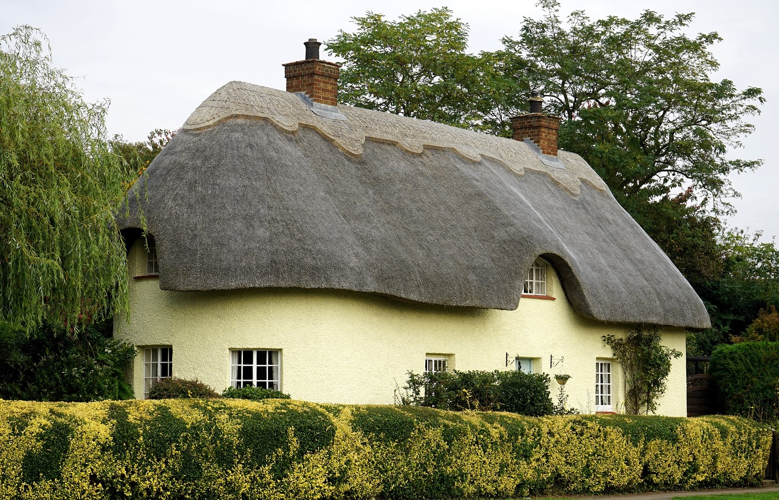
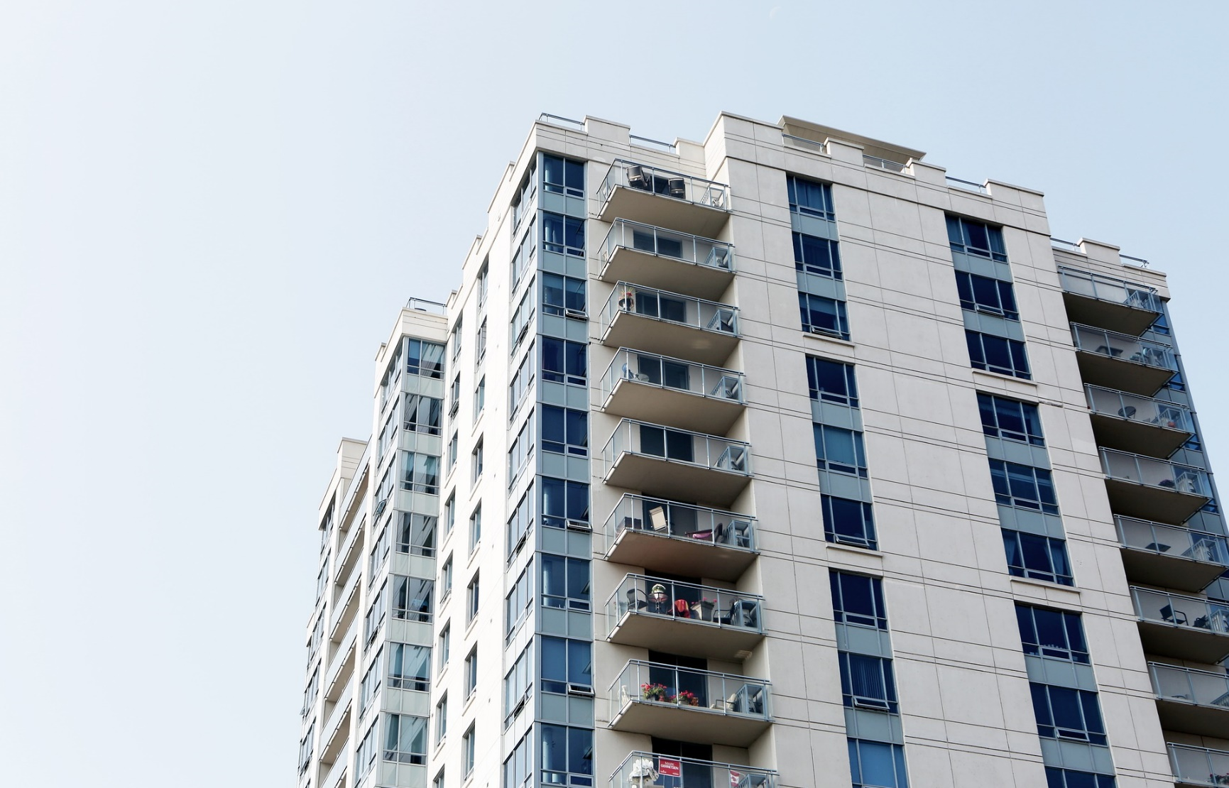
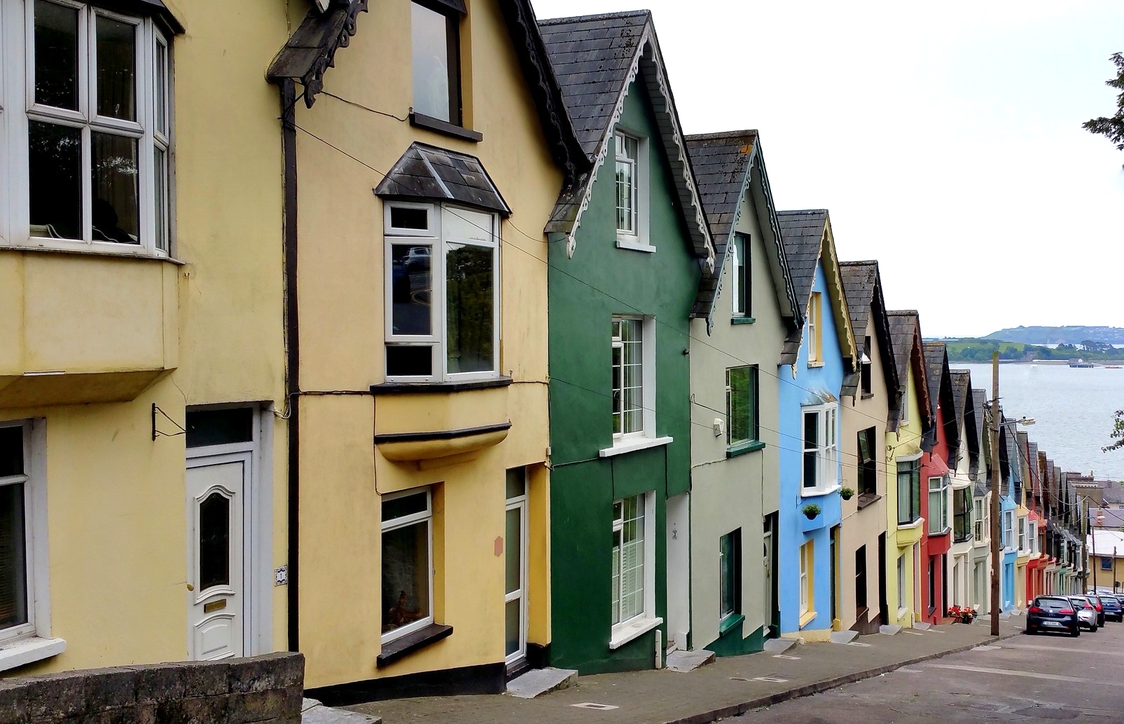
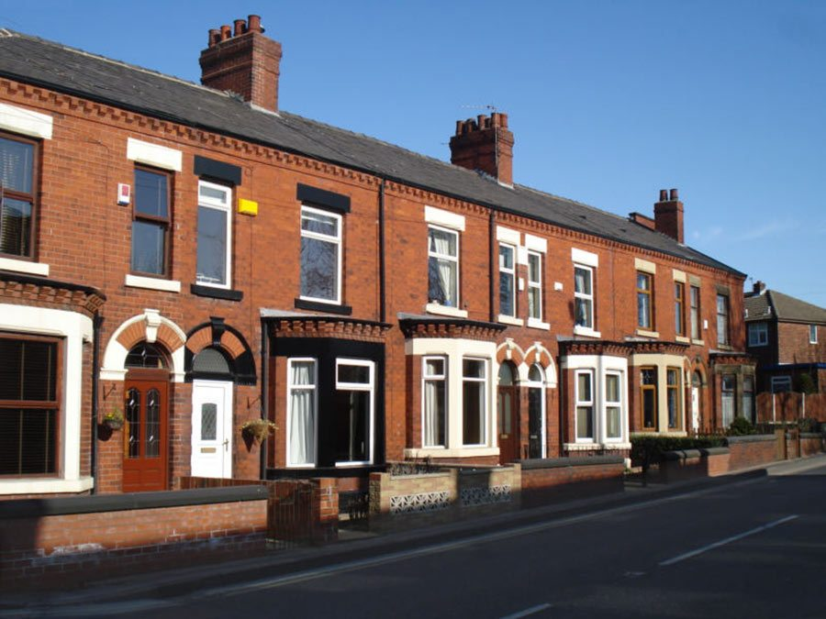
Homes
Notes:
There are so many different types of homes, some people live in houses, some in flats, some people live in caravans or in cottages. These can look very different but they share some common things, a door and windows. Look at the pictures and think about your home, does yours look similar or different to the pictures? Look at your drawing that you have done now too.

Slide 3
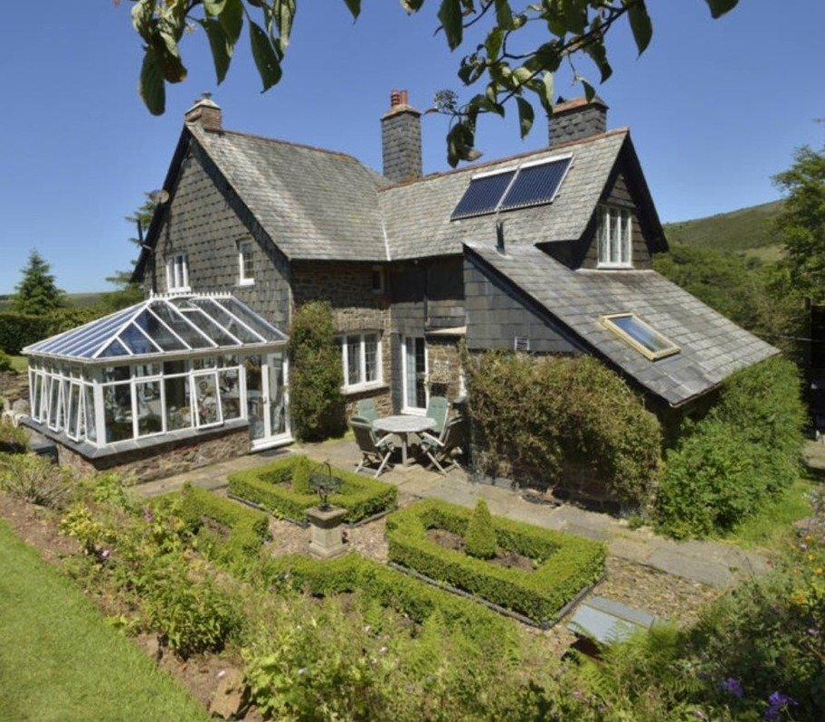
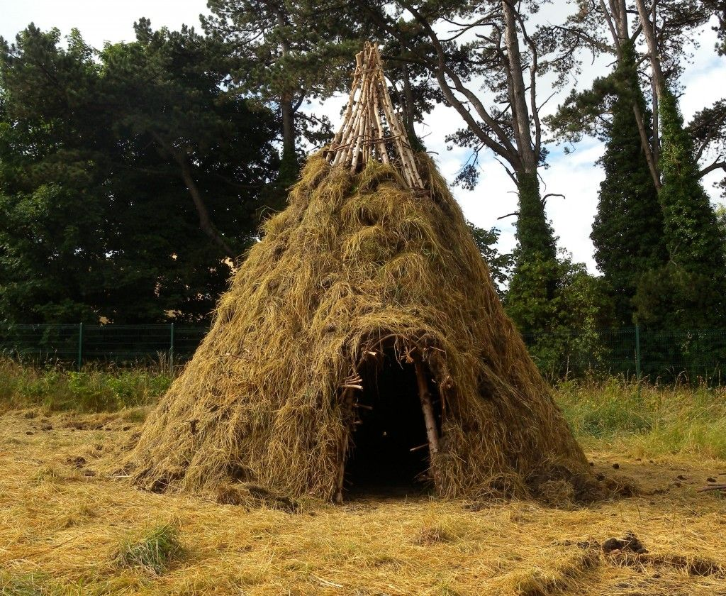
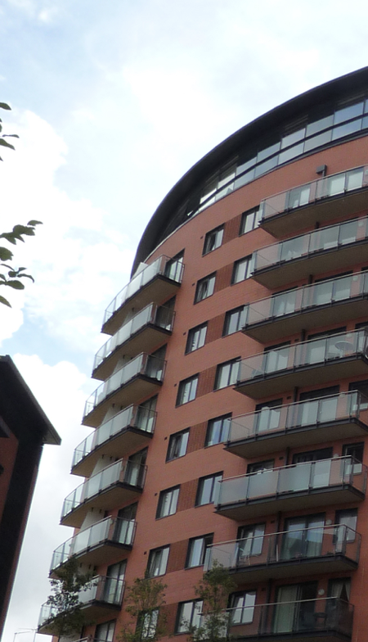
Which homes do you think are older? Why?
Notes:
Here are some pictures of different types of homes, some are older and some are newer. Which ones do you think are older and why?
Remember, just because it is older, doesn’t mean they’re not good.

Slide 4
Which homes do you think are older? Why?
brick
straw
stone
Notes:
These are the older houses, starting with the straw house. This is what very early houses looked like, what is missing? That’s right, a door, windows and it is made from straw. That reminds me of the story of the 3 Little Pigs. Do you think it’s a good idea to build a house from straw? No, so people did start to change the materials they used and used stronger ones such as stone and brick. What is your home made from?

Slide 5
Which homes do you think are older? Why?
solar panels
balcony
windows
conservatory
Notes:
Here are the newer houses. The first one seems to be quite old, but they have had new parts put on including the glass conservatory and then the solar panels on the roof. They use sun light to create energy for their home. The flats are very new. They are made from brick and have lots of people living inside them, they have lots of glass windows and balconies that people can stand on and look outside.

Slide 6
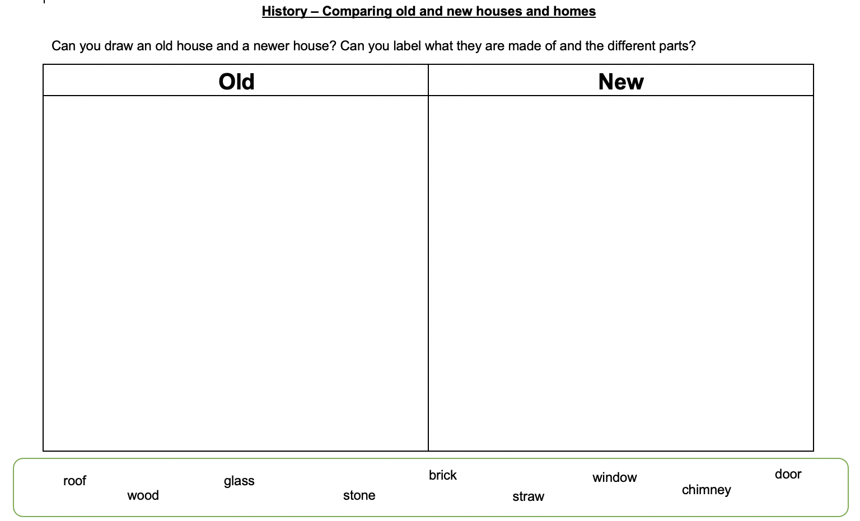
Notes:
Have a go at the worksheet, you will need to draw an older and a newer house. Use the pictures to help you and the words at the bottom to help you label them.

Slide 7
Commentary:
Slide 1: Today we’re going to be looking at older houses and newer houses. When you walk along the streets past houses, some of them look old, some new, and sometimes it is hard to tell. We’re going to look at different types of homes and which ones you could maybe call old or new and why.
Slide 2: There are so many different types of homes, some people live in houses, some in flats, some people live in caravans or in cottages. These can look very different but they share some common things, a door and windows. Look at the pictures and think about your home, does yours look similar or different to the pictures? Look at your drawing that you have done now too.
Slide 3: Here are some pictures of different types of homes, some are older and some are newer. Which ones do you think are older and why? Remember, just because it is older, doesn’t mean they’re not good.
Slide 4: These are the older houses, starting with the straw house. This is what very early houses looked like, what is missing? That’s right, a door, windows and it is made from straw. That reminds me of the story of the 3 Little Pigs. Do you think it’s a good idea to build a house from straw? No, so people did start to change the materials they used and used stronger ones such as stone and brick. What is your home made from?
Slide 5: Here are the newer houses. The first one seems to be quite old, but they have had new parts put on including the glass conservatory and then the solar panels on the roof. They use sun light to create energy for their home. The flats are very new. They are made from brick and have lots of people living inside them, they have lots of glass windows and balconies that people can stand on and look outside.
Slide 6: Have a go at the worksheet, you will need to draw an older and a newer house. Use the pictures to help you and the words at the bottom to help you label them.

