Slide 1
Learning intention: To consolidate number work.

Slide 2
Before you start the quiz, you will need a pencil or pen and some paper.
Write the numbers from 1 to 10 down your paper like this:
1
2
3
4
5
6
7
8
9
10

Slide 3
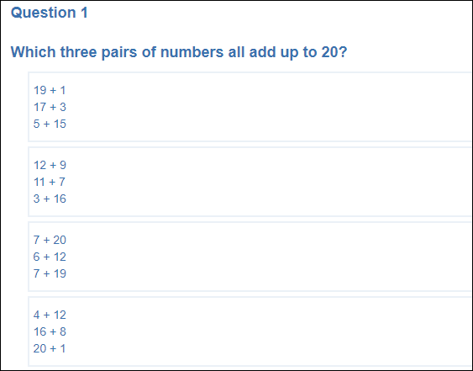
A
B
C
D

Slide 4
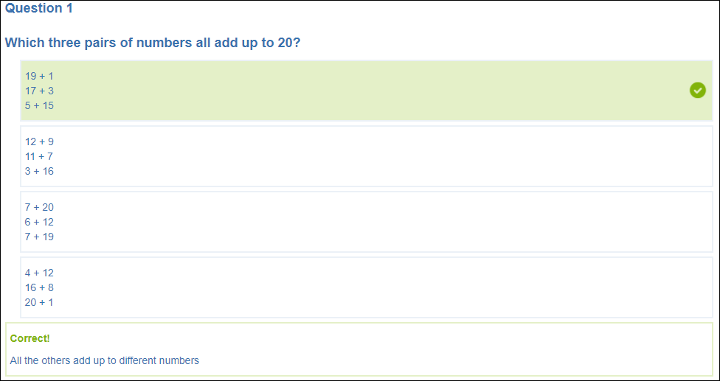
Answer A

Slide 5
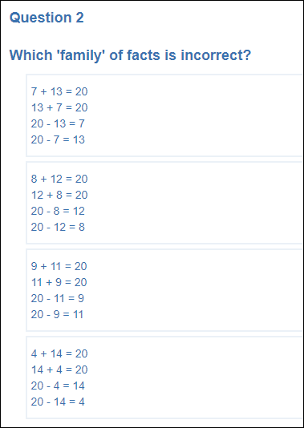
A
B
C
D

Slide 6
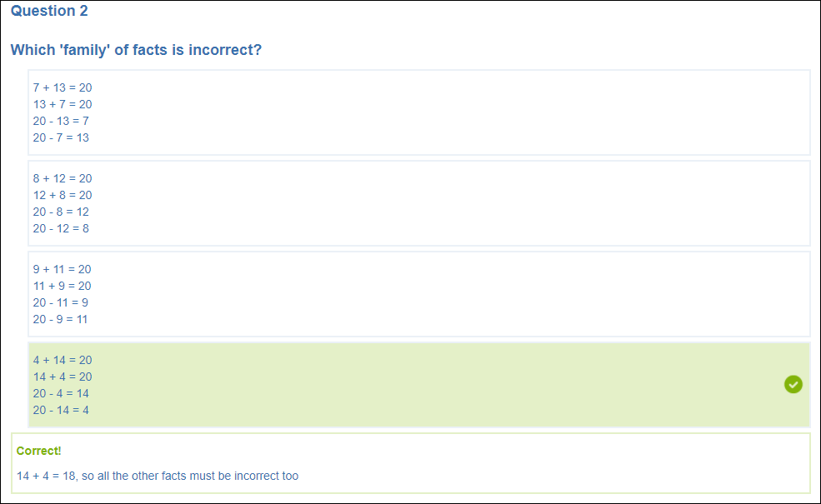
Answer D

Slide 7
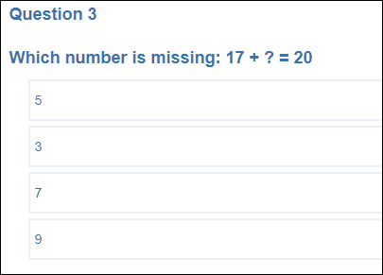
A
B
C
D

Slide 8
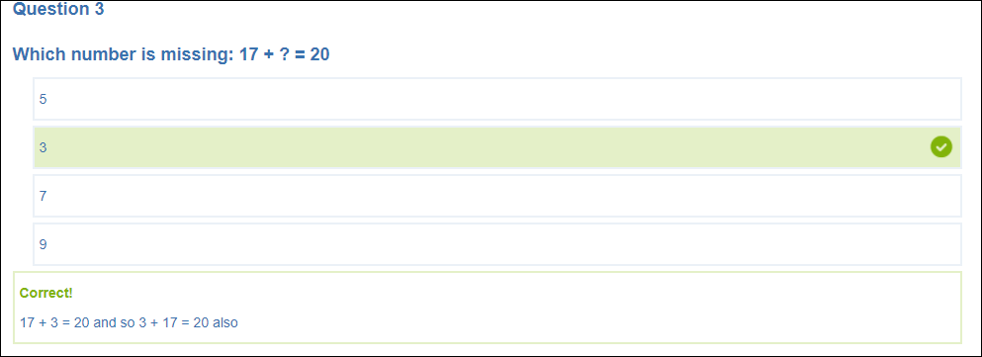
Answer B

Slide 9
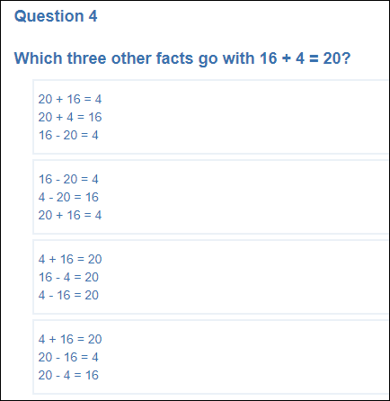
A
B
C
D

Slide 10
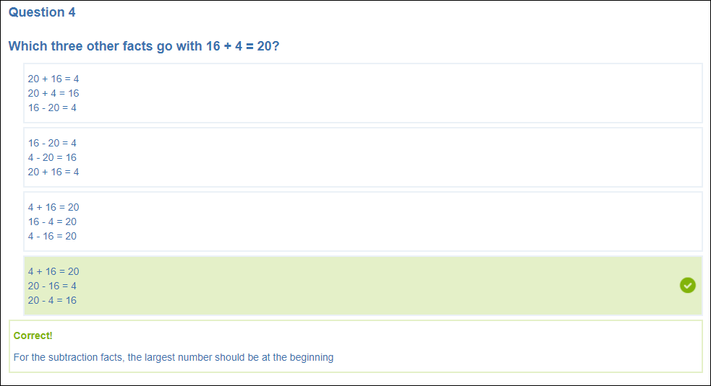
Answer D.

Slide 11
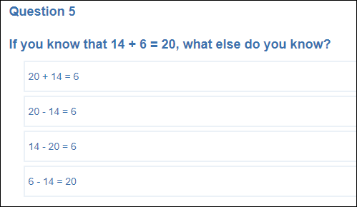
A
B
C
D

Slide 12
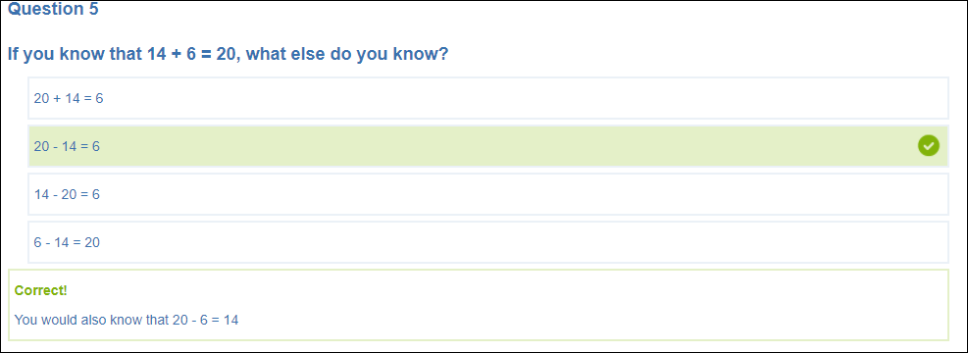
Answer B

Slide 13
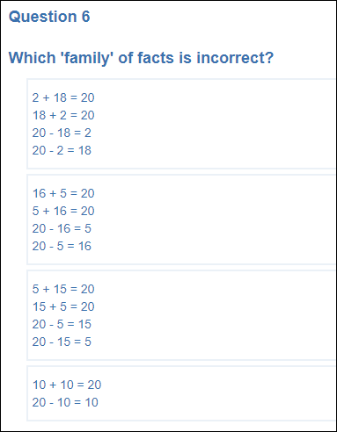
A
B
C
D

Slide 14
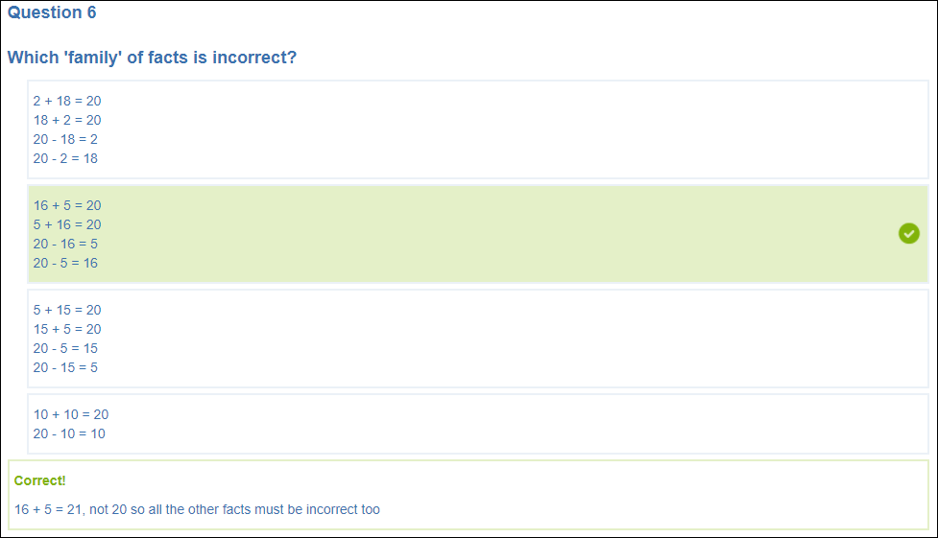
Answer B

Slide 15
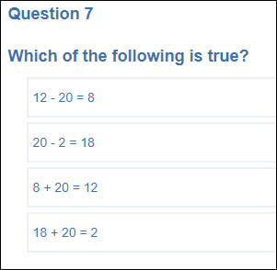
A
B
C
D

Slide 16
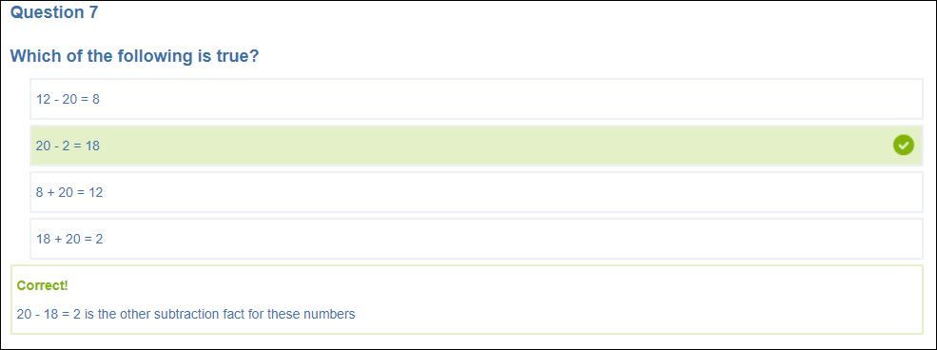
Answer B

Slide 17
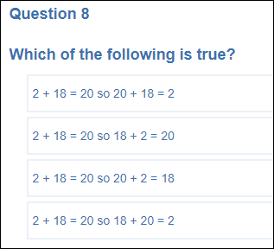
A
B
C
D

Slide 18
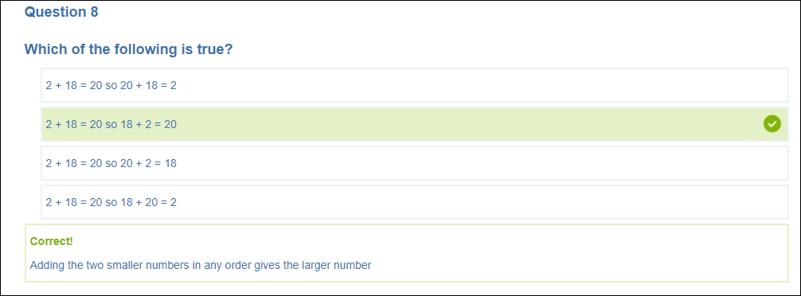
Answer B

Slide 19
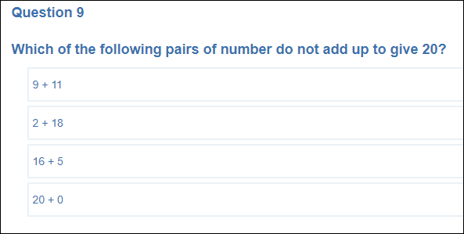
A
B
C
D

Slide 20
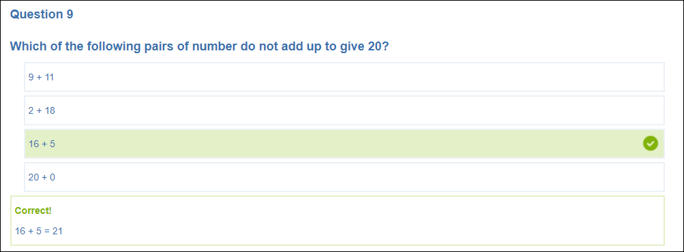
Answer C

Slide 21
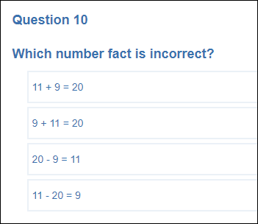
A
B
C
D

Slide 22
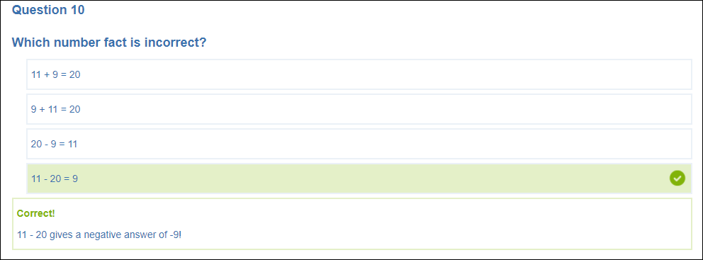
Answer D

Slide 23
Well Done!
Add your score.
Ask an adult to do the same quiz and help them if they need it.
Could you make your own number quiz?

