Slide 1

LI: To retell a traditional tale.
English
To create a new story map with one new character

Slide 2

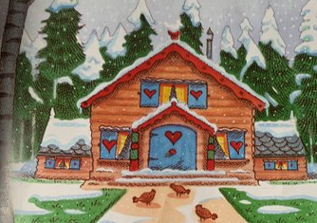
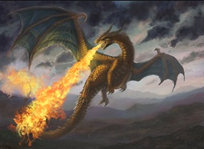
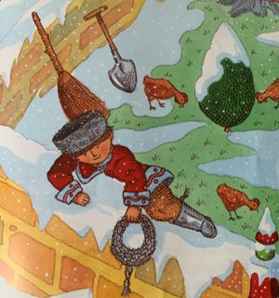
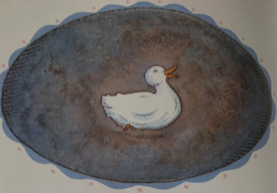

I am going to retell my story using my new character.

Slide 3
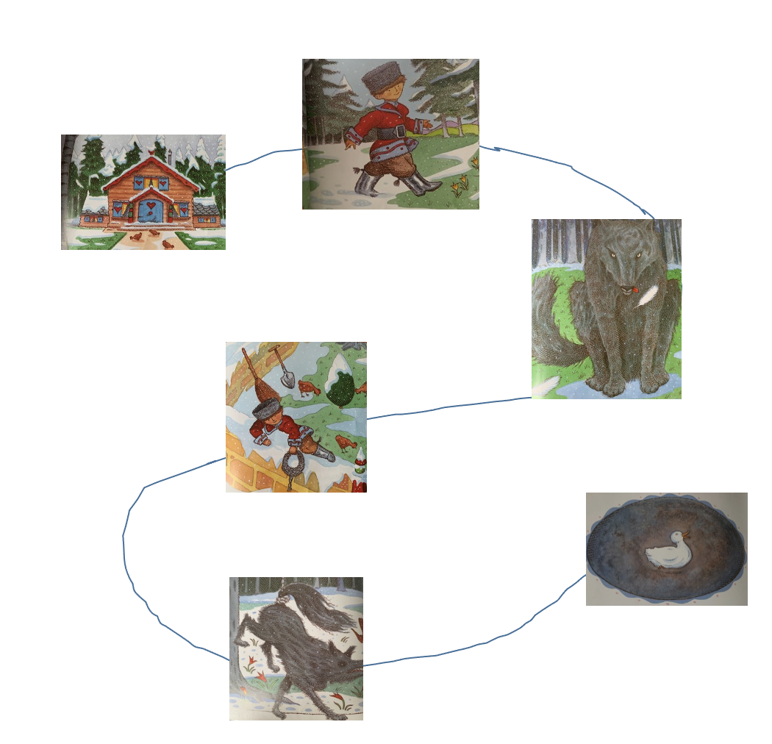
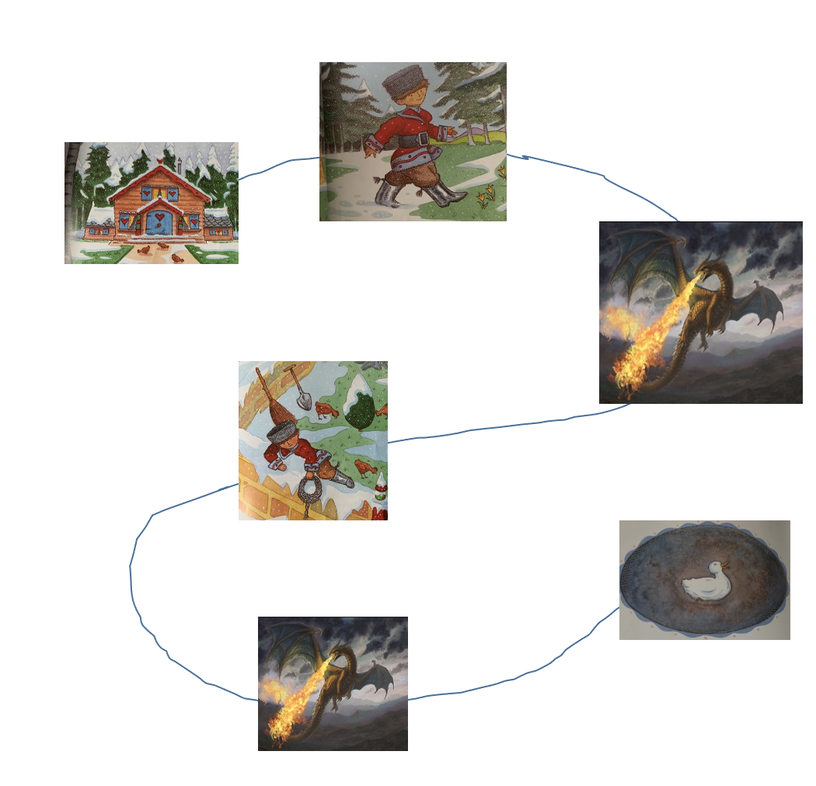
Spot the difference:

Slide 4
It’s the same story…
with new characters!

Slide 5
You designed a new character:

Slide 6
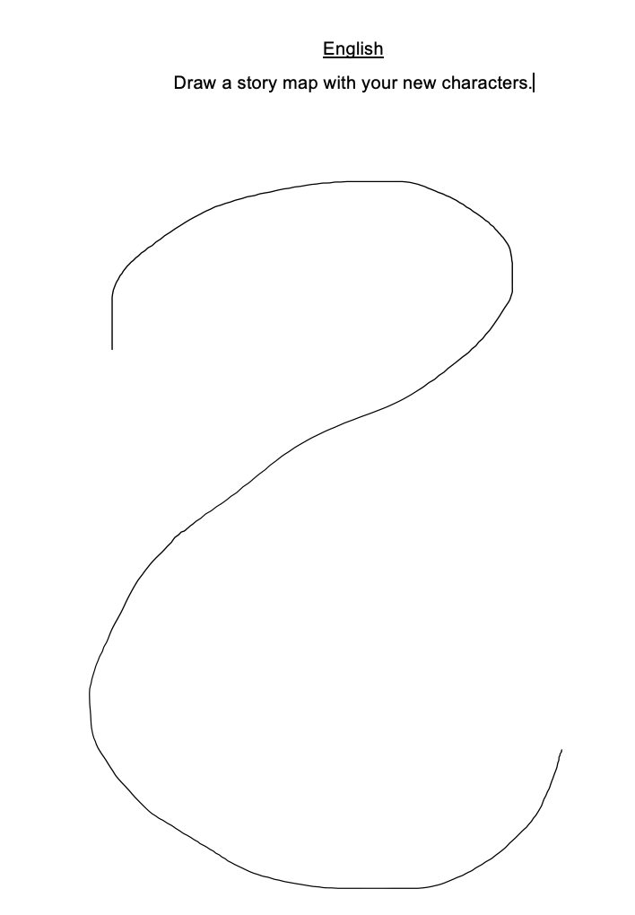
Now you need a new story map:

