Slide 1
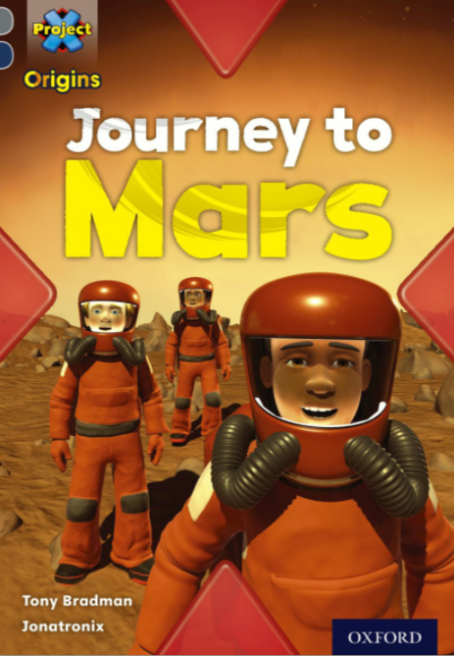

Slide 3
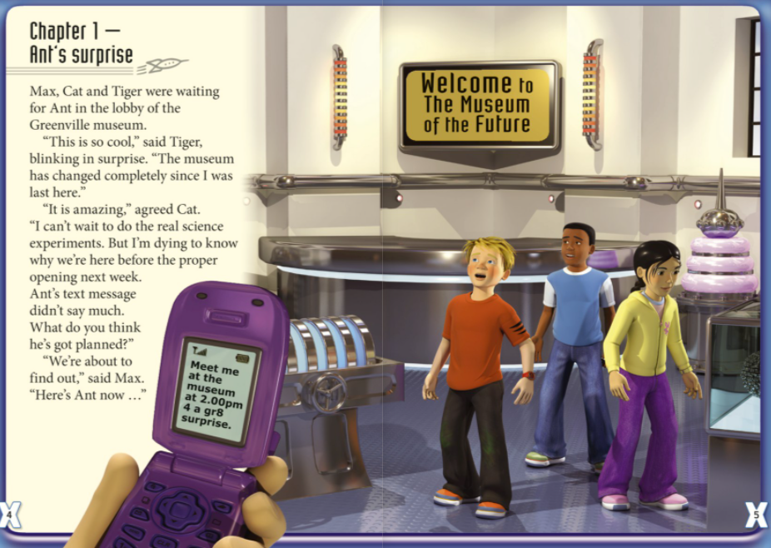
How do you think the children feel when they get Ant’s text message?

Slide 4
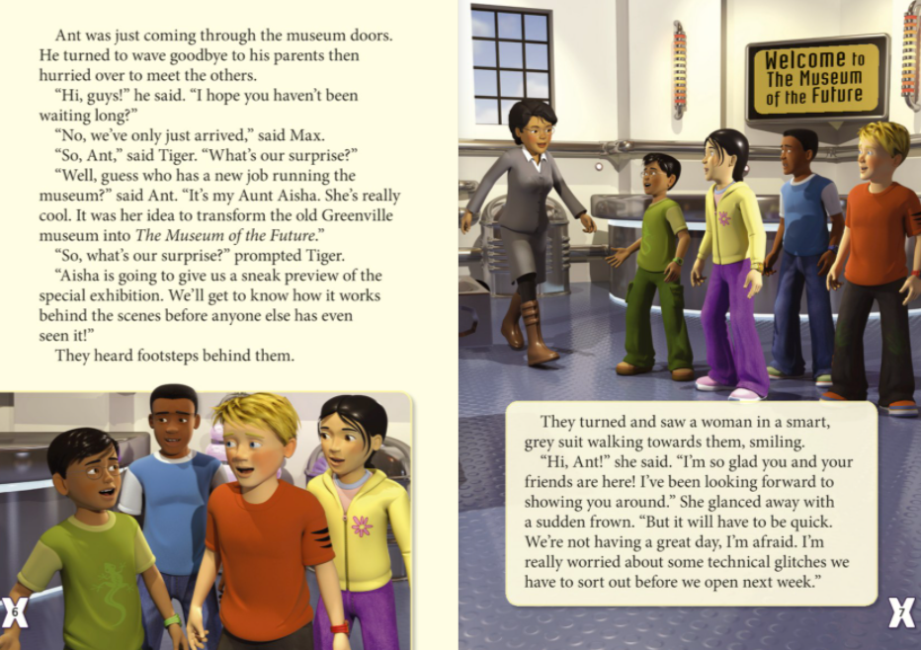
How do the children feel once Ant tells them why they’re there?
How does Aunt Aisha feel and why?

Slide 5
