Slide 1
Learning intention When were different modes of transport invented

Slide 2
We are going to investigate whenthe main modes of tyransport were invented.
Your task at the end is to create a timeline.

Slide 3
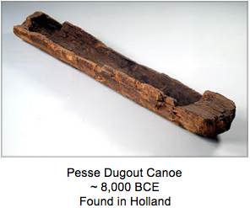
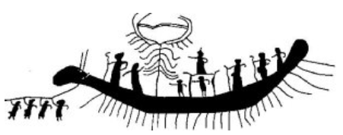
8,000BC
The oldest boat ever discovered was the Pesse Canoe from Holland. However it is thought the the oldest water craft would have been used at the start of the Stone Age 800,000 years ago!
The second picture is from Egypt from between 3,000 and 6,000 BC

Slide 4
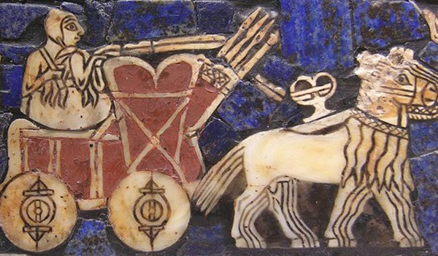
3,500BC
The potters wheel was the wheel invented about 5,000BC. The first wheeled vehicles were used. There is evidence from all across Asia and Eastern Europe

Slide 5
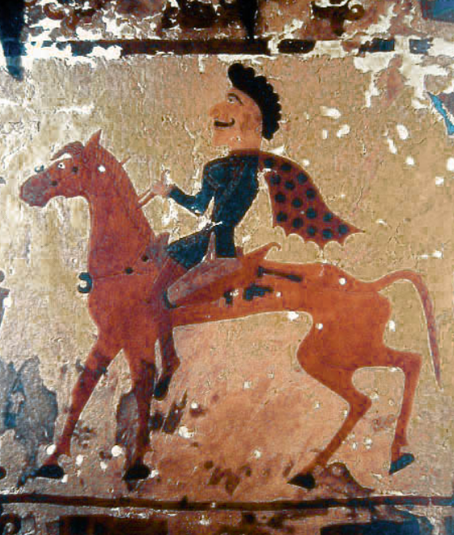
3,500BC
Horses were first domesticated in central Asia
The potters wheel was the wheel invented about 5,000BC. The first wheeled vehicles were used. There is evidence of wheeled transport from all across Asia and Eastern Europe.

Slide 6
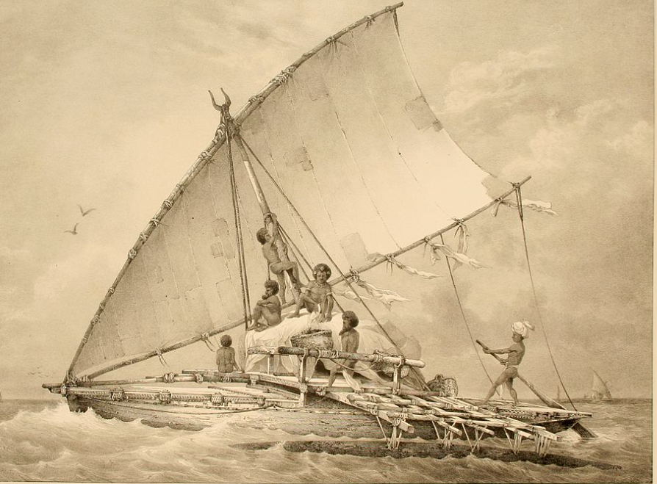
3,000BC
Ocean going sailing boats used the wind for power in the eastern Pacific Ocean

Slide 7
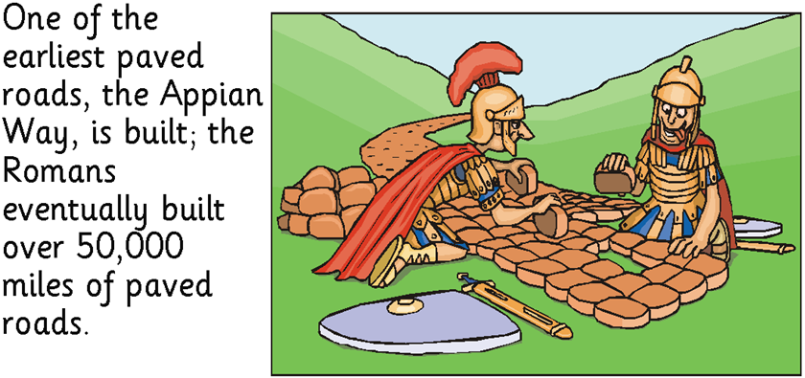
312BC

Slide 8
1,100AD
Horse draw carriages to carry paying passengers were first used. This is an English carriage from the 1300’s called a Whirlecoat, which was a luxurious carriage used by important people.

Slide 9
1662

Slide 10
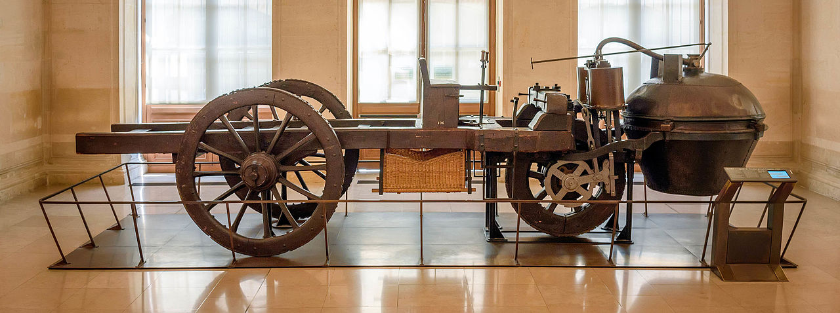
1769
The first power road vehicle was invented By Nicolas Cugnot in France. It was steam powered and very slow and noisy.

Slide 11
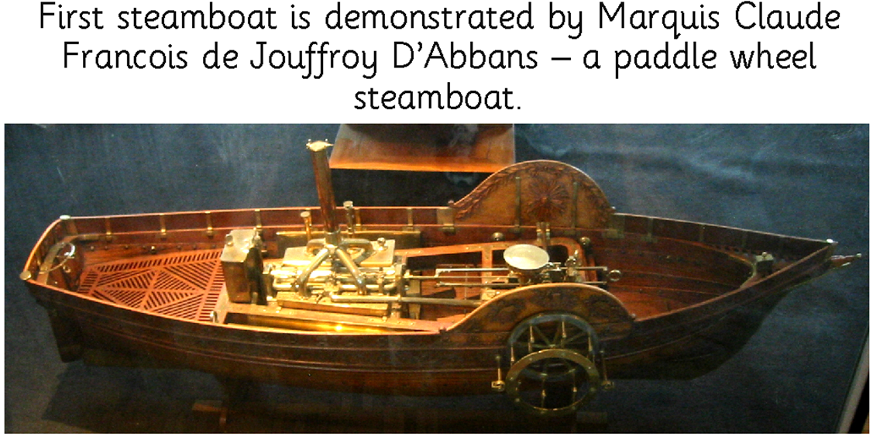
1772

Slide 12
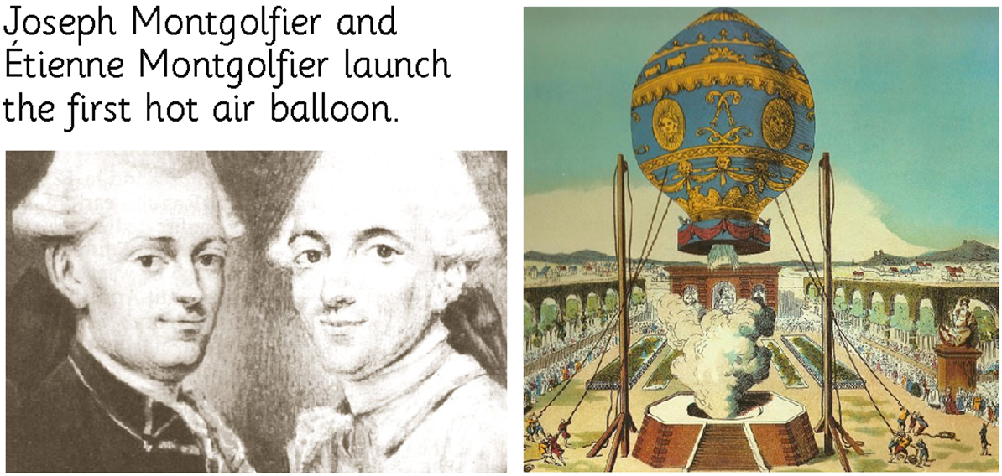
1783

Slide 13
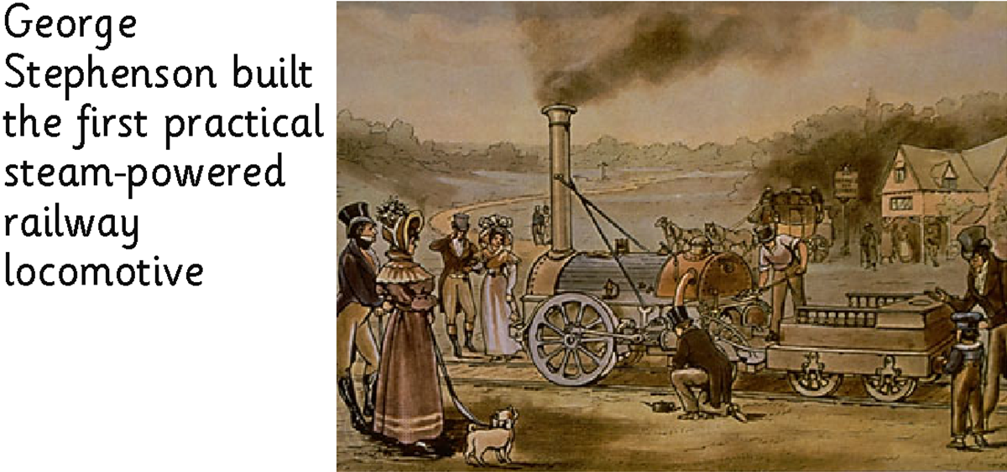
1814

Slide 14
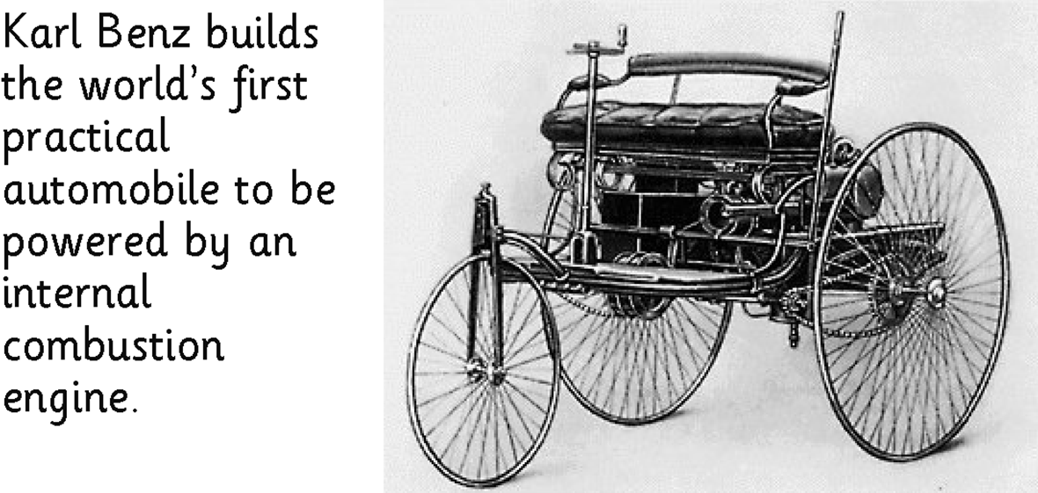
1885

Slide 15
1889

Slide 16
1903

Slide 17
1908

Slide 18
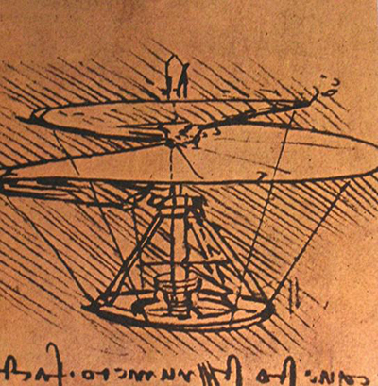
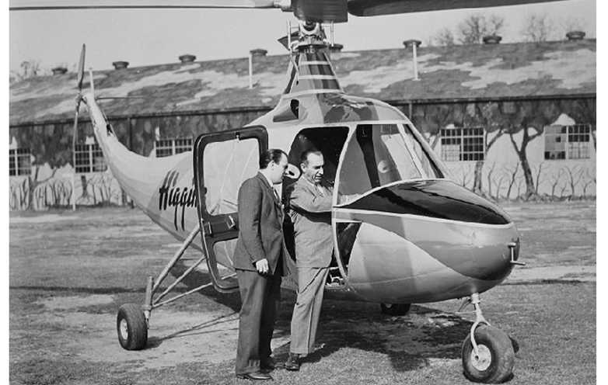
1940
Modern helicopters where invented, although Leonardo Da Vinci had the idea 600 years earlier!

Slide 20
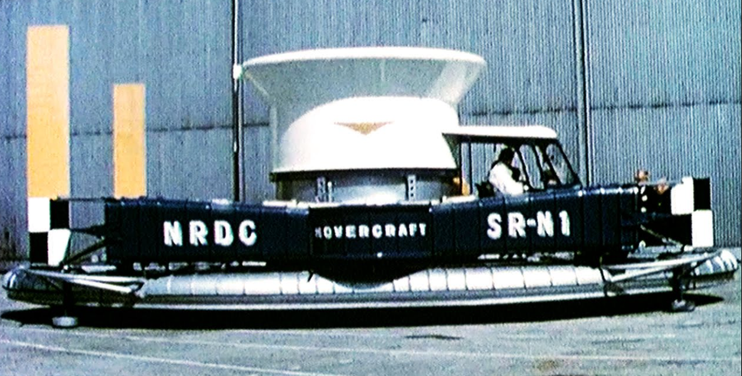
1956
The Hovercraft was invented by Christopher Cockerell in the UK.

Slide 22
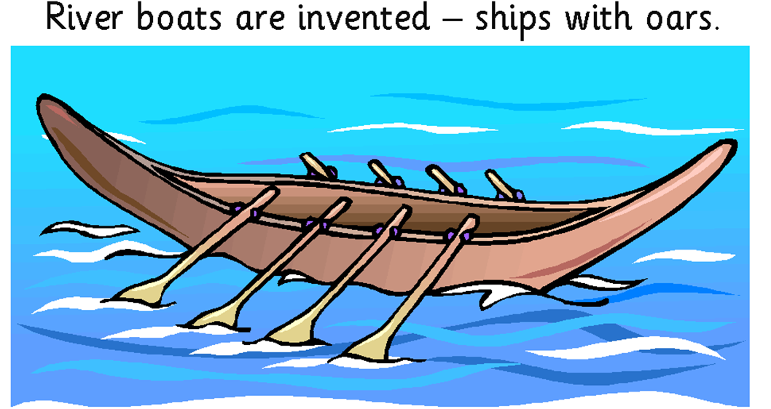
3,500BC

