Slide 1
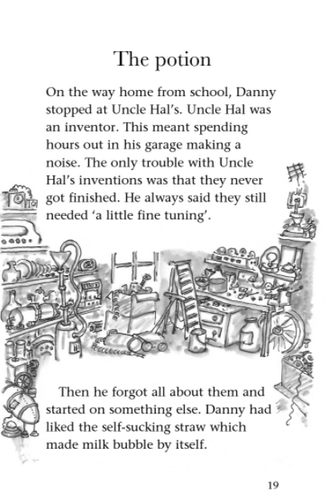
1. Where did Danny go after school?
2. What was the problem with Uncle Hal’s inventions?

Slide 2
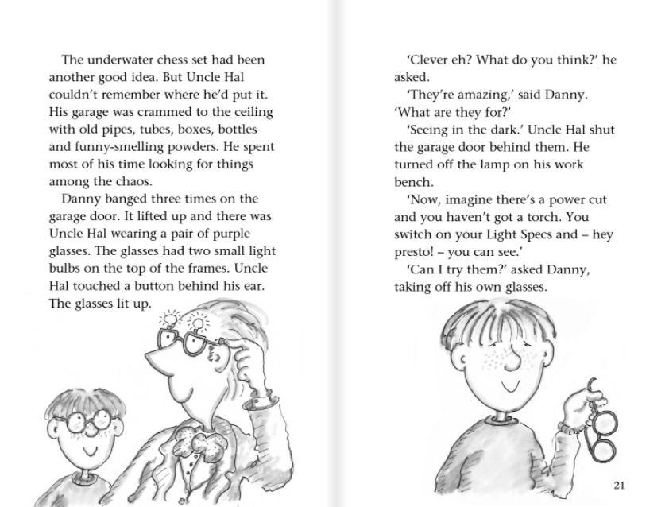
3. Name one of Uncle Hal’s inventions.

Slide 3
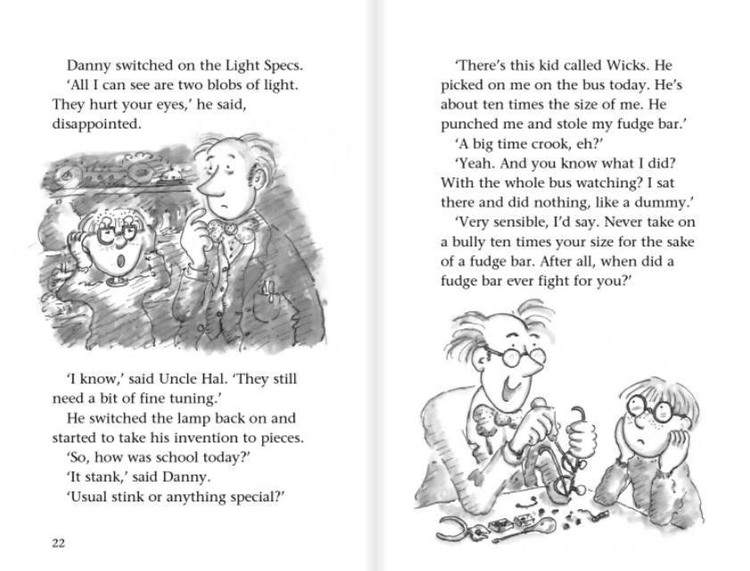
4. What was the name of the Bully?

Slide 4
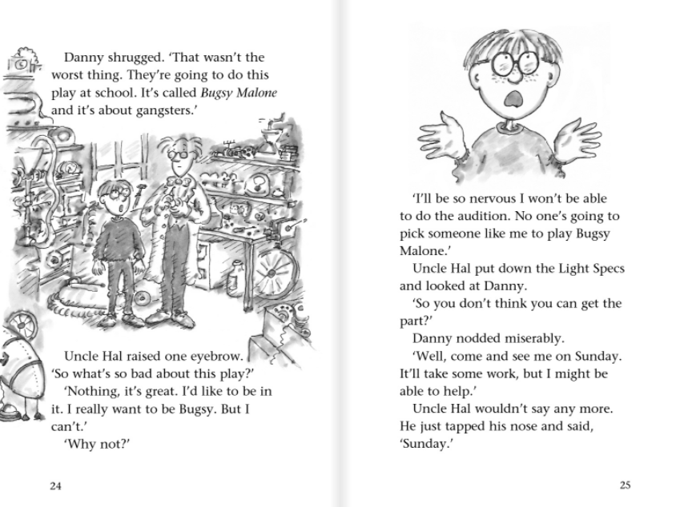
5. True or false? Danny wants to be in the school play.
6. When does Uncle Hal tell Danny to come back?

Slide 5
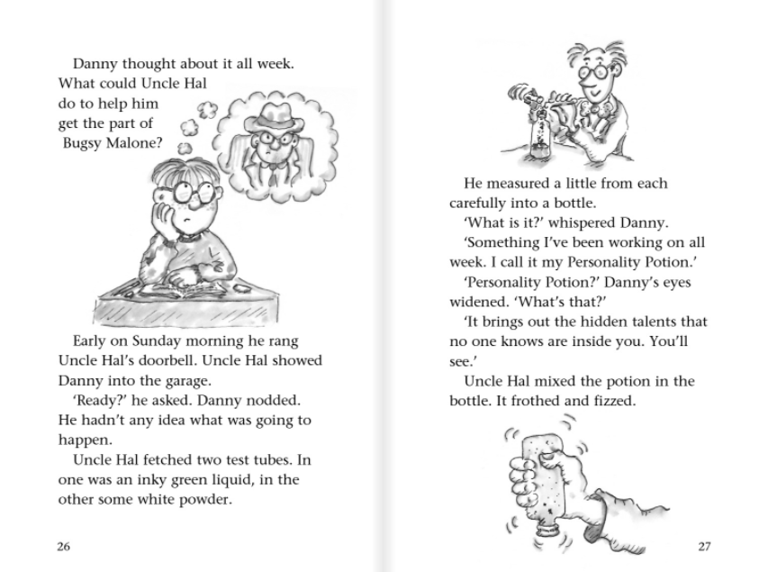
7. True or false? Uncle Hal showed Danny a test tube full of a green powder.

Slide 6
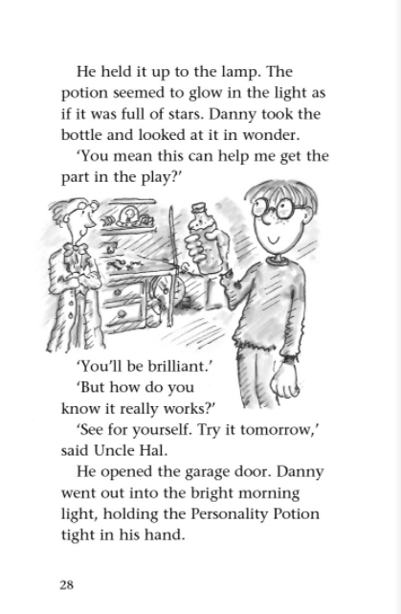
8. What does Danny hope the potion will do?

