Slide 1

Year 1
Maths
Alternative 1
Money Quiz

Slide 2
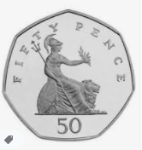
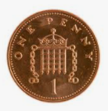
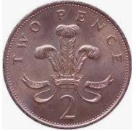
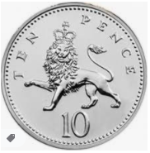
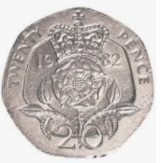
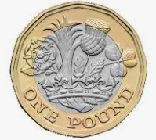
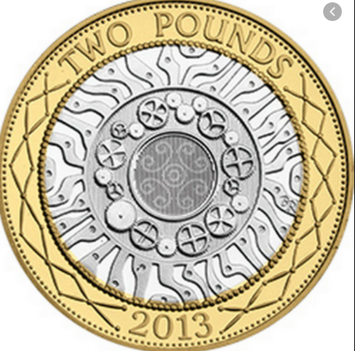
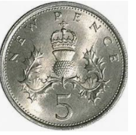
Today in maths we are going to see how much we can remember about money.
1p 2p 5p 10p 20p 50p £1 £2

Slide 3
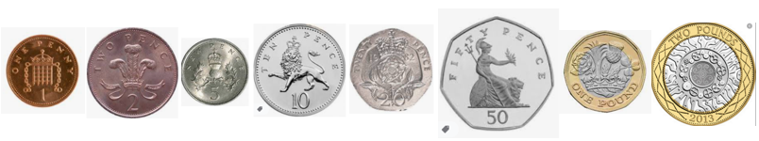
Work out which coin it is from the clues.
I am a silver coin.
I am a circle coin.
I am worth more than 5p and less than 20p.
Which coin am I?

Slide 4
Work out which coin it is from the clues.
I am a bronze coin.
I am a circle coin.
I am worth less than 2p.
Which coin am I?

Slide 5
Work out which coin it is from the clues.
I am a gold and silver coin.
I am worth less than £2.
Which coin am I?

Slide 6
Work out which coin it is from the clues.
I am a silver coin.
I am not a circle coin.
I am worth more than 20p and less than £1.
Which coin am I?

Slide 7
Work out which coin it is from the clues.
I am a silver coin.
I am a circle coin.
I am worth more than 2p and less than 10p.
Which coin am I?

Slide 8
Work out which coin it is from the clues.
I am a bronze coin.
I am a circle coin.
I am worth more than 1p and less than 5p.
Which coin am I?

Slide 9
Answers
Slide 3 – 10p Slide 6 – 50p
Slide 4 - 1p Slide 7 – 5p
Slide 5 – £1 Slide 8 – 2p

