Slide 1

To Identify and understand the tropics

Slide 2
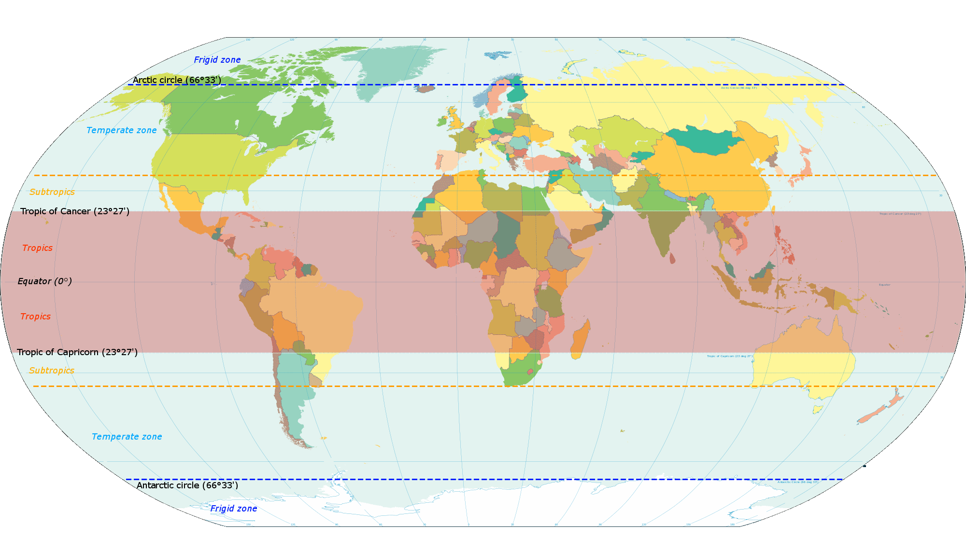
Tropics
The Tropic of Cancer is in the Northern Hemisphere at 23°N and the Tropic of Capricorn is in the Southern Hemisphere at 23°S
The tropics are the region of Earth surrounding the Equator.

Slide 3
The Tropics of Cancer
Tropic of Cancer is a line of Latitude currently positioned at 23° north of the Equator.
Another reference for the Tropic of Cancer is the Northern Tropic.
The Northern Tropic is the point where once a year the sun appears directly overhead the most northerly part of the Earth. This event happens in the month of June.
The Tropic of Capricorn
Tropic of Capricorn is another line of Latitude currently positioned at 23° south of the Equator. The Southern Tropic is another reference for the Tropic of Capricorn. The Tropic of Capricorn is the point where once a year the sun appears directly overhead the most southerly part of the Earth. This event happens in the month of December.
These areas of the Earth known as The Tropics are characterised by warm to hot weather and lush vegetation.

