Slide 1
The Great Kapok Tree
The Ending

Slide 2
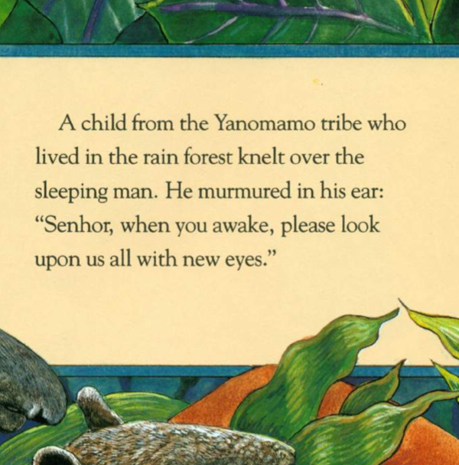
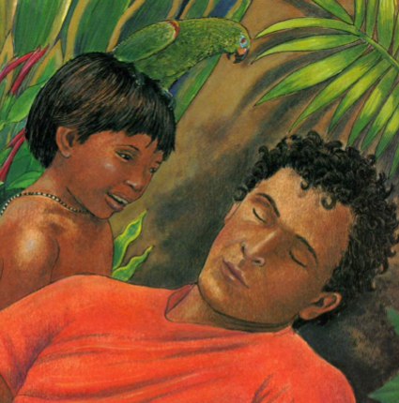

Slide 3
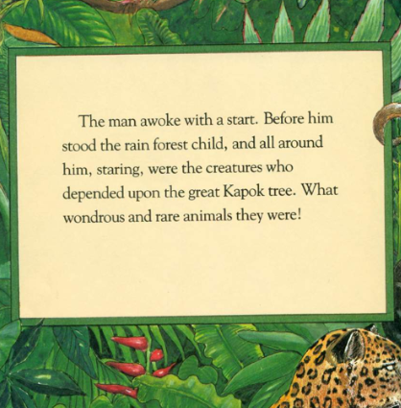
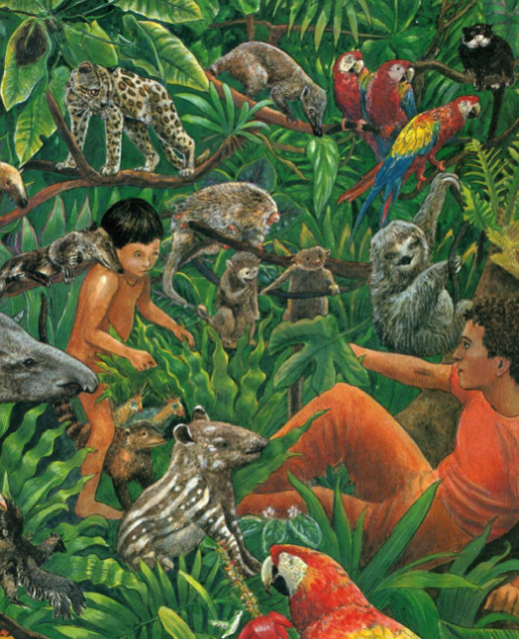

Slide 4
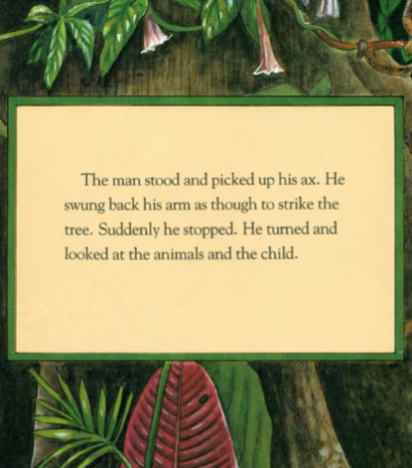

Slide 5
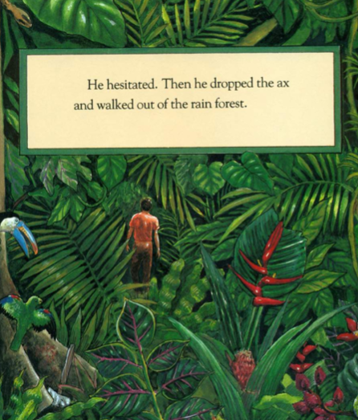

Slide 6
The basic structure of the story
Beginning:
The story starts with a man walking into the rainforest with his ax. He begins to chop down a tree then has a sleep.
Middle:
The animals all come to talk to the man, giving him reasons why he should not chop the tree down.
Ending:
He wakes up and realizes how beautiful and important the tree is and decides to not cut the tree down.

Slide 7
Planning your own story
You are going to use this structure to plan your own version of the story.
Think about who is your character going to be and where will they rest?
What animals are going to talk to them and what is their reasoning?
How does your character leave the forest?

Slide 8
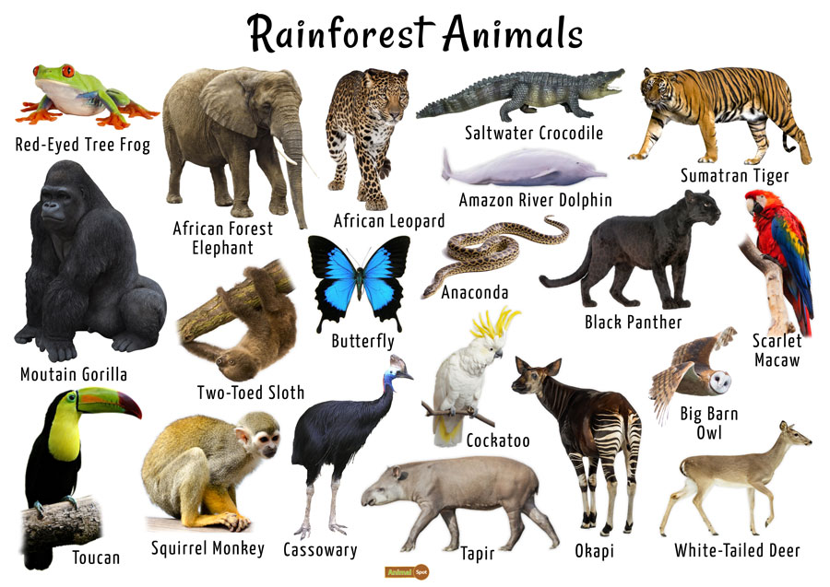
Here are some rainforest animals to help you think about who will be in your story

