Slide 1

Recognise and name 3D shapes
You already know the name of some 2D (flat) shapes. For example: square, circle, triangle, rectangle, hexagon.
Today we are going to recognise and name some 3D (solid) shapes.

Slide 2
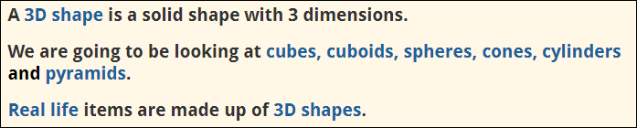
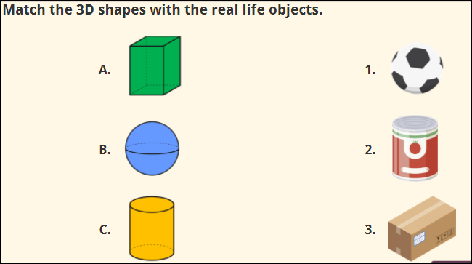

Slide 3
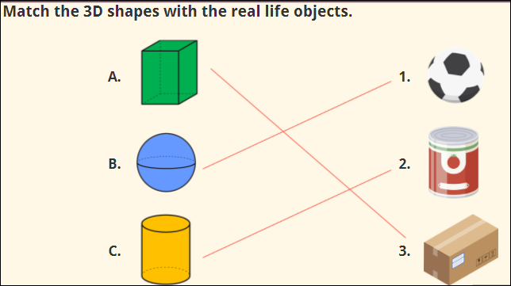

Slide 4
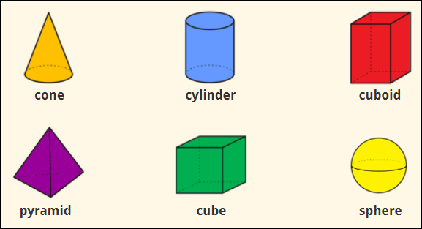
Names of 3D shapes

Slide 5
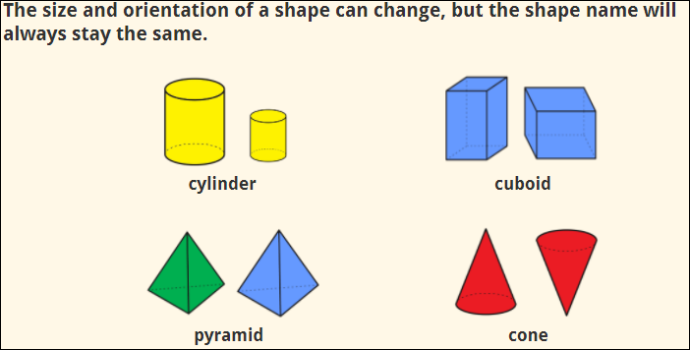

Slide 6
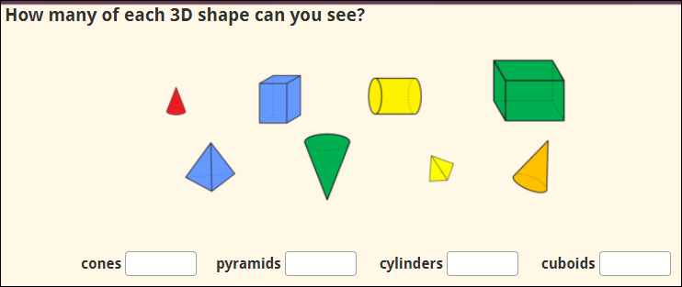

Slide 7
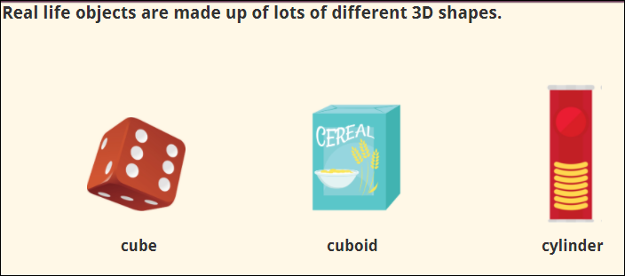
Look around your house and see if you can name some of the 3D shapes you find.

Slide 8
