Slide 1
Art
Learning intention:
Develop tone

Slide 2
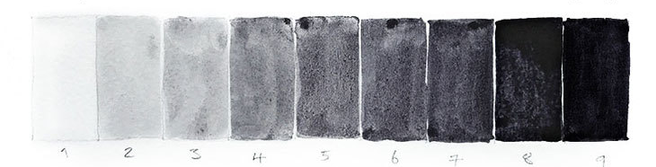
Tone is the lightness and darkness of a colour on a painting or drawing.
Here are some good examples of how artists use light and dark in their work.

Slide 3
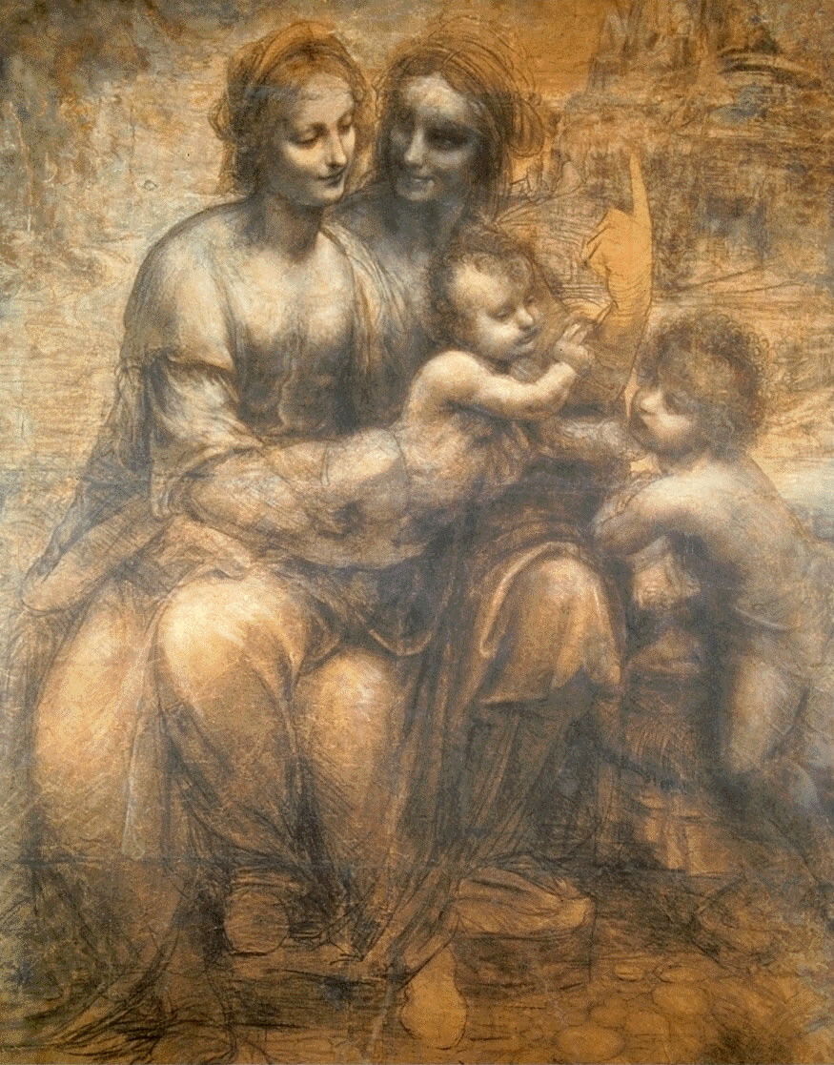
Leonardo Da Vinci

Slide 4
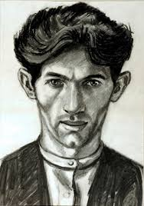
Norman Cornish

Slide 5
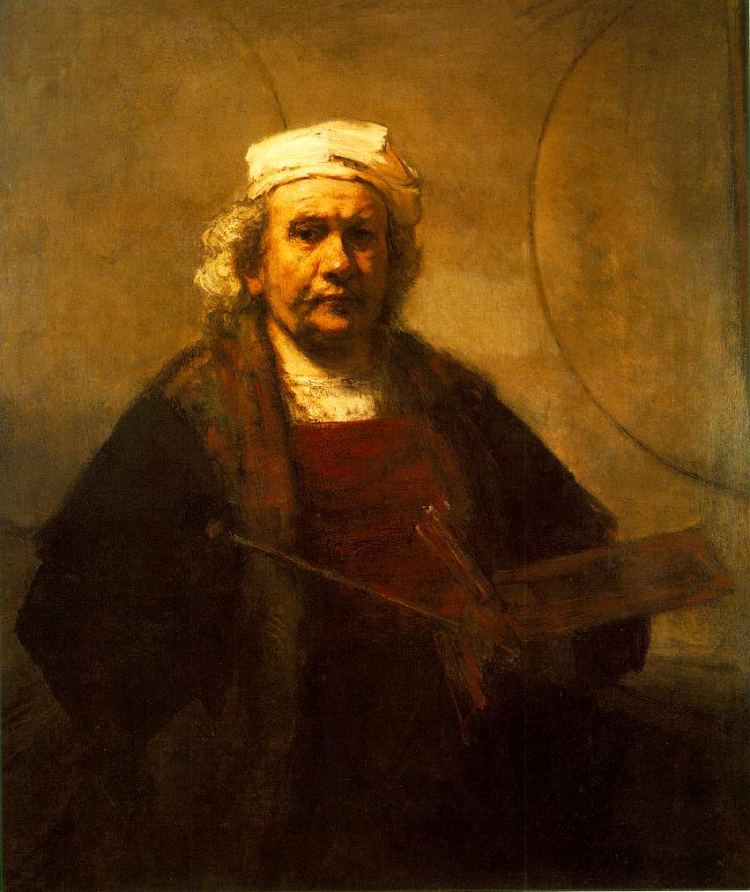
Rembrandt

Slide 6
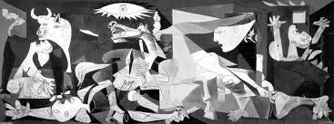
Picasso

Slide 7
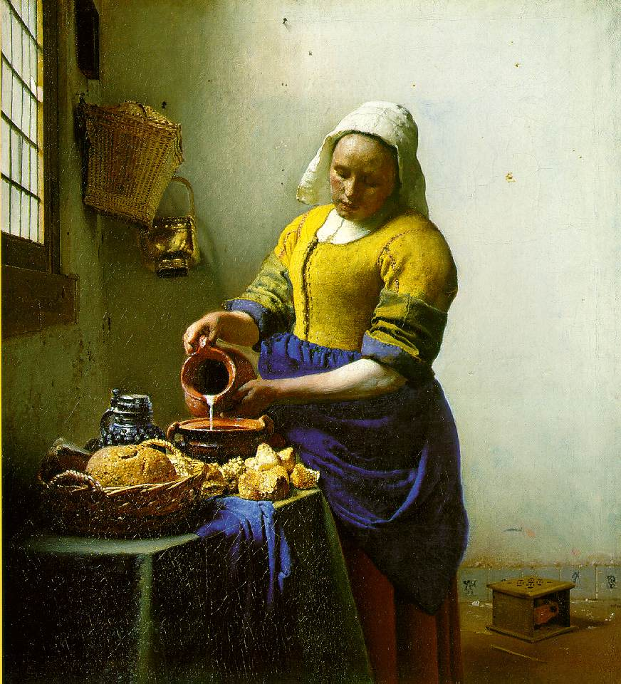
Vermeer

Slide 8
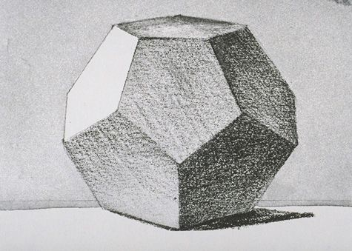
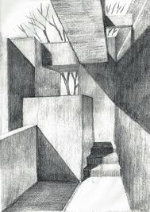
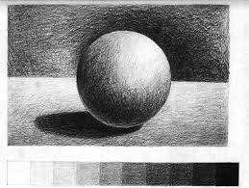
Examples of tone using a pencil:

Slide 9
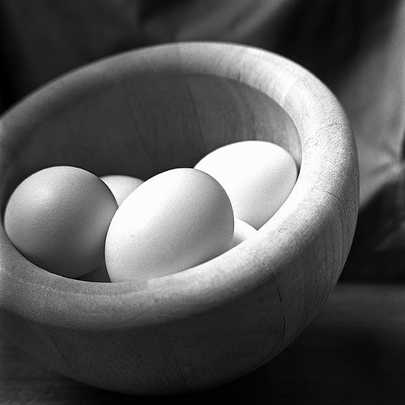
Draw this bowl of eggs using your pencil to create tone. If you have some eggs at home, arrange them in a bowl like this.
Remember:
For a light tone, hold the pencil gently and further up.
For a dark tone, hold the pencil harder and further down, towards the tip.
You can create your own, or use the steps on the next slides to help you.

Slide 10
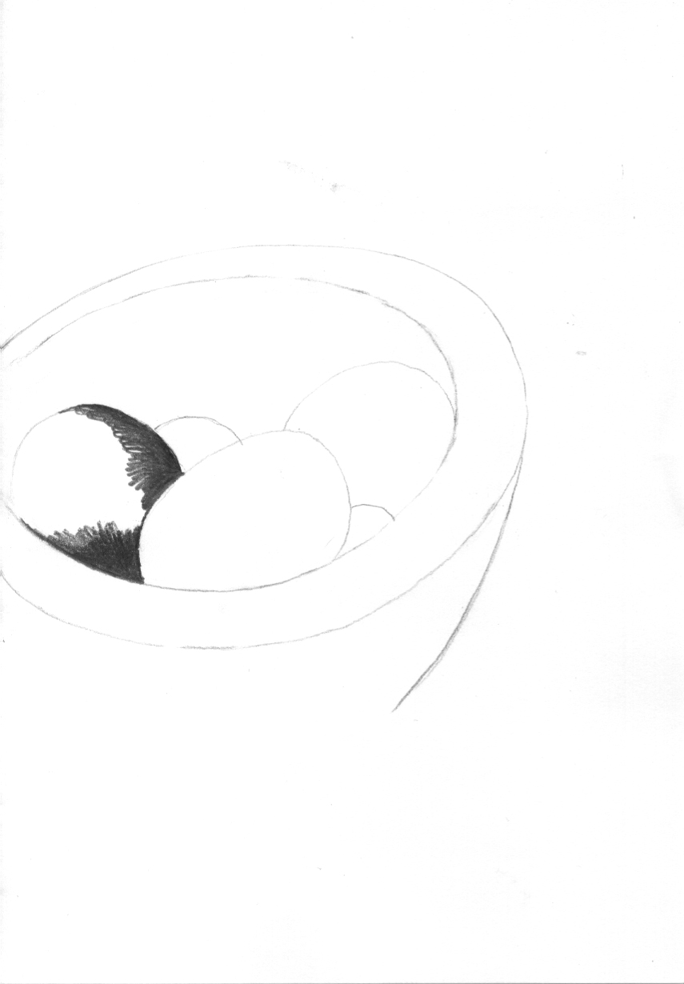
1

Slide 11
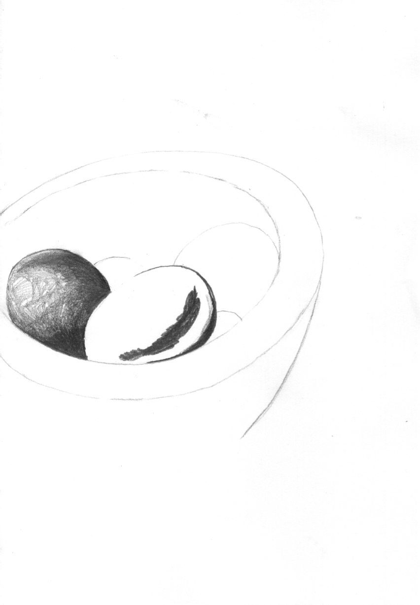
2

Slide 12
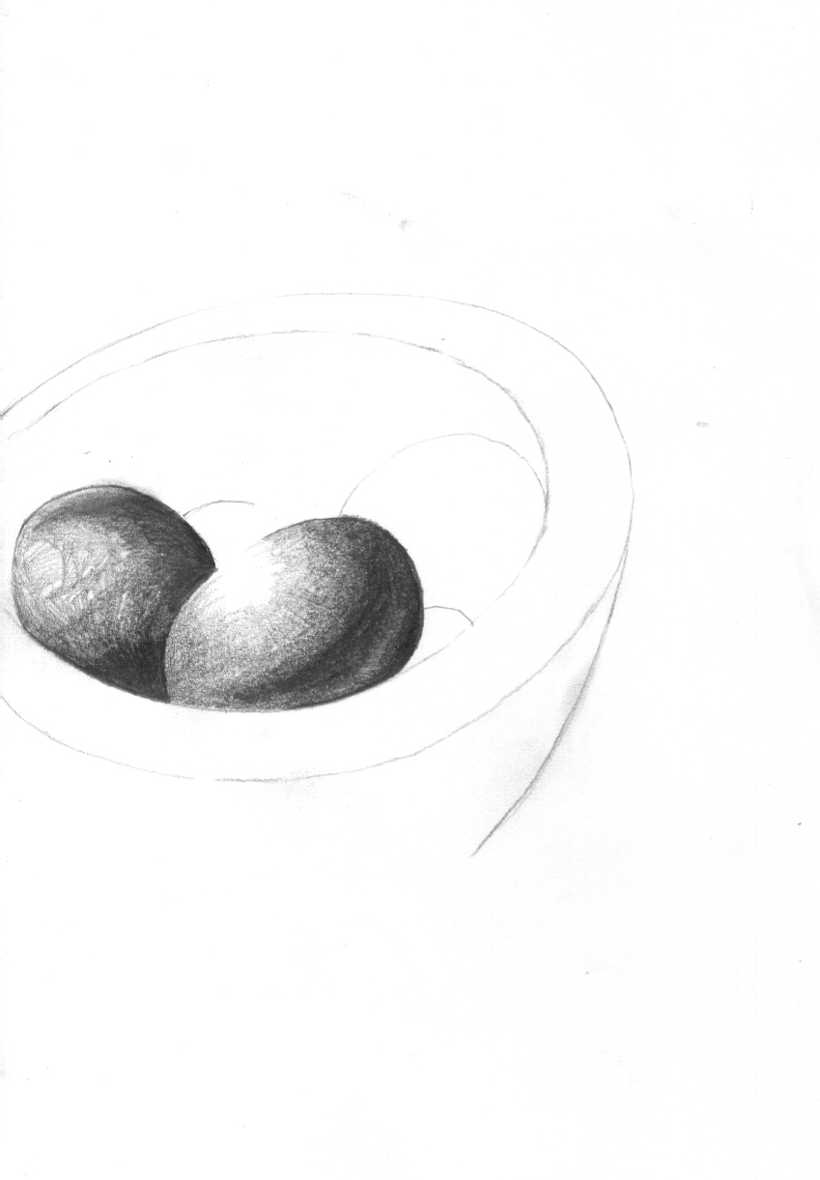
3

Slide 13
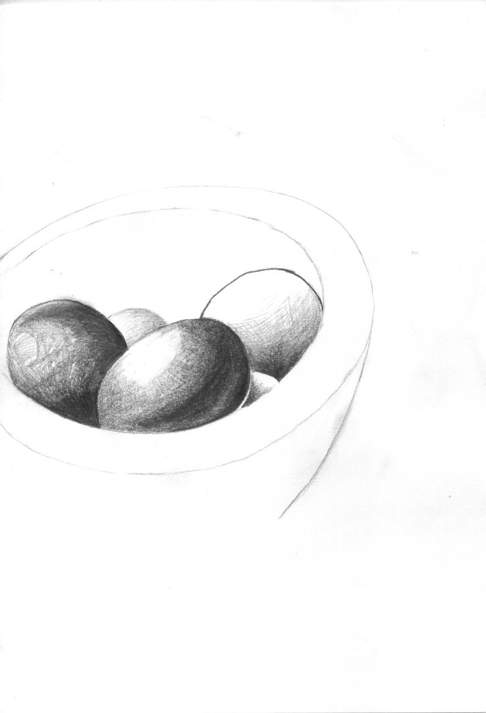
4

Slide 14
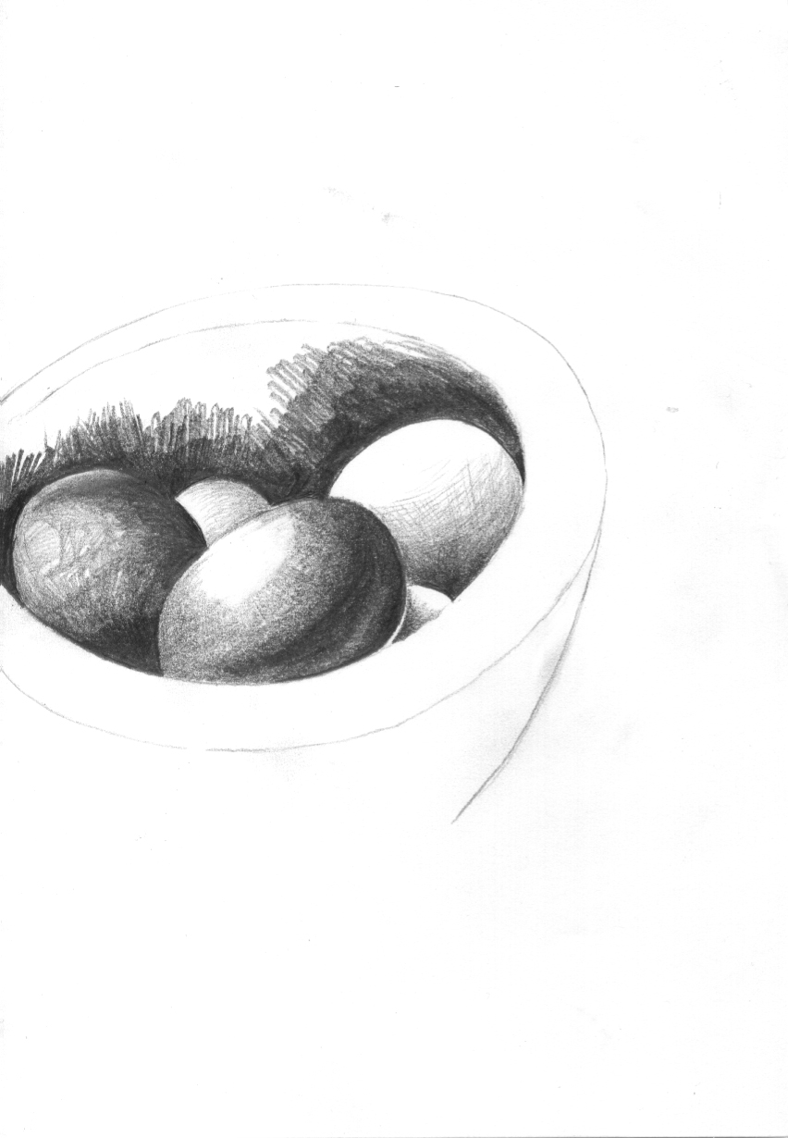
5

Slide 15
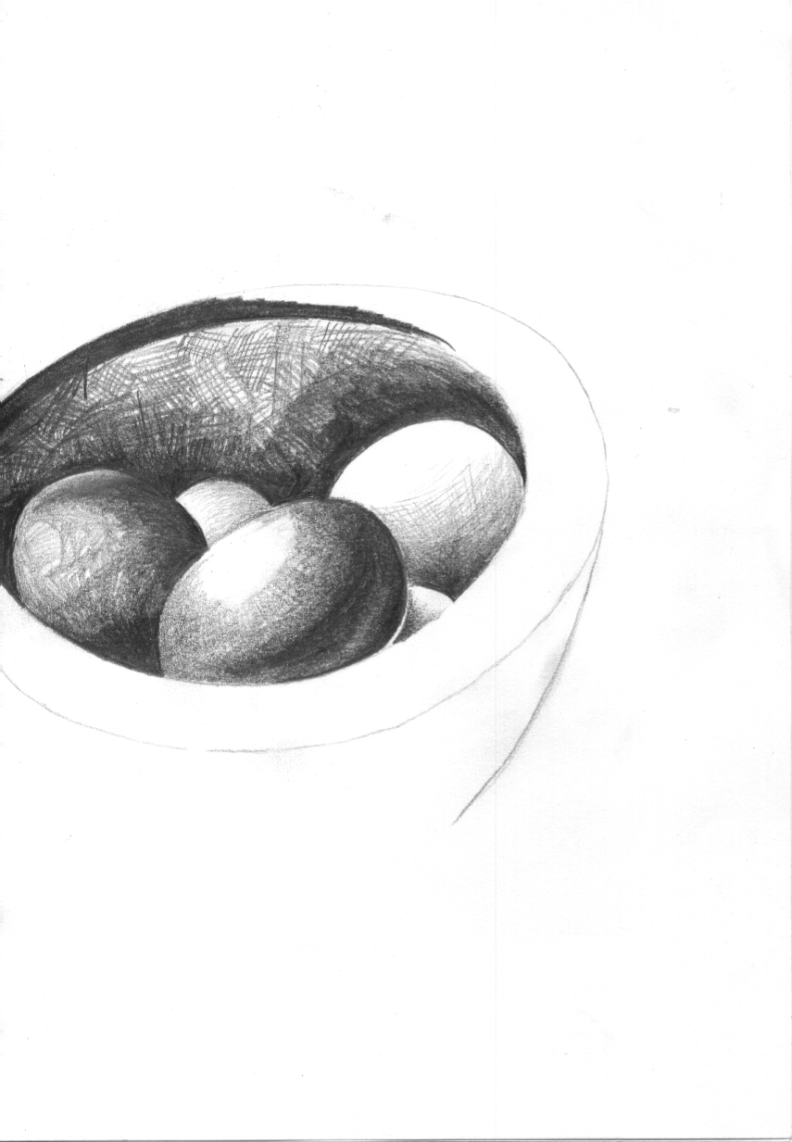
6

Slide 16
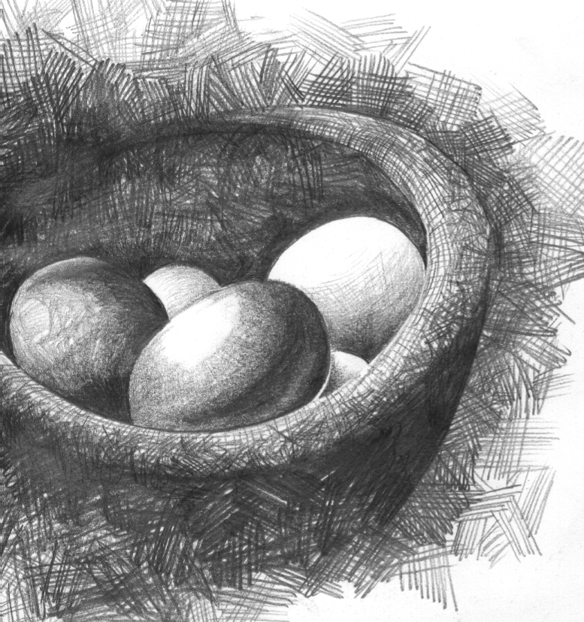
7 Completed sketch using crosshatching to compliment picture

