Slide 1
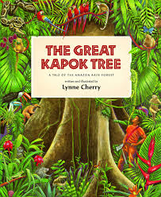
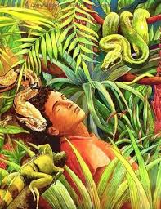
To write my version of The Great Kapok Tree

Slide 2
Let’s recap what you have learnt this week.
Using adjectives.
Adjectives are there to add more detail to nouns (things)
The green snake in the tall tree.
Using adverbs
Adverbs, normally end with an ly, and are used to describe verbs (doing words)
The snake slithered quietly to the man.

Slide 3
Your task
I am going to give you some sentences that are mixed up. I would like you to put these sentences into the correct order and then write them down. When you are re-writing them could you try to improve them by adding an adjective or an adverb.
Example: If the sentence was ‘The man fell asleep by the tree.’
You could re-write this by adding an adjective to describe the man.
‘The tired man fell asleep by the tree.’

Slide 4
Check your work
When you have finished fixing and ordering sentences for the first two paragraphs, read your work either by yourself or with someone else to make sure it makes sense.

