Slide 1
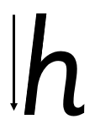
Focus sound: h
h - Start at the top, come all the way down, bounce half way back up, go over, down and flick

Slide 2
Your turn! Write h in your book using the lines.
Then try:
hat
hip
hop

