Slide 1
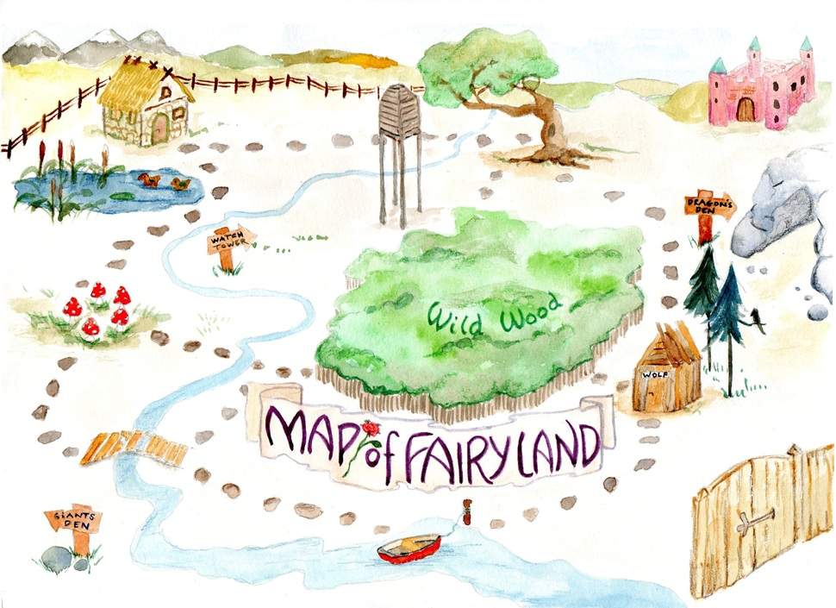
Learning intention: to write instructions
You are going to be writing instructions for an adventure! What are we telling the reader to do in Fairyland?

Slide 2
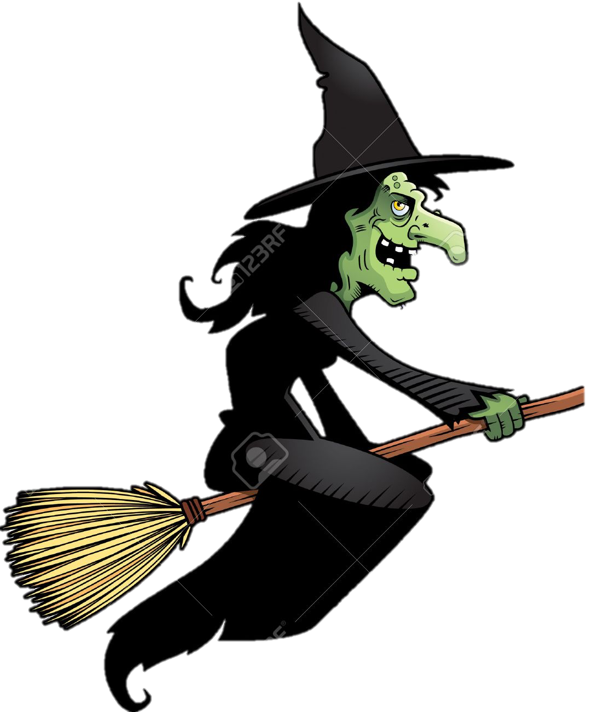
Oral rehearsal. Practice telling someone these instructions! You can also act them out with actions.
witch’s
. . .
Run
path
hut
. .
. . .
Go
Get
Go
ship
. .

Slide 3
Oral rehearsal. My turn your turn. Can you write the instruction?

Slide 4
Oral rehearsal. My turn your turn. Can you write the instruction?

Slide 5
Oral rehearsal. My turn your turn. Can you write the instruction?

Slide 6
Oral rehearsal. My turn your turn. Can you write the instruction?

