Slide 1
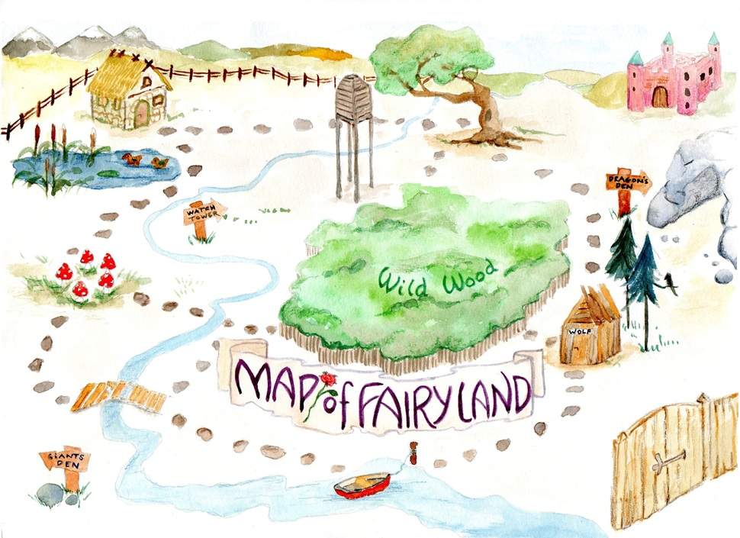
Learning intention: to explore apostrophes for possession.

Slide 2
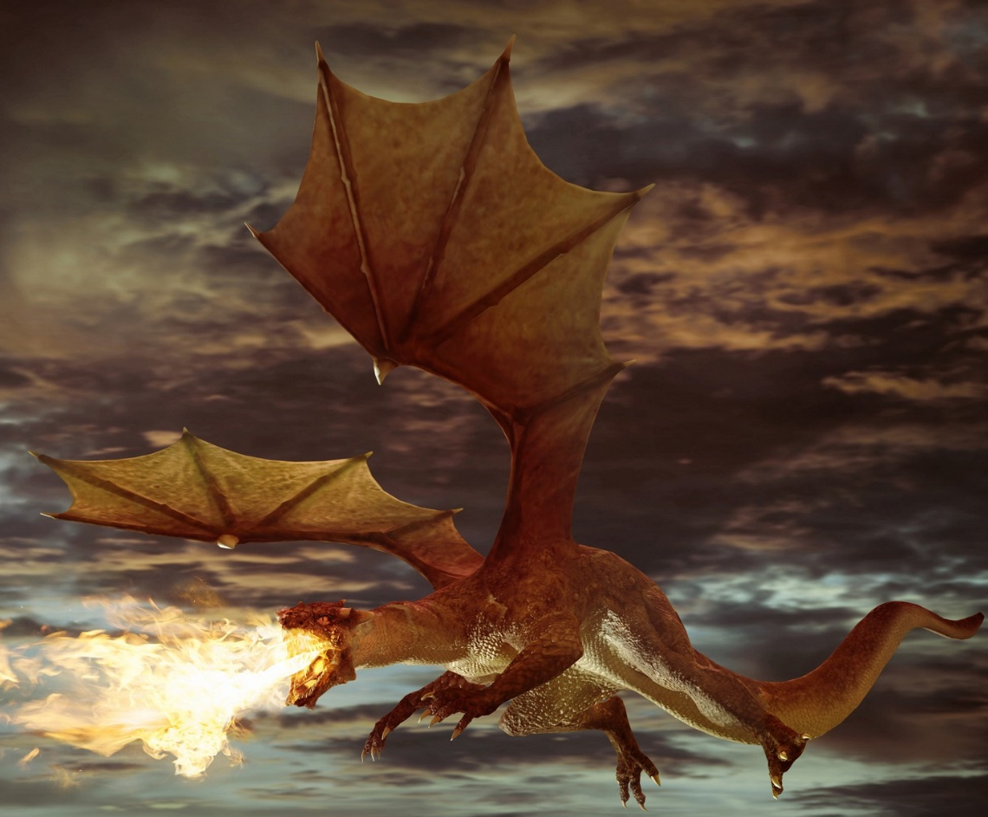
Learning intention: to explore apostrophes for possession.
This is the den of the dragon.
We can say it is the dragon’s den.

Slide 3
dragon’s den
dragon + ’ + s = dragon’s
apostrophe

Slide 4
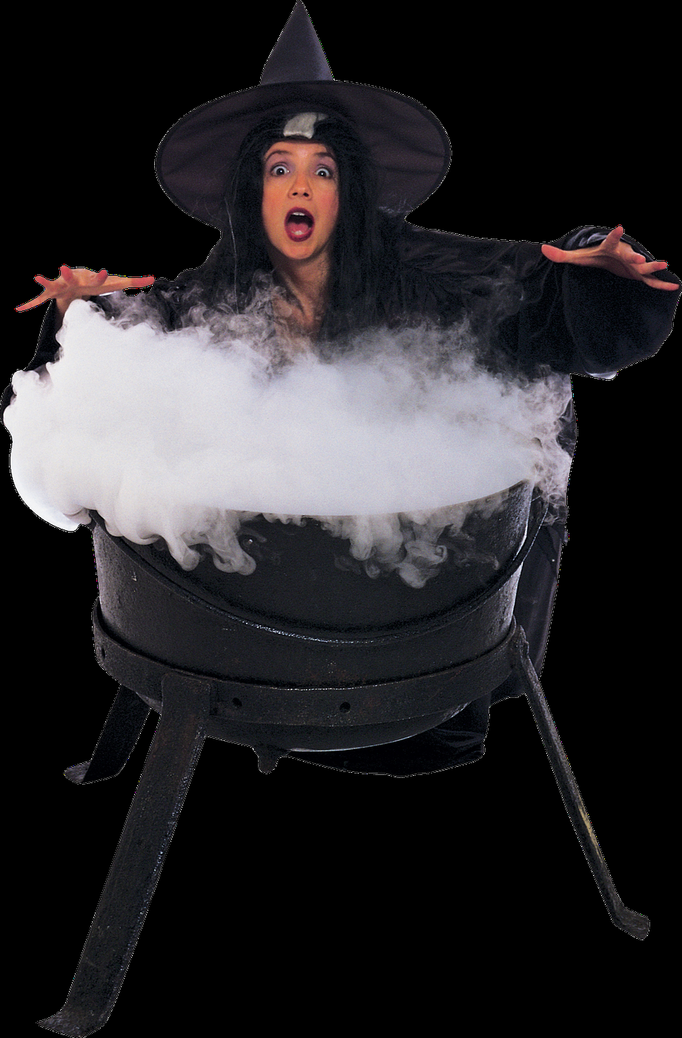
This is the house belonging to the witch.
We can say it is the witch’s house.
witch + ’ + s = witch’s house

Slide 5
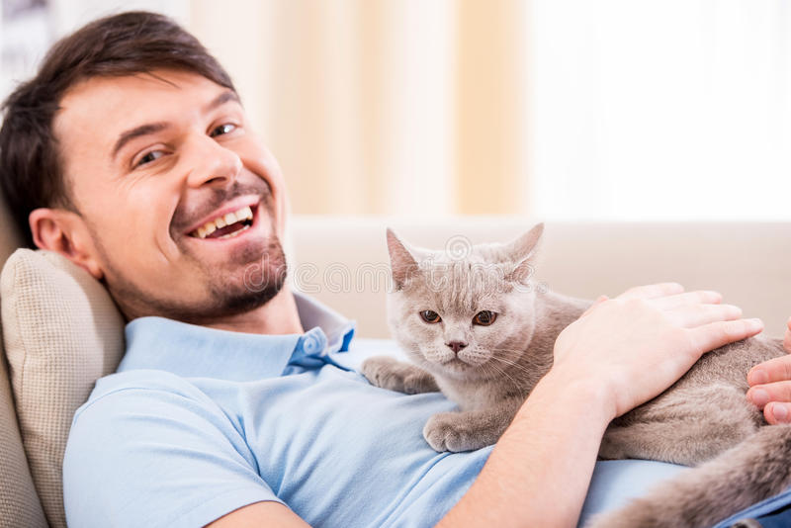
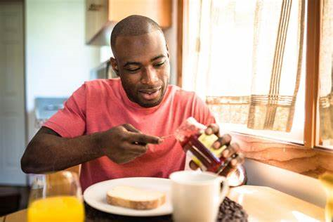
Your turn! Add an apostrophe.
mans cat
Tims jam

Slide 6
Did you get it right?
mans cat
man’s cat
apostrophe
Tims jam
Tim’s jam
apostrophe

