Slide 1
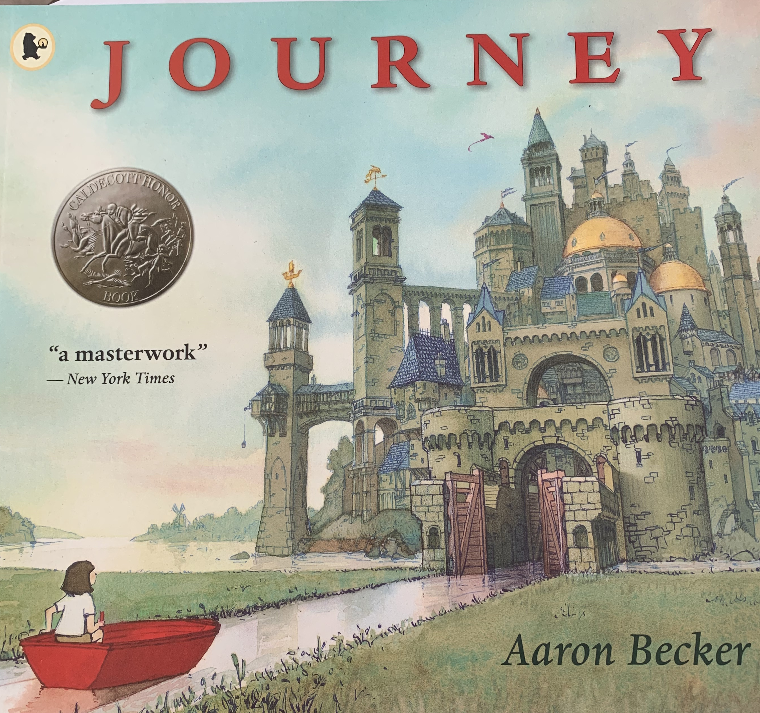

Slide 2
Journey is a special book because…
It has no words!

Slide 3
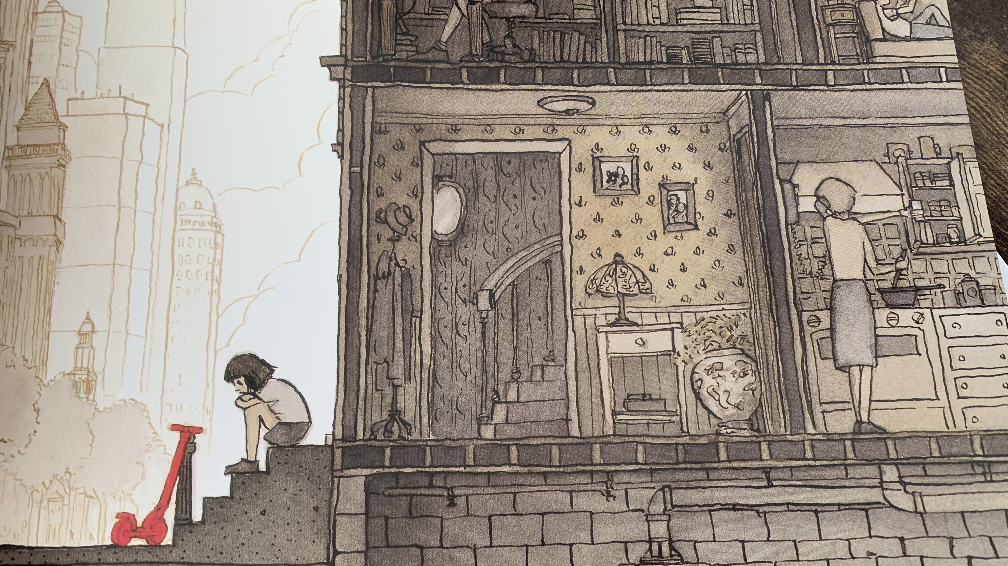
1

Slide 4
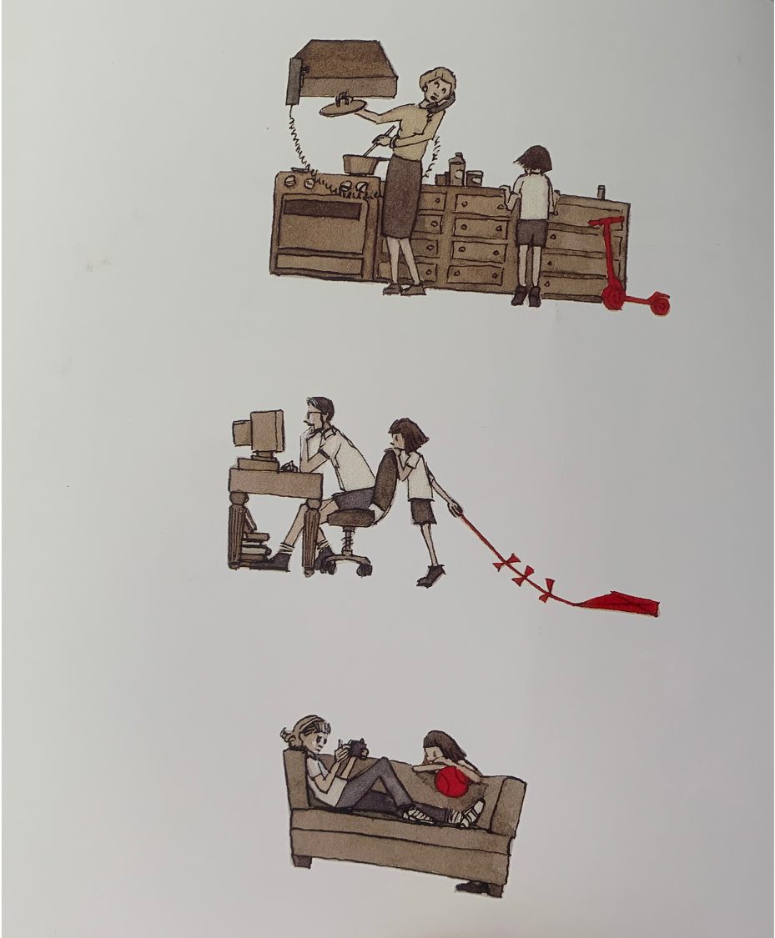
2

Slide 5
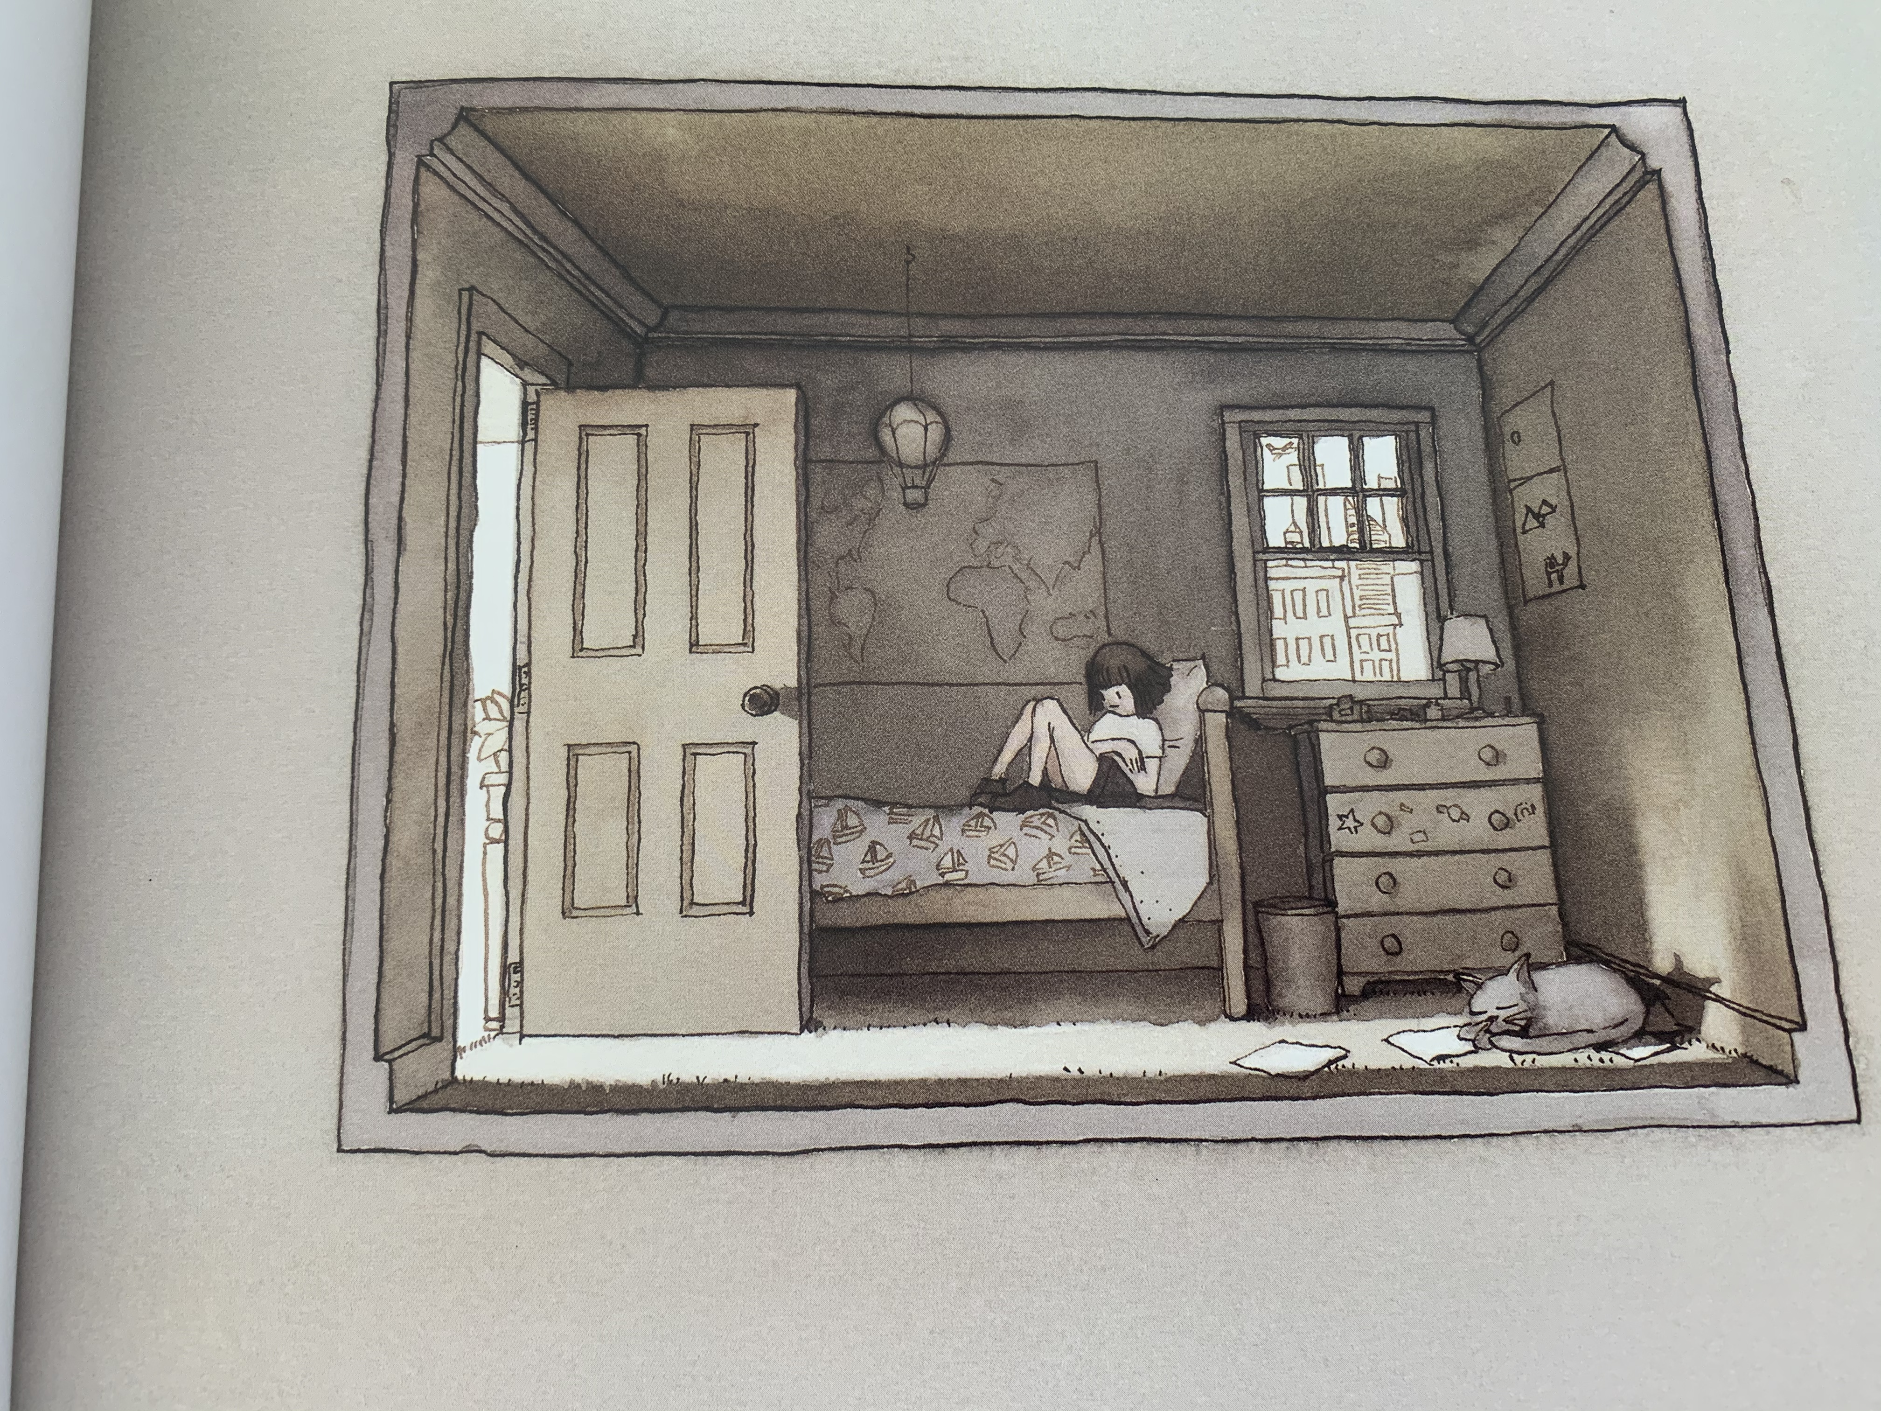
3

Slide 6
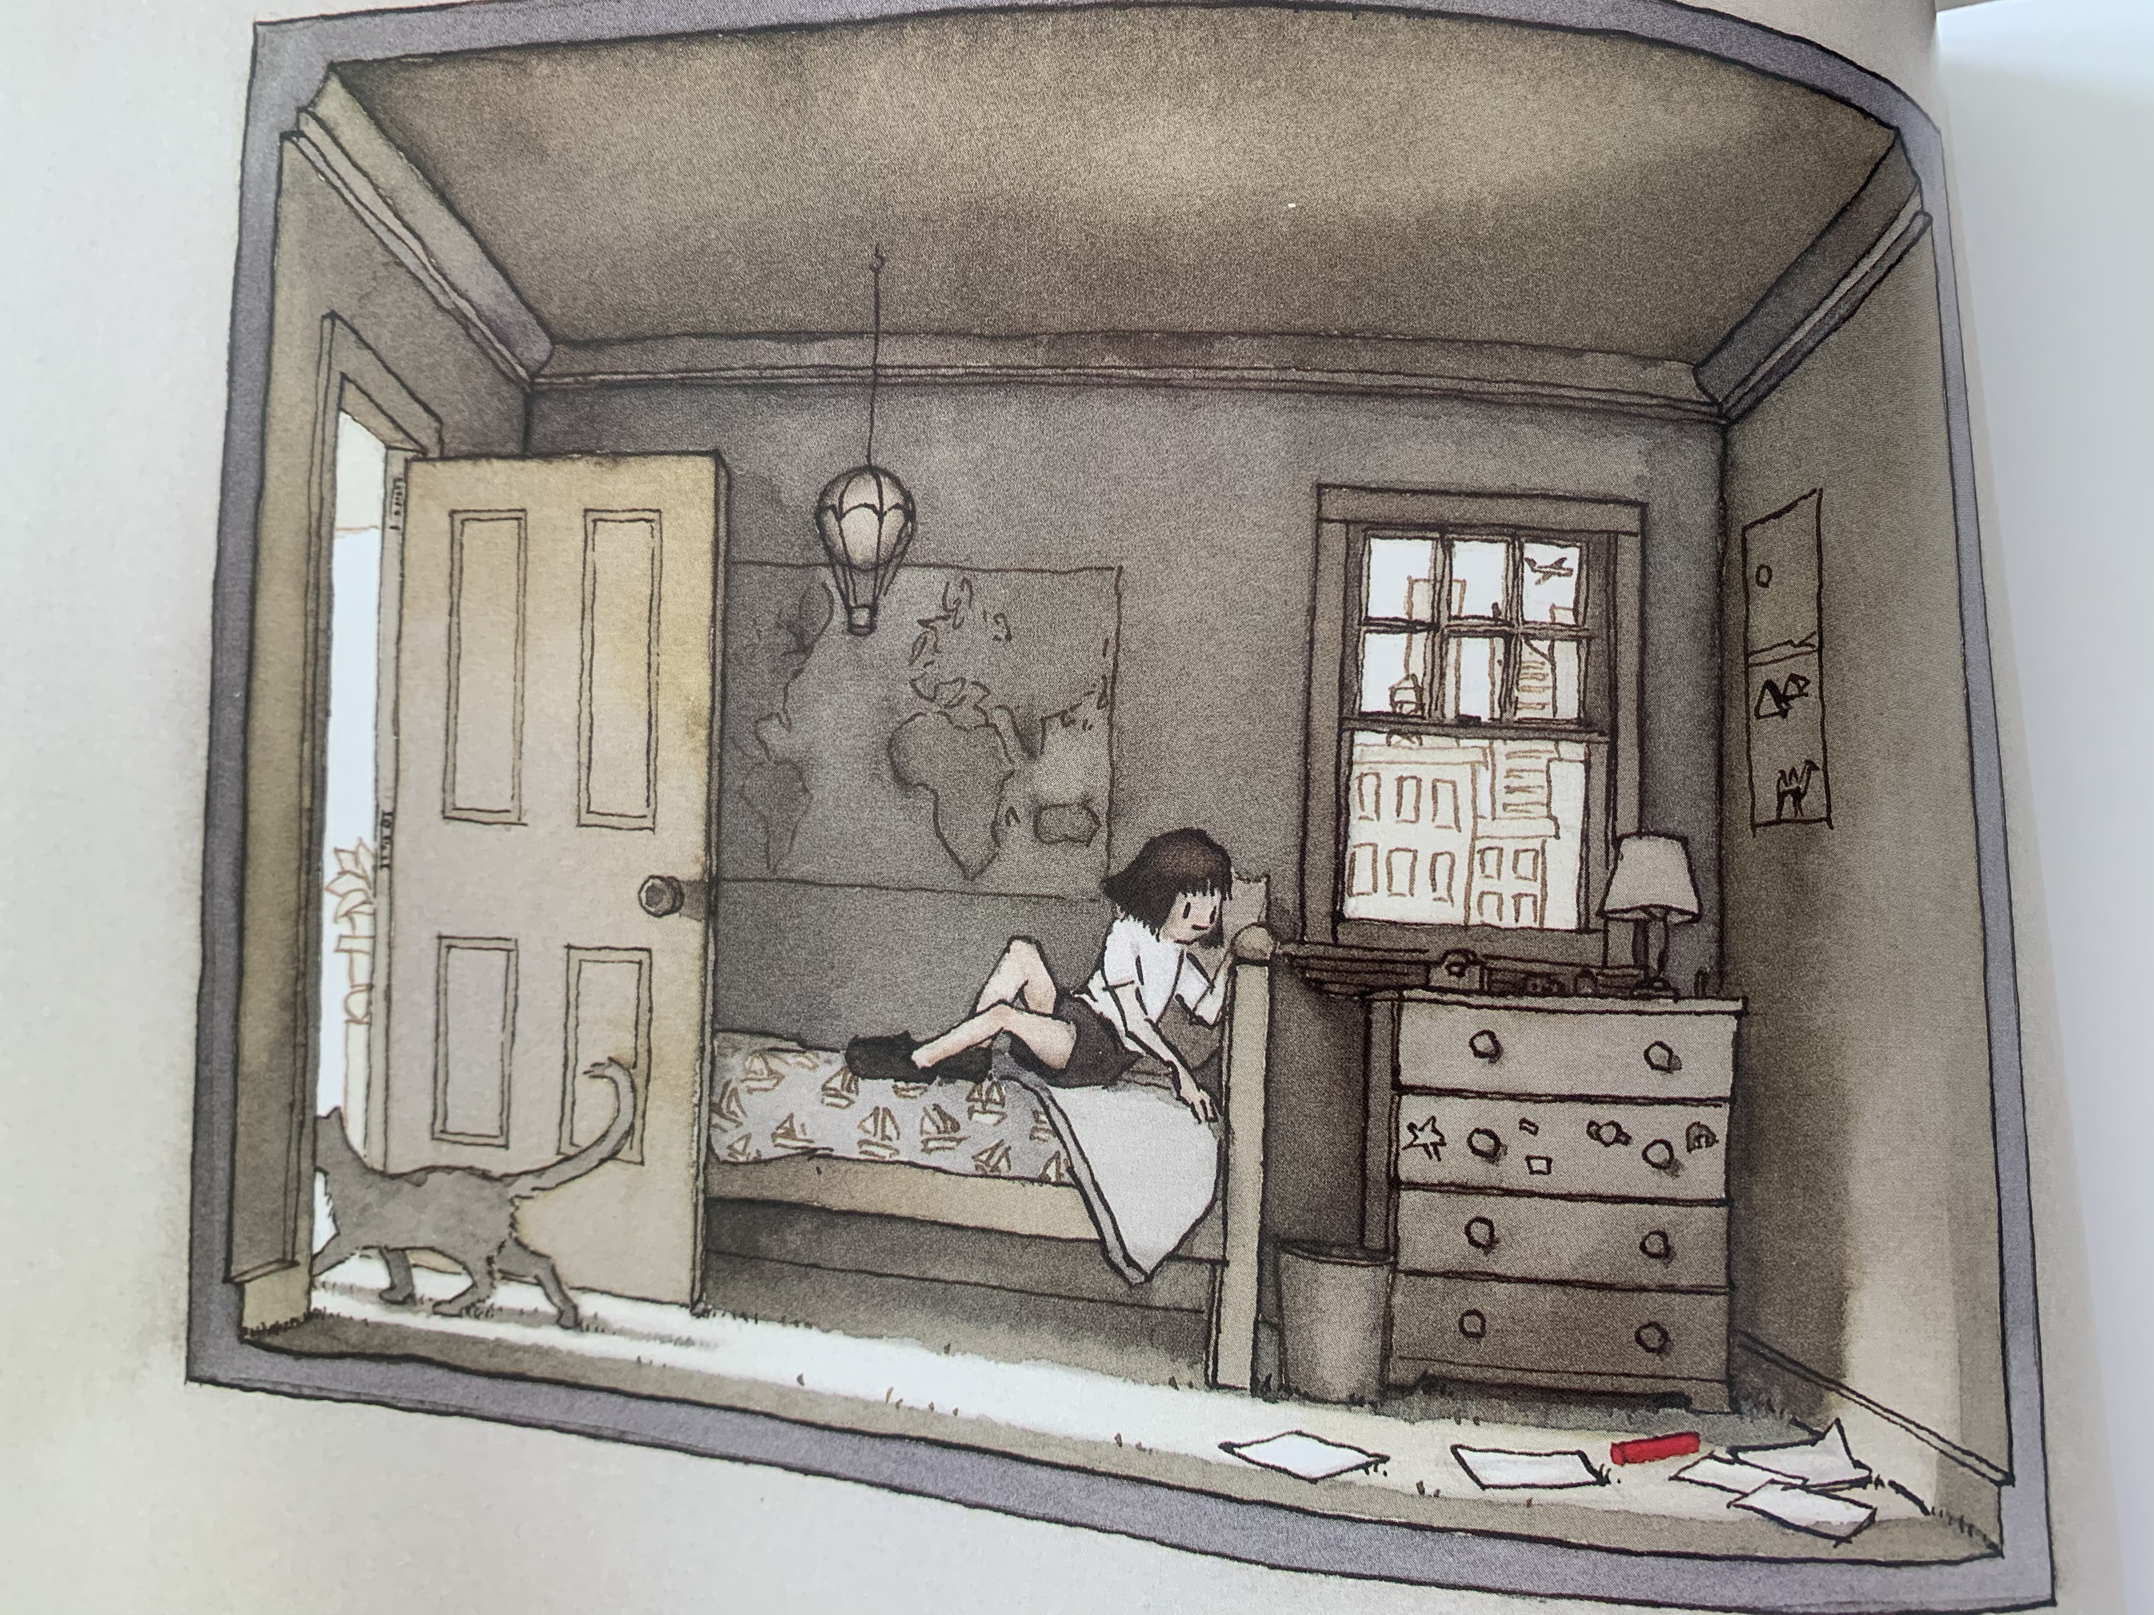
4

Slide 7
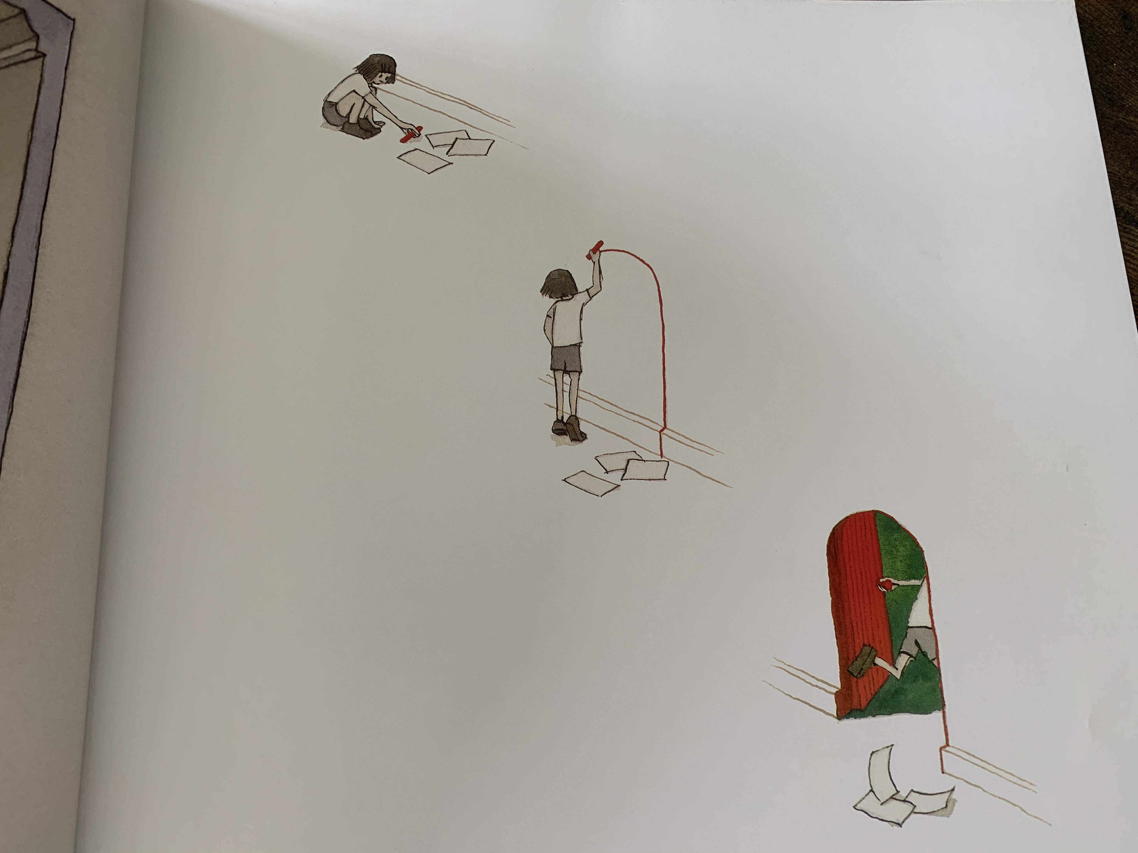
5

Slide 8
Questions:
Page numbers are at the bottom of the slide
p. 1 How is the little girl feeling? How do you know?
p.2 What colour are the little girl’s toys?
p.3 Where is the little girl now? How do you know?
p.4 What has appeared on the floor?
p.5 Where is the little girl going?

