Slide 1
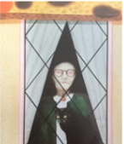
Learning intention: to write a witch story
Today we are writing the middle of the story.
Remember to use your setting description and story map from last week to help you to write your story.
Look at the next slide to see how I used my story map to help me to write the middle of the story.

Slide 2
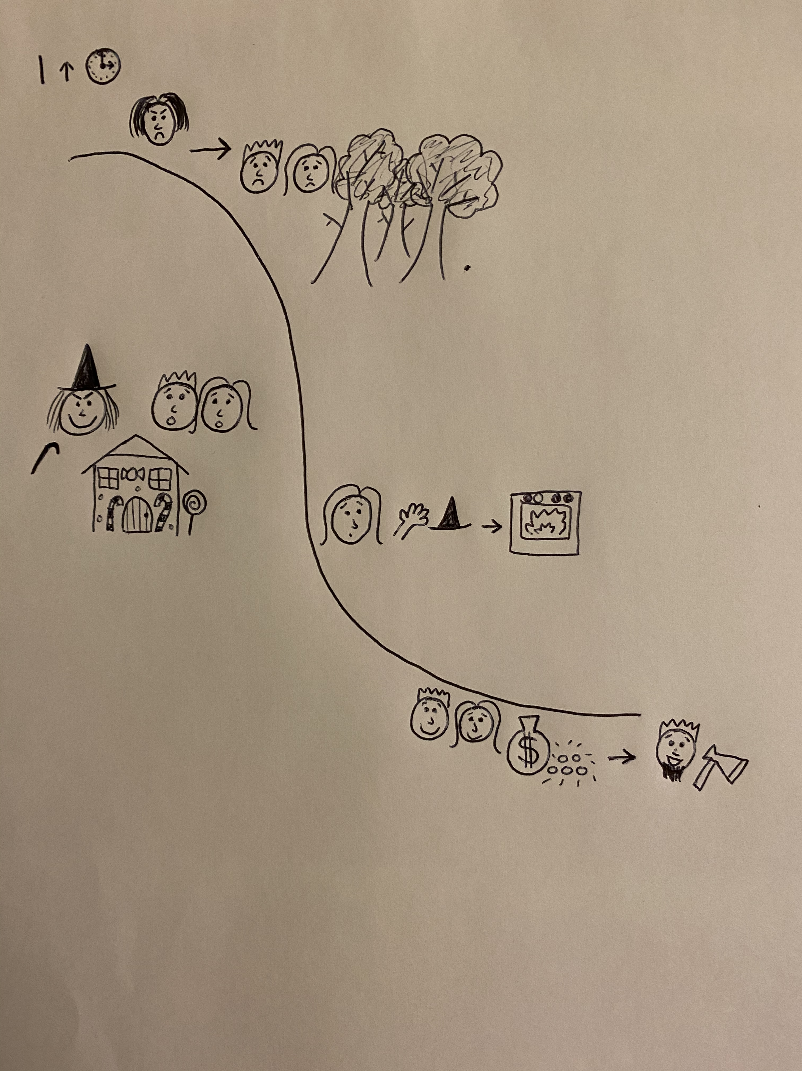
peaceful
freezing
suspicious
towering mountains
My story middle
Introduce new character of the witch
Introduce new setting of the witch’s house

Slide 3
Hansel and Gretel were abandoned on the mysterious, lonely mountain again. This time they couldn’t get home because the birds had eaten the trail of breadcrumbs! At the very top of the mountain they discovered a house made from wonderful sweets but …
Retell the middle of the story in your own words and describing the new setting.

Slide 4
Can you write the middle of your story using your story map and setting vocabulary?
Remember:
Capital letters
Full stops
Conjunctions to extend your sentences (and, or, but, because, when, if, that)

