Slide 1
Today we are going to look at pictures from a story.
This story is a traditional tale: can you think of any other traditional tales? What is special about these stories?

Slide 2
Snow White
Jack and the Beanstalk
Little Red Riding Hood
Examples
The Pied Piper
Peter and the Wolf

Slide 3
Features of traditional tales:
Fairy tale language such as ‘once upon a time’
Magic
Good and evil characters
They are fiction

Slide 4
Look at the following pictures.
Can you make your own questions for what you would like to know about the story?
Remember question marks.
Can you use a different question starter for each one? Use the examples on the next page.

Slide 5
Can…?
Who…?
When…?
Why…?
Are…?
Will…?
Where…?

Slide 6
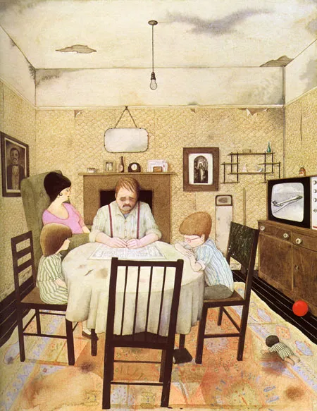
What do you notice in the picture?
What would you like to find out?

Slide 7
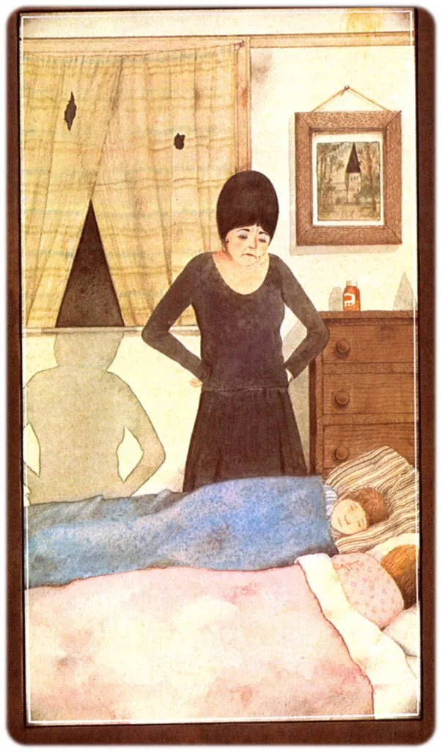
What do you notice in the picture?
What would you like to find out?

Slide 8
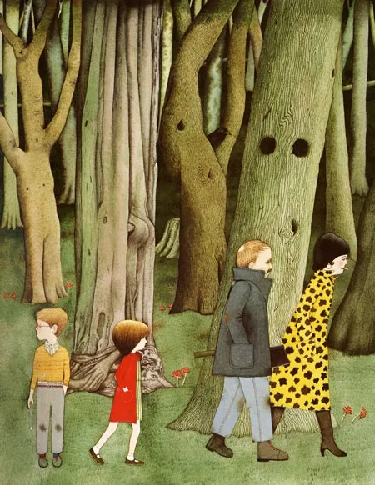
What do you notice in the picture?
What would you like to find out?

Slide 9
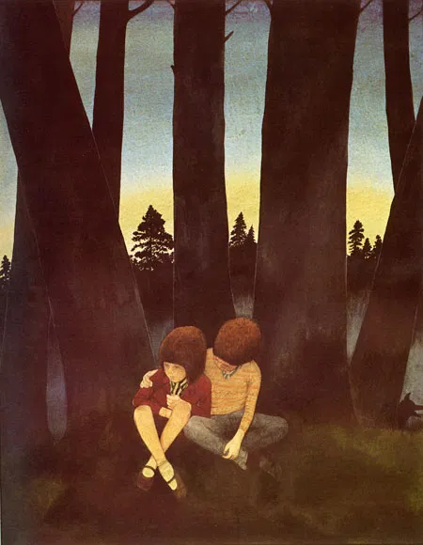
What do you notice in the picture?
What would you like to find out?

Slide 10
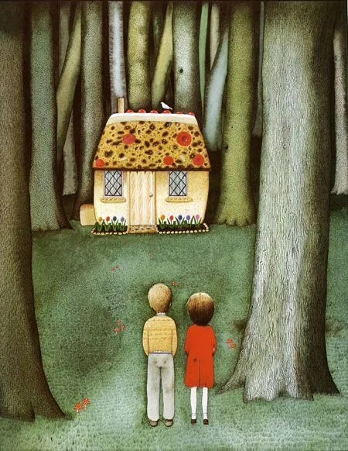
What do you notice in the picture?
What would you like to find out?

Slide 11
Does this traditional tale remind you of any other stories you have heard before?
What do you think the rest of the story will be about?

