Slide 1
The continent of Australia.
We are to find out some information about this continent.
To be able to identify some physical and human features.
Vocabulary:
Continent- A large mass of land surrounded by water
Physical feature- natural part of the land
Human feature- made by humans
What do you already know about Australia?

Slide 2
What are physical features?
Physical features are natural and would be here even if there were no people around. For example, seas, mountains and rivers

Slide 3
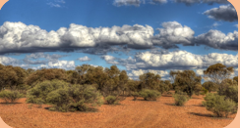
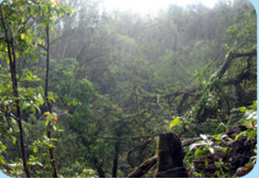
Physical features
Most of Australia is made up of a desert called the Outback.
Australia also has rainforests.
The Daintree Rainforest is the oldest rainforest in the world.

Slide 4
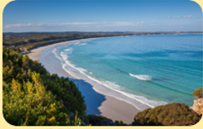
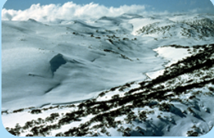
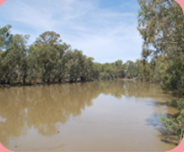
Physical features
coast
alps
river
Vocabulary:
Alps- mountains

Slide 5
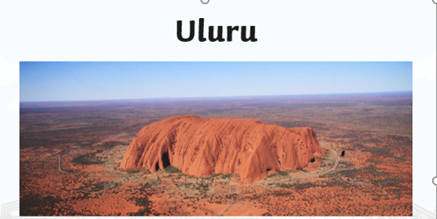
Physical features
Uluru is also called Ayers rock

Slide 6
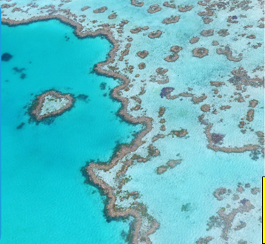
Physical features
The Great Barrier reef
This is a huge coral reef and can be seen from space
Vocabulary:
Species- different kinds

Slide 7
What are human features?
These are things that have been built by humans. For example- roads, buildings and bridges.

Slide 8
Human Features
Vocabulary:
Opera- a type of music
Sails- .large pieces of cloth that the wind blow into to make a ship move.

Slide 9
Human Features
Vocabulary:
Pedestrian- people walking
Harbour- this is near the land, boats go here to be protected from strong currents and waves

Slide 10
Task:
Use some of the examples from this PowerPoint and draw them under the headings:
Physical feature Human feature.
Or complete the Human and Physical feature sheet.

