Slide 1

Learning Intention
Speech
Identifying speech punctuation

Slide 2
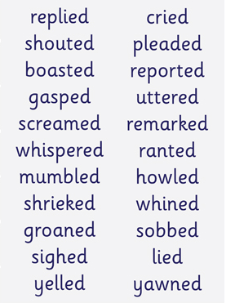
Synonyms for ‘said’
A synonym is a word that means the same as another word.
Example: big – large, huge, massive, vast.
Walk – wander, creep, dash, hurry
Synonyms make your writing more expressive and exciting for the reader.
These are just some of the words used instead of ‘said’. They help the reader understand how a character is feeling and make reading more interesting and exciting.

Slide 3
Key vocabulary
said
yelled
whispered
shouted
suggested
asked
screamed
demanded
declared
cried

Slide 4
We are going to read back chapter 7.
As we do can you notice which words Roald Dahl has used instead of ‘said’ and does it make the story more interesting and the characters show more emotion?
When we have finished you will complete a task choosing the best word for ‘said’ to express emotion for some sentences.

Slide 5
Fantastic Mr Fox – Chapter 7
“We’ll never let him go!”
At six o’clock in the evening, Bean switched off the motor of his tractor and climbed down from the driver’s seat. Bunce did the same. Both men had had enough. They were tired and stiff from driving the tractors all day. They were also hungry. Slowly they walked over to the small fox’s hole in the bottom of the huge crater. Bean’s face was purple with rage. Bunce was cursing the fox with dirty words that cannot be printed. Boggis came waddling up. ‘Dang and blast that filthy stinking fox!’ he said. ‘What the heck do we do now?’

Slide 6
‘I’ll tell you what we don’t do,’ Bean said. ‘We don’t let him go!’
‘We’ll never let him go!’ Bunce declared.
‘Never never never!’ cried Boggis.
‘Did you hear that, Mr Fox!’ yelled Bean, bending low and shouting down the hole. ‘It’s not over yet, Mr Fox! We’re not going home till we’ve strung you up dead as a dingbat!’ Whereupon the three men all shook hands with one another and swore a solemn oath that they would not go back to their farms until the fox was caught.
‘What’s the next move?’ asked Bunce, the pot-bellied dwarf.

Slide 7
‘We’re sending you down the hole to fetch him up,’ said Bean. ‘Down you go, you miserable midget!’
‘Not me!’ screamed Bunce, running away.
Bean made a sickly smile. When he smiled you saw his scarlet gums. You saw more gums than teeth. ‘Then there’s only one thing to do,’ he said. ‘We starve him out. We camp here day and night watching the hole. He’ll come out in the end. He’ll have to.’
So Boggis and Bunce and Bean sent messages down to their farms asking for tents, sleeping-bags and supper.

Slide 8
Now find the sheet ‘English Alternative 1 synonyms for said’
Choose which expressive synonym for said’ would work for each sentence.
Top Tip
When you have ? Remember the character is asking a question so choose an ‘asking’ word.

