Slide 1
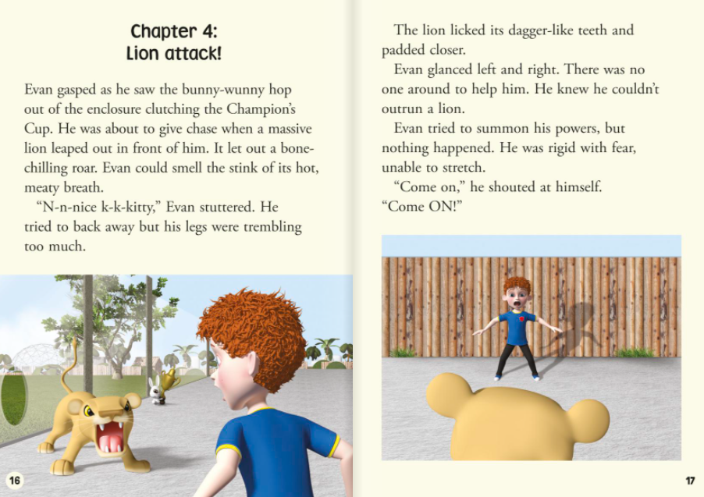
1. Why were Evan’s legs trembling?

Slide 2
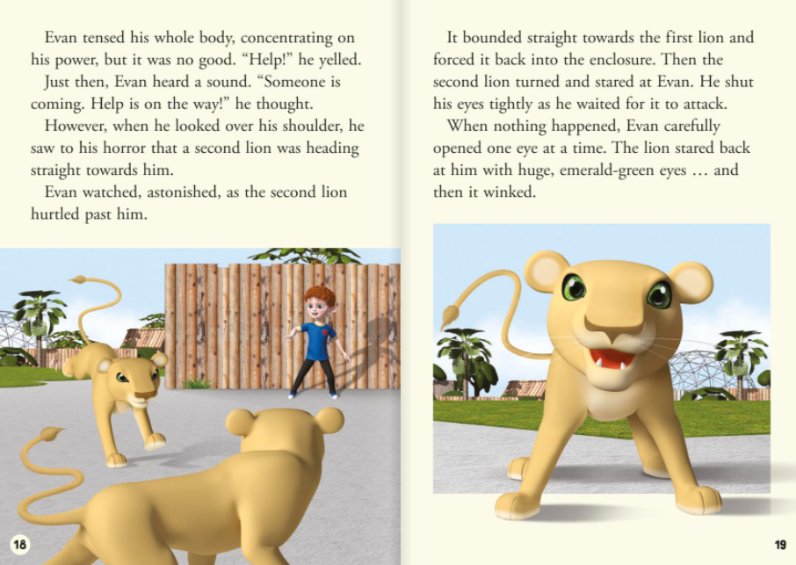
2. How do you think Evan felt at the end of page 19? Why?

Slide 3
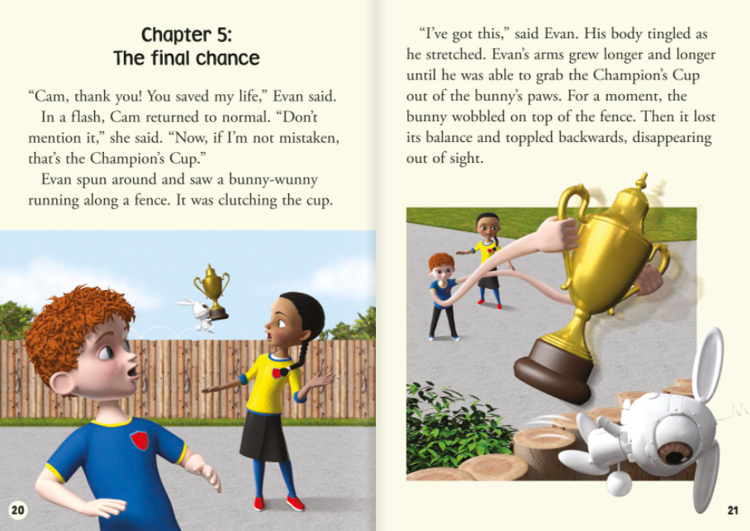

Slide 4
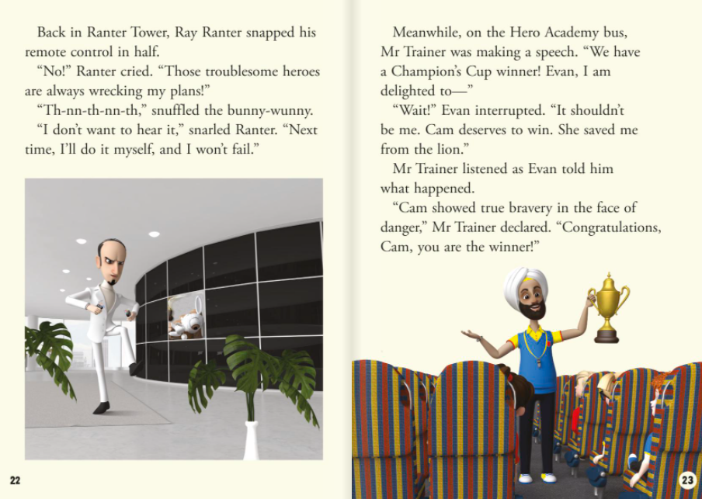
3. How does Ray Ranter feel? Why?

Slide 5
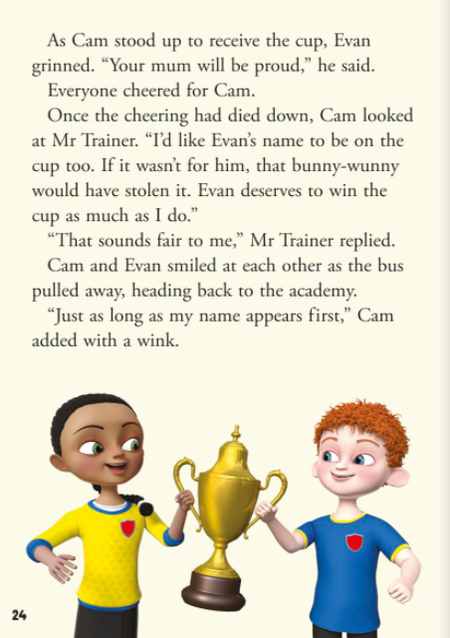
4. Why did Evan choose to share the cup with Cam?

