Slide 1
Year 1 Missing number addition sentences

Slide 2
Missing number addition using a number line.
4 + = 6
1
2

Slide 3
Missing number addition using a number line.
2
4 + = 6
1
2

Slide 4
Missing number addition using a number line.
3 + = 7
1
2
3
4
Notes:
Lets try another one together. Remember we need to start at number 3 on our number line because that is the first number in our number sentence and then we need to jump to 7 because that is our answer. Are you ready, lets count our jumps. 1, 2, 3, 4. our missing number is 4. 3 + 4 = 7

Slide 5
Missing number addition using a number line.
4
3 + = 7
1
2
3
4

Slide 6
Missing number addition using a number line.
5 + = 9

Slide 7
Missing number addition using a number line.
2 + = 8

Slide 8
Missing number addition using a number line.
1 + = 6

Slide 9
Missing number addition using a number line.
3 + = 9

Slide 10
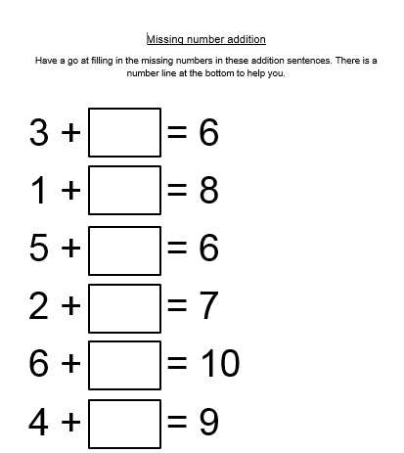
Now have a go at the worksheet

Slide 11
Slide 2 - We are going to be learning how to find the missing number using a number line. Our number sentence is 4 add something equals 6. So, we need to start at 4 on our number line because that is the first number and then jump to 6 because that is the answer and count our jumps. Are you ready, 1, 2. We needed to jump 2 numbers to get to 6, so our missing number is 2. 4 + 2 = 6
Slide 4 - Lets try another one together. Remember we need to start at number 3 on our number line because that is the first number in our number sentence and then we need to jump to 7 because that is our answer. Are you ready, lets count our jumps. 1, 2, 3, 4. our missing number is 4. 3 + 4 = 7
Slide 6 – Now try this one
Slide 10 – Have a go at the worksheet.

