Slide 1

Learning intention quiz the four operations
+ - x ÷

Slide 2
Strategies
You can use which ever strategy or method you think works for you.
Mental – in your head
Partitioning – splitting your numbers up into ones, tens and hundreds and then adding or subtracting.
Column method

Slide 3
Examples 25 + 43 =
Partitioning
Add the tens
20 + 40 = 60
Add the ones
5 + 3 = 8
Add the totals
60 + 8 = 68
Column method
2 5
+ 4 3
____
2 5
+ 4 3
6 8

Slide 4
Addition and subtraction
Complete the questions on each slide.
24 + 15 =

Slide 5
Addition and subtraction
361 + 232 =

Slide 6
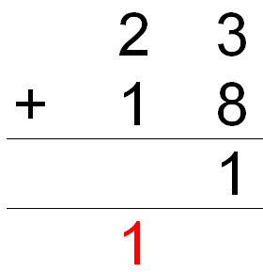
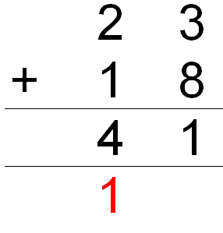
Addition and subtraction
Don’t forget to carry the ones if you get more than 9 when you add the ones column.

Slide 7
Addition and subtraction
45 + 37 =

Slide 8
Addition and subtraction
68 – 36 =

Slide 9
Addition and subtraction
94 – 64 =

Slide 10
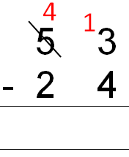
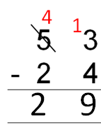
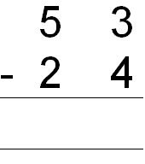
Addition and subtraction
Remember to exchange if the lower digit is bigger than the upper digit. You can’t take 4 away from 3

Slide 11
Addition and subtraction
42 – 24 =

Slide 12
Addition and subtraction
74 – 47 =

Slide 13
Reasoning
Find the missing number.
25 + _____ = 58
58 – 25 = _____

Slide 14
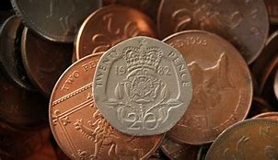
Reasoning
Charlie has 45p. His mum gives him 85p. How much does he have now in pounds and pence?
£___ . ___

Slide 15
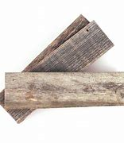
reasoning
Martha has three pieces of wood.
One is 45cms one is 32cms and
one is 18cms. How long would they be all together?

Slide 16
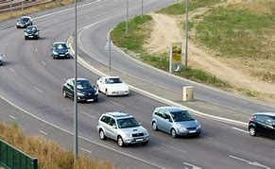
Reasoning
Halle drives 38 miles in her car. After 16 miles she runs out of petrol. How far has she still to travel?

Slide 17
Multiplication
62 x 3

Slide 18
Multiplication
41 x 6

Slide 19
Multiplication
61 x 6

Slide 20
Division and multiplication fact families
Find the missing number.
62 X 3 = ____
3 x 62 = ____
____ ÷ 62 = 3
____ ÷ 3 = 62

Slide 21
Division and multiplication fact families
Find the missing number.
___ X 4 = 64
4 x ___ = 64
64 ÷ 4 = ___
64 ÷ ____ = 4

Slide 22
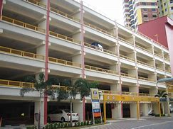
Reasoning
A car park has 5 floors. Each floor can hold 41 cars. How many cars altogether can park.

Slide 23
Answers
24 + 15 = 39
361 + 232 = 593
45 + 37 = 82
68 – 36 = 32
94 – 64 = 30
42 – 24 = 18
74 – 47 = 27
25 + 33 = 58
58 – 33 = 25
45p + 85p = £1. 30
45cm + 32cm + 18cm = 95cm
38miles – 16miles = 22miles to go
32 x 3 = 186
41 x 4 = 246
61 x 6 = 366
62 x 3 = 186
16 x 4 = 64
41 cars on each of 5 floors = 205 cars

