Slide 1
To be reflective on peoples feelings

Slide 2

Mindfulness is:
Mindfulness isn’t:
Being present – focusing on what is right in front of you, not in the past or future
Notice what is happening in our bodies.
Meditation
Spiritual or religious
Visualisation – taking our mind off to imaginary places.
“Mindfulness means the awareness that arises from paying attention in a particular way; on purpose, in the present moment, and non-judgmentally.” Jon Kabat-Zinn 1990.
Mindfulness Through Film

Slide 3

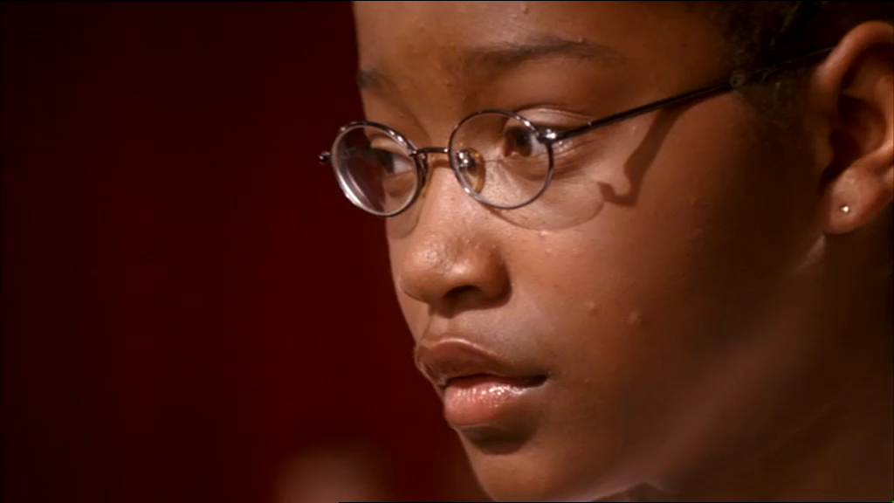
Akeelah and the Bee
Property of Sony Pictures Home Entertainment © (2007) All rights reserved.
Mindfulness Through Film

Slide 4
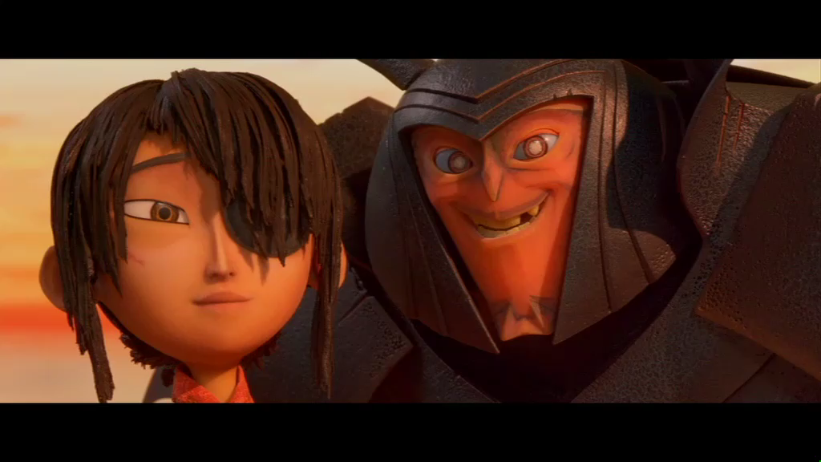
Kubo and the Two Strings
Property of Universal Pictures Int (UK) © (2016) All rights reserved.
Mindfulness Through Film

Slide 5
Characters finding stillness
Think about the two movies you have just watched. Read these questions and try to come up with some answers. You could choose to do these by yourself and write them down or try to do it with someone and see if you share the same answers.
What task is the character faced with?
What feelings might the character be feeling initially? How can you tell?
What do you think they are they doing with their minds to help them in their task?
How do you think they feel afterwards? How can you tell?
How would you try to find stillness?
Mindfulness Through Film

