Slide 1
To compare and order money
Problem solving questions

Slide 2

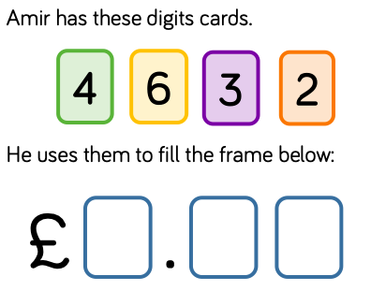
Today’s task
This is your question today.
What it is tell you that Amir can put 3 of these cards at a time into the frame underneath.
You will have to read the tasks carefully then answer them.
We can look at task 1 together on the next slide.

Slide 3
Task 1) Can you make an amount more than 2 pounds and less than 3 pounds?
To solve this, I need to think what the pound part will be.
If it needs to be more than 2 pounds but less than 3 pounds that tells me that the 2 must go in the pounds section.
Then I can put whatever numbers I want in the pence section and the total will be more than £2 but less than £3.

Slide 4
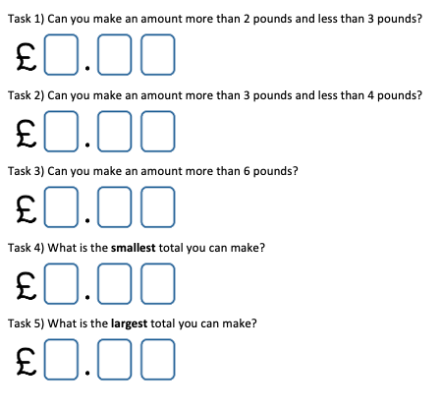
Here are all the questions for you to hear.

