Slide 1
To learn about music from the past

Slide 2

This week we have listened to some different music from the 1970’s.
We have also thought about the tempo of the music and how it makes you feel.
Today we are going to look at 3 musical artists, and find out some more about them.

Slide 3
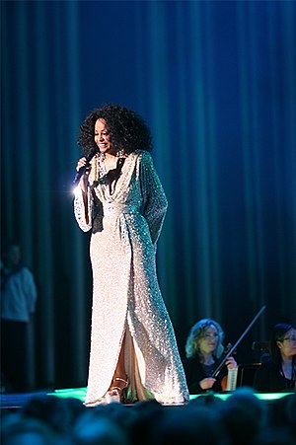
Diana Ross
Diana Ross was born in Detroit, America, in 1944. Her first job was as a secretary until she joined the band The Supremes.
They sung a type of music called Motown and have sold millions of copies of their music in the 1960’s.
Diana Ross left the band in the 1970’s to sing by herself. She was very successful at this.

Slide 4
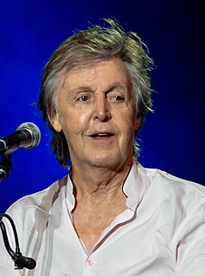
Paul McCartney
Paul McCartney was born in Liverpool, England, in 1942. When Paul was 15, he and his friends formed a band called The Beatles.
Paul McCartney was one of the main songwriters for the band and with his help, The Beatles made 13 albums, selling millions all over the world.
Paul left the band in 1971 and went on to make a new band with his wife, Linda, called Wings.

Slide 5
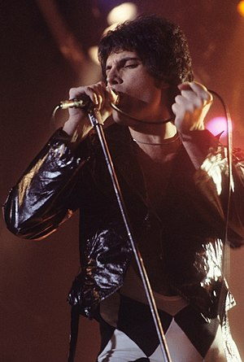
Freddie Mercury
Freddie was born in 1946 in a country called Zanzibar but he grew up in England. His real name is Farrokh Bulsara but all his friends called him Freddie so he changed it.
In 1970, Freddie formed a band called Queen and they played a type of music called Rock music.
They became one of the most famous bands in the world and Freddie is in the Rock and Roll hall of Fame. Unfortunately, Freddie died in 1991 when he was 45 years old.

Slide 6
Today’s task
Using the information in this PowerPoint can you tell me three interesting facts you have learnt about these musical artists.
You could also ask your parents or other family members as they may know some facts about these artists too!

