Slide 1
Learning Intention: To find verbs

Slide 2
What is a verb?
A verb is a word, it is a doing word!
A verb is something that you can do.

Slide 3
Find the verbs:
Notes:
Let’s look at the pictures together. When you see a verb (a doing word) you need to say verb alert!
What is the boy doing? He is crying. The boy can cry. Verb alert! The verb is cry.
What is that? It is a door. Is the door doing anything? No, there is no verb.
What is the boy doing? He is reading. He can read. Verb alert! What is the verb? It is read.

Slide 4
Let’s find some verbs in our story!

Slide 5
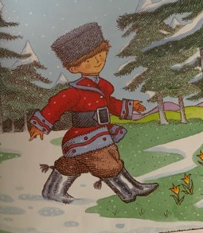
Notes:
Look at the picture. Who can we see? What are they doing?
Peter is walking. Peter can walk. VERB ALERT! I heard a verb (a doing word), the verb is walk. Can you walk?

Slide 6
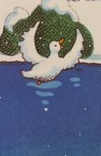
Notes:
Look at the picture. Who can we see? What are they doing?
The duck is swimming. The duck can swim. VERB ALERT! I heard a verb (a doing word). Is it duck? Is it can? Is it swim? Yes! The verb is swim.

Slide 7
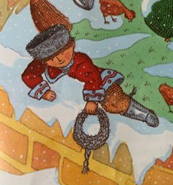
Your turn:
Notes:
Your turn. Look at the picture. Who can we see? It’s Peter! What is Peter doing?
Peter is climbing. Verb alert! Climb. Finish the sentence using the verb, Peter can …

Slide 8
Your turn:
Peter can climb.
Notes:
Your turn. Look at the picture. Who can we see? It’s Peter! What is Peter doing?
Peter is climbing. Verb alert! Climb. Finish the sentence using the verb, Peter can …

Slide 9
Today’s verbs:
walk
swim
climb

Slide 10
Commentary:
Slide 3: Let’s look at the pictures together. When you see a verb (a doing word) you need to say verb alert!
What is the boy doing? He is crying. The boy can cry. Verb alert! The verb is cry.
What is that? It is a door. Is the door doing anything? No, there is no verb.
What is the boy doing? He is reading. He can read. Verb alert! What is the verb? It is read.
Slide 5: Look at the picture. Who can we see? What are they doing? Peter is walking. Peter can walk. VERB ALERT! I heard a verb (a doing word), the verb is walk.
Slide 6: Look at the picture. Who can we see? What are they doing? The duck is swimming. The duck can swim. VERB ALERT! I heard a verb (a doing word). Is it duck? Is it can? Is it swim? Yes! The verb is swim.
Slide 7: Your turn. Look at the picture. Who can we see? It’s Peter! What is Peter doing? Peter is climbing. Verb alert! Climb. Finish the sentence using the verb, Peter can …

