Slide 1
Learning Intention – To find different possibilities and combinations of numbers.

Slide 2

How many different two-digit numbers can be made using the digit cards – 1,2,3,4 and 5?
For example: If you put 1 and 2 together it makes 12.
If you put 1 and 3 together it makes 13.

Slide 3
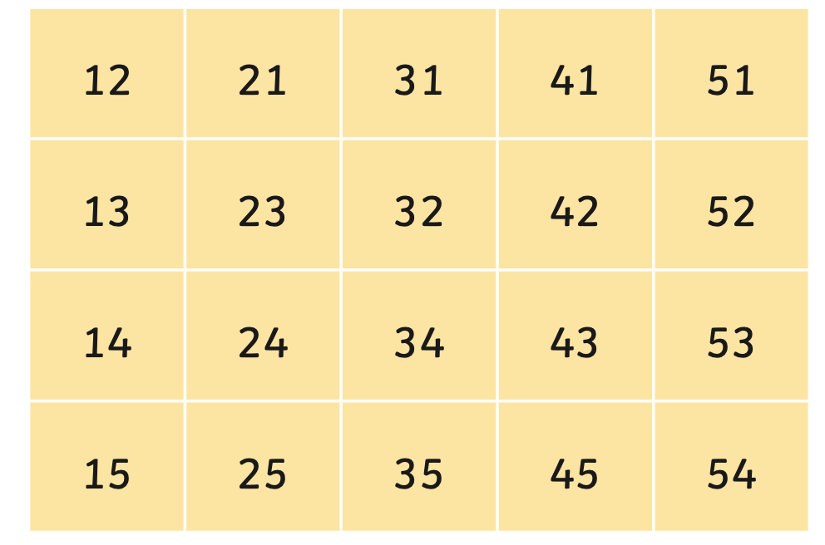
If you get stuck, use the table below to complete the missing numbers:

Slide 4

Place each of the numbers 1 to 5 in the V shape below so that the two arms of the V have the same total.
How many different
ways are there?

