Slide 1
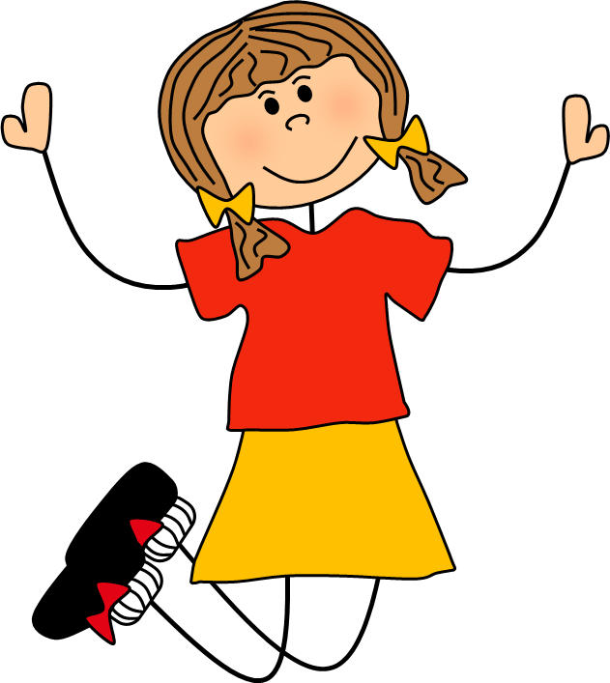
Verbs
jump

Slide 2
What are we learning?
Today we are going to learn about verbs. Verbs are doing words. They tell us what someone or something is doing.

Slide 3
What is a verb?

Slide 4
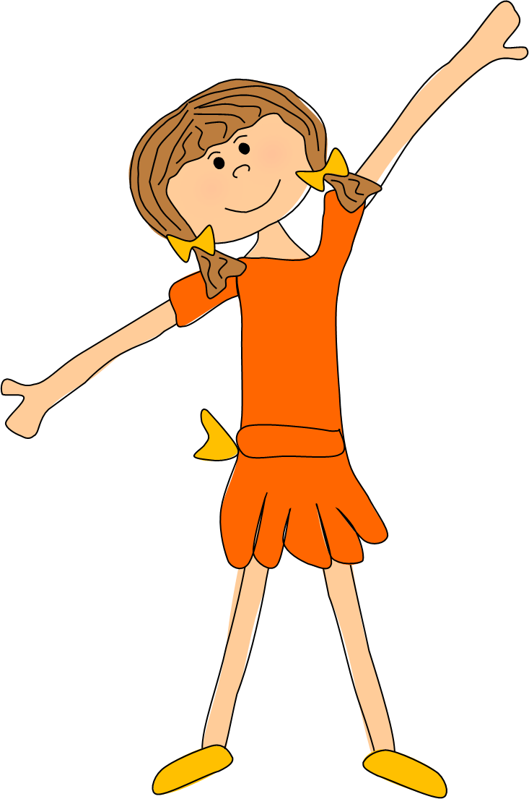
A verb is an action word. It tells us what someone or something is doing…
Alex dances well.

Slide 5
The fish swim in the sea.

Slide 6
The choir sing beautifully.

Slide 7
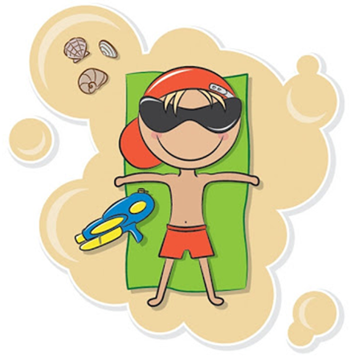
I relaxed on the beach.

Slide 8
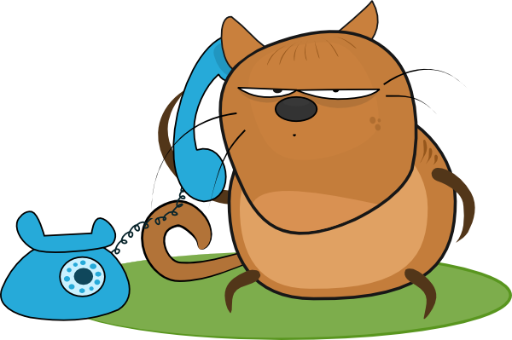
Joe is chatting on the phone.

Slide 9
Can you think of any other verbs? Move around your house and see how many verbs you perform.

Slide 10
Below are some of the things we can do. They are all verbs.
sleep
jump
think
argue
play
smile
skip
shout
swim
worry

Slide 11
Sort the words on the following slide into verbs and not verbs. Click on each word to send it to the correct place in the table.

Slide 12
Verbs
Not Verbs
exercise
dinosaur
impossible
joke
whisper
beautiful
strong
argue
food
more
wander
laugh
goal
frighten
bake
guitar
scream

Slide 13
The verb is the most important word in a sentence. It tell us what is being done in the sentence…
Alex is dancing.
The verb ‘dancing’ tells the reader what the subject of the sentence (Alex) is doing.

Slide 14
Try the work in your learning pack using what you have learnt in this PowerPoint.

Slide 15
Action Words Worksheet
Underline the verb in each sentence.
Fred is reading his book slowly.
The vicious bear growled.
The mouse nibbled the cheese.
4. Charlie ran as fast as lightning.
5. Lucy posted a letter to her friend.
Circle the verb with the similar meaning.
walk
disappear
run
push
moan
stroll
open
drive
argue
speak
vanish
dive
sprint
ride
roar
break
shove
groan
fall
grow
Change the highlighted verb to a more interesting verb.
Imran disappeared from inside the haunted house.
The baby threw her teddy out of the pram.
The stack of plates fell to the floor.
‘Please, help me,’ I said.
Gerry smiled from ear to ear.
_____________________________________________________________________________________________________________________________
Notes:
Worksheet to accompany activity.

