Slide 1

Learning intention How iron age people lived

Slide 2
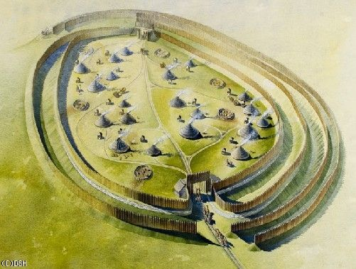
Living in an Iron Age Hillfort.

Slide 3
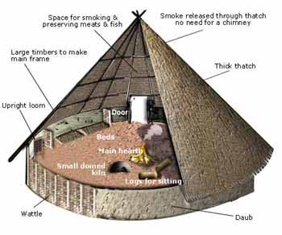
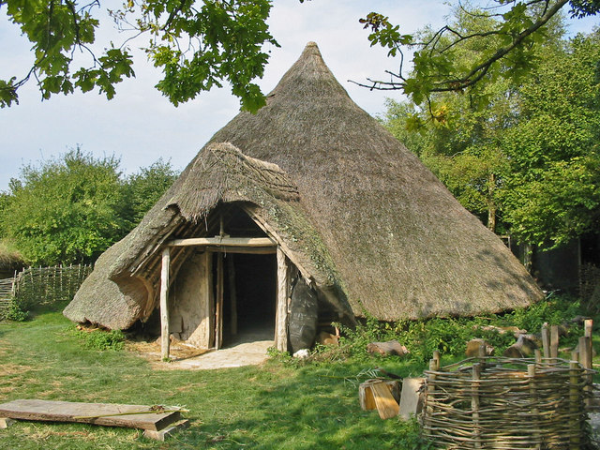
Iron age roundhouses
Roundhouses could be anything from about 4 metres to 10 metres wide. They had pointed roofs and were made from wooden beams. The walls were either stone or made with wattle and daub (woven wood plastered with straw and mud).
There was a pole in the centre of the roundhouse which supported other poles which spread out to form the roof. The roof was thatched (covered) with grass or straw. The door was decorated with carvings and plants and herbs to keep evil spirits away.
One family would live together in one large room. Sometimes the larger roundhouses could have more than one family living in them.

Slide 4
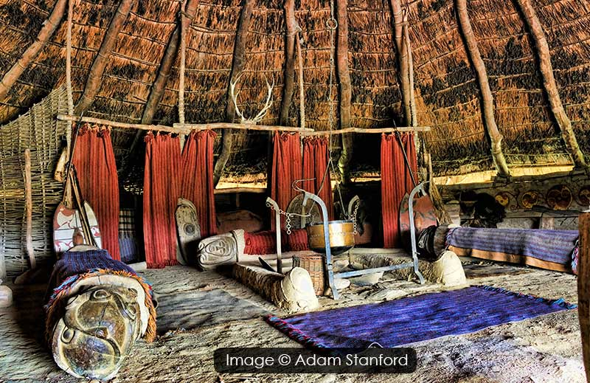
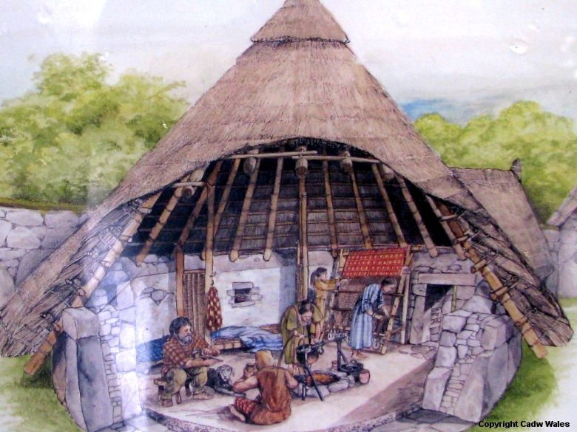
A roundhouse was lit and heated by a fire built into a clay and stone hearth in the middle of the floor. The smoke would get out through the thatch so there was no need for a chimney. A bronze or iron cauldron (pot) would be hung above the fire for cooking food. Some food that had been preserved in salt or smoked would hang from the ceiling. (no fridges then!)
There might have been a loom in the larger more wealthy houses to make clothes. Around the walls would have been benches used for sleeping.
Simple furniture such as a table and a chest would have been made from wood.
Tools and weapons would have been kept close as they were treasured possessions.

Slide 5
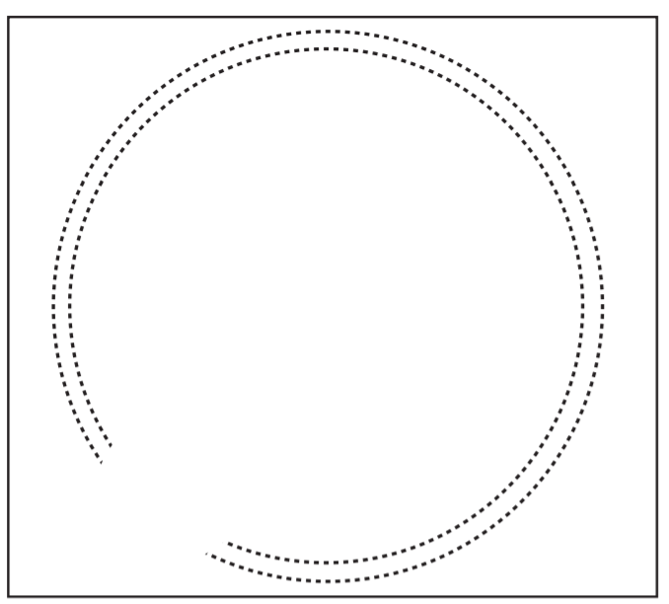
Task
Draw a plan of a roundhouse
What might it have looked like?
Remember to include
A central pole Fire and cauldron Benches
Animal skins Low wooden table Wooden chest
Loom
What else could you include?
Think about:
Food storage and cooking- what equipment would they need?
What would they cook on?
sleeping- blankets/wool/skins
defence – weapons
Draw a circle (a saucer or small plate might help)
Include a door way and label neatly.

