Slide 1
To find fractions of an amount
Non-Unit fractions

Slide 2
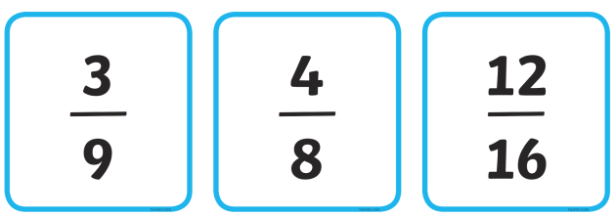
A non-unit fraction
A non-unit fraction is a fraction where the numerator is larger than 1

Slide 3
Find a non-unit fraction of an amount
To find a fraction of an amount we need to look carefully at both parts of the fraction.
Lets look at the question 2/5 of 15
We make a bar model of 5 parts (the denominator)
We share 15 (the total) between the 5 parts, that’s 3 each
We circle 2 parts (the numerator) to find the answer
So we know 2/5 of 15 = 6
000 | 000 | 000 | 000 | 000

Slide 4
Lets look at another question
¾ of 20
We make a bar model of 4 parts (the denominator)
We share 20 (the total) between the 4 parts, that’s 5 each
We circle 3 parts (the numerator) to find the answer
So ¾ of 20 = 15
00000 | 00000 | 00000 | 00000

