Slide 1
Hansel and Gretel.
Using inference skills.
This is using the pictures and text for clues to find out more about the story and characters.

Slide 2
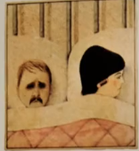
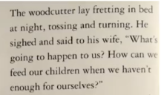
The picture show us that the woodcutter looks extremely sad and worried.
The word ‘fretting’ is another word for worrying.
The Words ‘tossing and turning’ tell us that the woodcutter is not able to sleep properly.
The questions he asks show us that he is very worried about his family.
I think it shows us that the man is worried for his family and cares for them. He doesn’t want anything to happen to them.

Slide 3
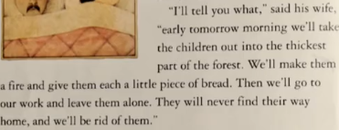
What does this part of the text tell you about the wife?
I think it shows she is cruel, unkind, mean, greedy and selfish.
She wants to take them into the forest so they can’t find their way back and might be in danger. She is selfish because she wants all the food to herself and not share it with the children.
The words ‘get rid’ show that she does not love or care for the children. Sometime people say they will ‘get rid’ of old things or rubbish.

Slide 4
Now use the pictures and text on the worksheet.
What clues tell you more about the story and characters?
This can sometimes be a tricky job as you have to read and look at the pictures carefully and really think about them.

