Slide 1
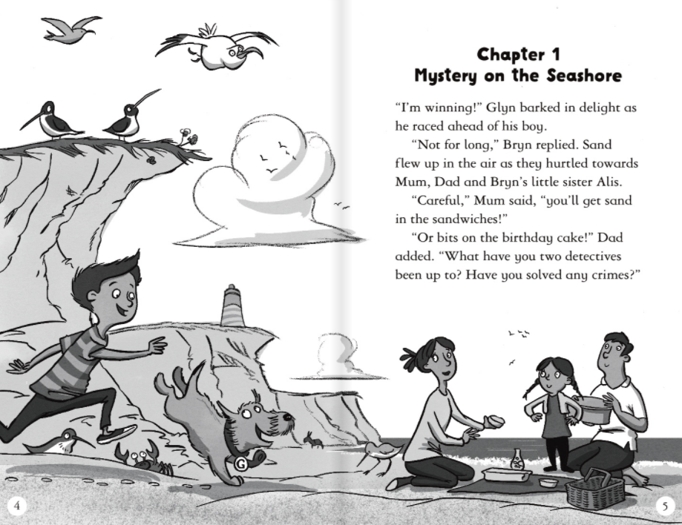
1.Which word in this sentence shows that Glyn is a dog?
Glyn barked in delight as he raced ahead of his boy.

Slide 2
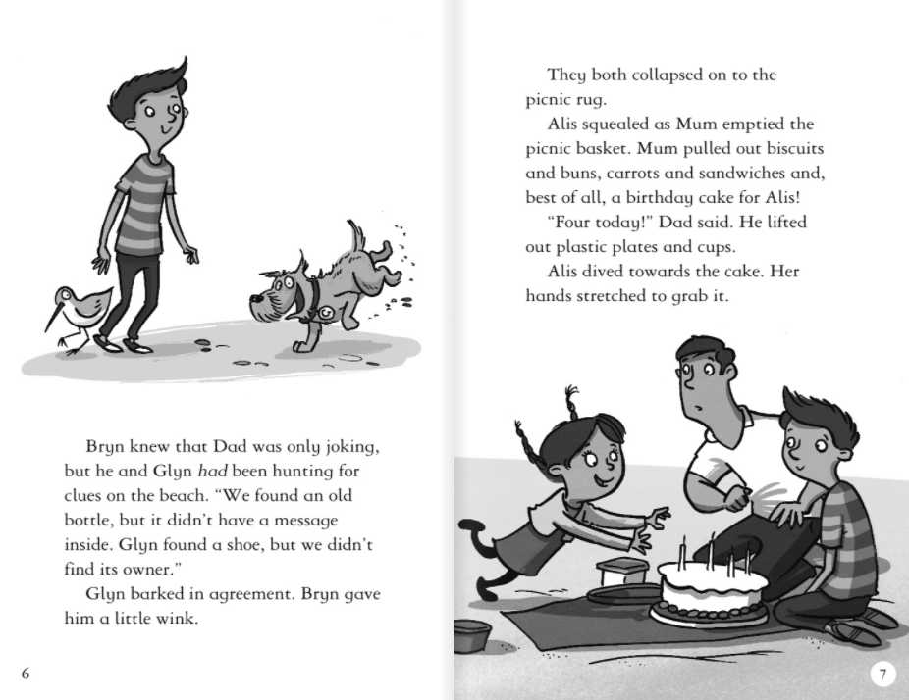
2.How can you tell Alis is excited?

Slide 3
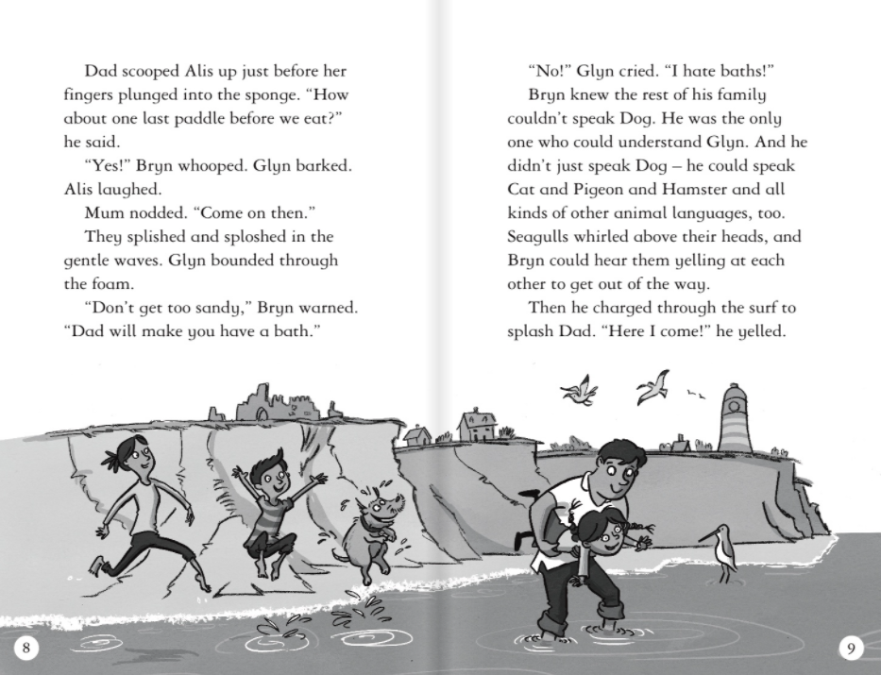

Slide 4
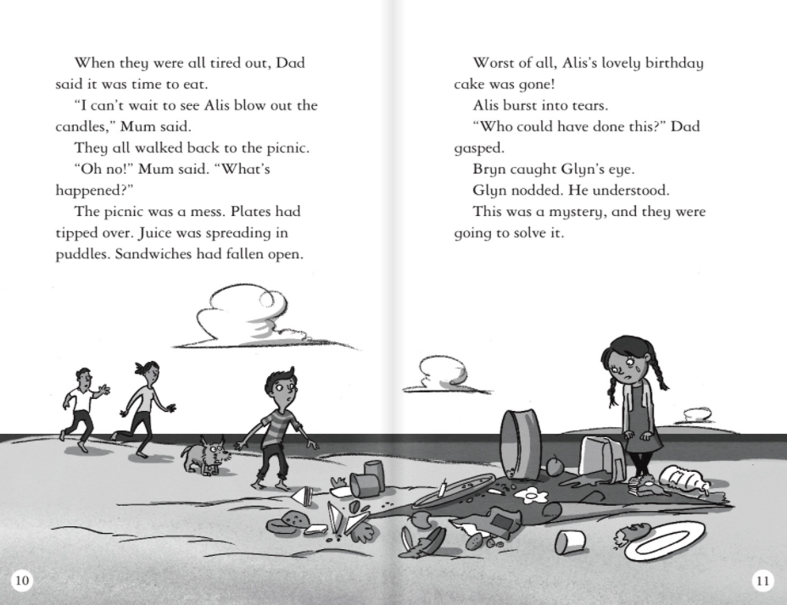
3.Why did Alis burst into tears?

