Slide 1
Learning intention: To begin to recognise continents and increase knowledge of these.
Today we will learn about the continent of North America.

Slide 2
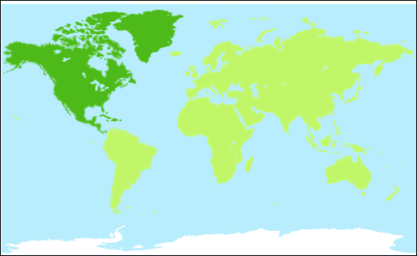
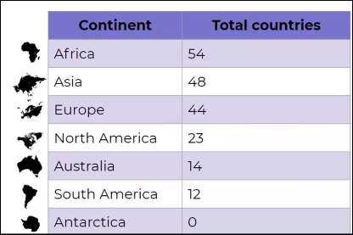
Can you find the continent of North America on the map?
The continent of North America is made up of 23 countries.
These include the United States of America (USA), Canada, Mexico and Cuba.

Slide 4
Some facts about North America

Slide 5
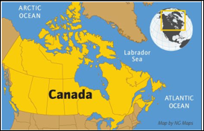
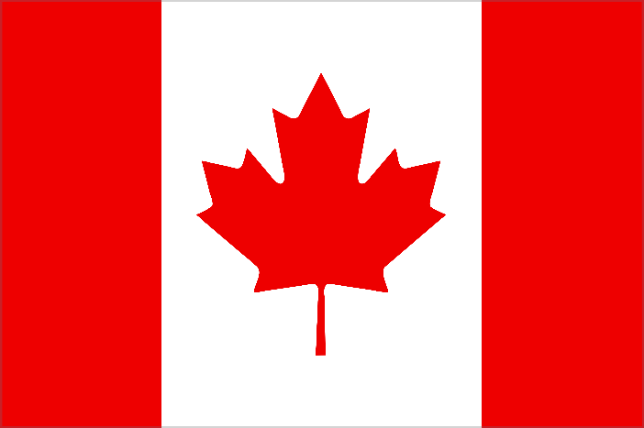
Let’s look at some of the countries that are in North America. Can you name any?
Canada
Majestic mountains, frozen glaciers, beautiful cities and incredible wildlife. Let’s find out about Canada.
Canada is the second largest country in the world.
The far North of Canada lies in the frozen Arctic.
It is huge and has 6 time zones.
It has two official languages French and English
The flag of Canada has a maple leaf on it because there are lots of maple trees in Canada.
Nearly half of the country is covered with trees.

Slide 6
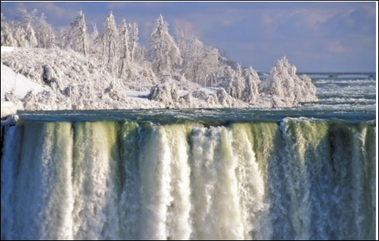
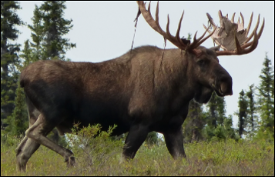
Canada has a varied landscape. It has mountains, plains ( large areas of flat grasslands with no trees)
Wildlife and nature
In the South there are plains where buffalos and antelopes live.
In the north there are more forests where moose and black bears live.
If you visit Canada you might also see: wolves, mountain lions, beavers and racoons.
A moose

Slide 7
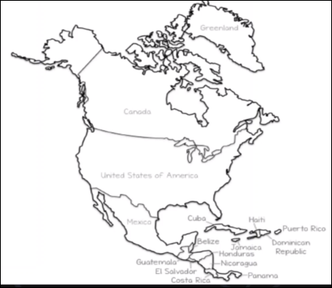
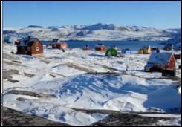
Greenland
Greenland is the second largest island in the world.
Nearly three quarters of the land is covered with ice.

Slide 8
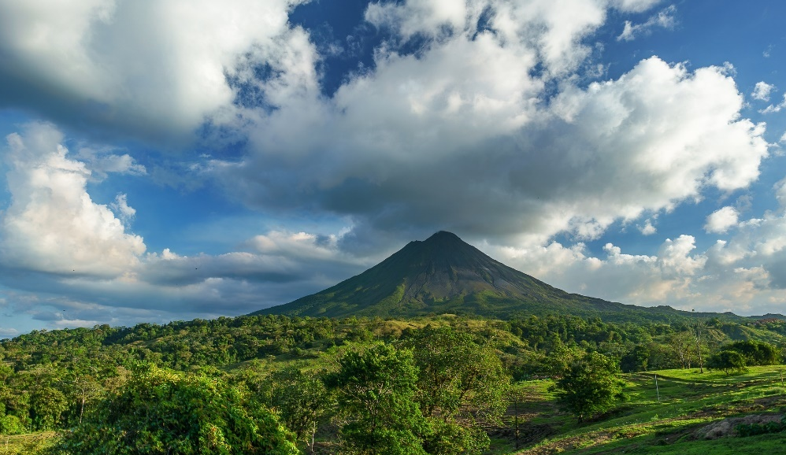
Costa Rica
Costa Rica is made up of lush rainforests, mighty volcanoes and long stretches of sandy beaches.
Arenal Volcano.
It is cone shaped and over 1,600 metres high.
The crater is 140 metres wide.
It used to be one of the most active volcanoes in the world.
Since 2010, it has been dormant.

Slide 9
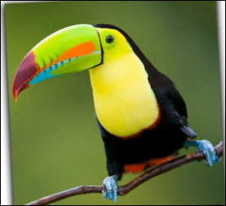
Wild life
Costa Rica is home to lots of animals, from the endangered giant anteaters to happy eagles, sloths and big cats.
There are six types of toucan that live here.
30 years ago, rainforests in Costa Rica were being destroyed and animals were becoming endangered.
The government decided they must do something to stop this.
They spent money on educating people about how to look after nature.
They replanted rainforests and told people not to chop them down.
They showed visitors how to enjoy nature without harming it.
Things are much better now.
toucan

Slide 10
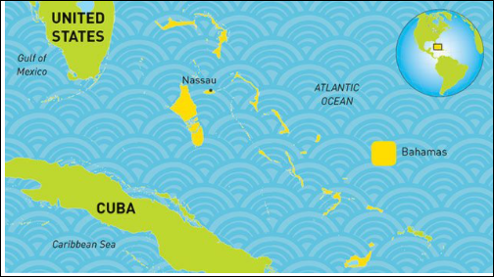
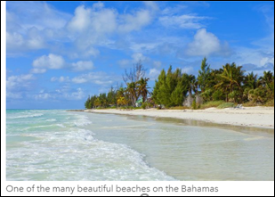
The Bahamas
The Bahamas has stunning beaches, wonderful wildlife and colourful carnivals.
The Bahamas is very tropical and rarely gets below 15 degrees.
The Bahamas is made up of 700 islands which are close together.
Only about 30 of them have people living on them.

Slide 11
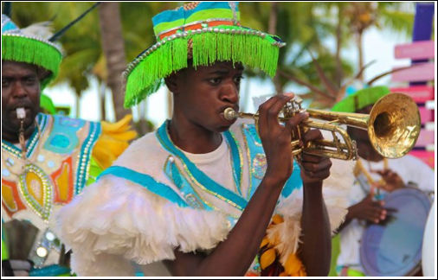
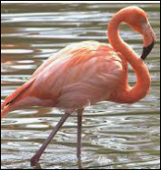
Wildlife
Turtles, parrots, iguanas and the world’s largest colony of flamingos live here.
The island of Andros has one of the longest coral reefs in the world. This is home to lots of colourful fish, such as the spotlight parrotfish and the blue tang.
On December 26th the people of the Bahamas celebrate Junkanoo.
People dress in colourful costumes and parade through the streets.
They play the drums, horns, cowbells and whistles.
flamingo

Slide 12
Facts about North America:
It is made of 23 countries
The largest country is Canada
The largest city is Mexico City
The biggest island is Greenland
The largest lake is Lake Superior
The longest river is Missouri River (2,341 miles)

