Slide 1
Learning intention: To solve division problems.

Slide 2
Bella has 10 boxes and 30 books to share equally between them. How many books go in each box?
If you are sharing an amount equally this is division.
30 ÷ 10 = 3
You can read this as ‘30 shared equally between 10’.

Slide 3
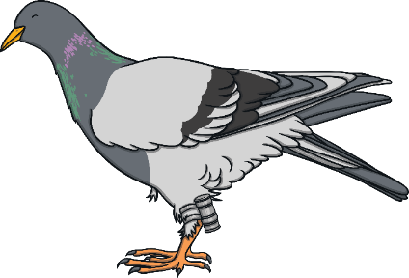
Bob has 35 birds. He puts five birds in each cage.
How many cages does he need?
Let’s look at how you would work this out.
You could share the 35 birds into equal groups…
You add 5 birds in the first group then begin adding 5 birds to the next group. Repeat until all birds have been shared equally.
If you are grouping an amount into equal groups this is division.
35 ÷ 5 = 7
You can read this as ‘35 divided into groups of 5’.

Slide 4
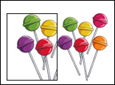
Sam puts ten lollies in each bag.
He has 90 lollies. How many bags can he fill ?
Can you show this as a division number sentence?
Check your answer
90 ÷ 10 = 9
I put my lollies into groups of 10. Then counted how many bags they would go in.

Slide 5
Joe has 12 chocolate bars and wants to share them with his little brother.
How many chocolate bars do they each get?
Can you show this as a division number sentence?
Check your answer
12 ÷ 2 = 6

