Slide 1
20.1.21 To make a prediction

Slide 2
Look at the cover below

Slide 3
This is a collection of poems by the writer T.S. Eliot.
What do the following words mean:
Possums
Practical
Illustrated

Slide 4
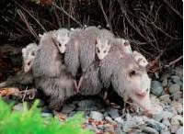
Possum
An animal from Australia.
Practical
To do with real life experiences.
Illustrated
Drawings to match the pictures.

Slide 5
Look back at the front cover….
What do you think you can work out about the book from the cover?
Try to think of five different things.

