Slide 1
Aboriginal Art
Colours, symbols and patterns

Slide 2
Key vocabulary Aboriginal art Oldest form of art in the world created by the Aboriginal people of Australia Pattern a repeated decorative design. Environmental art art that is inspired by the world around and its surroundings Symbols a mark, sign or word that represents an idea or object

Slide 3
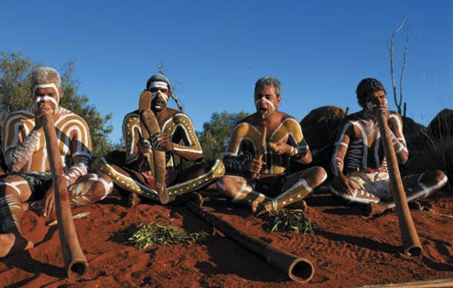
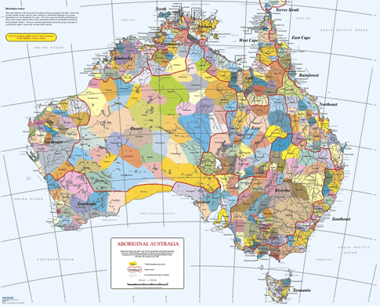
Who, What, Where?

Slide 4
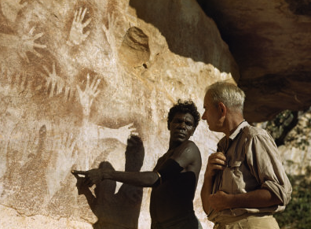
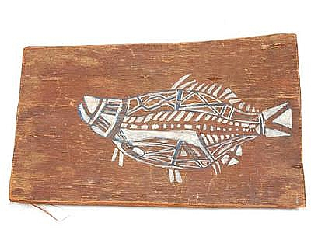
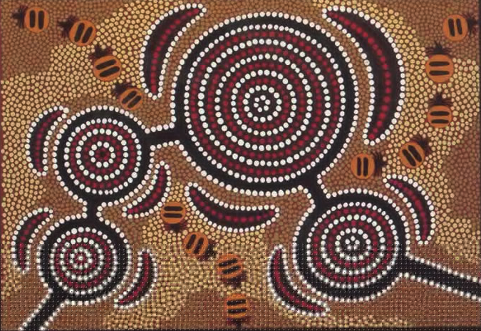
Three types of Aboriginal Art
Negative printing - Simple figures
Bark painting- X-ray fish
Geometrical

Slide 5
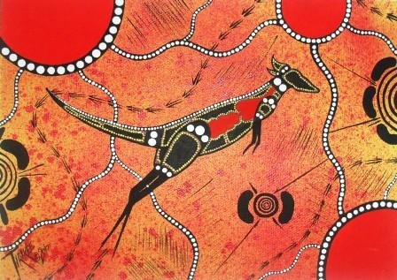
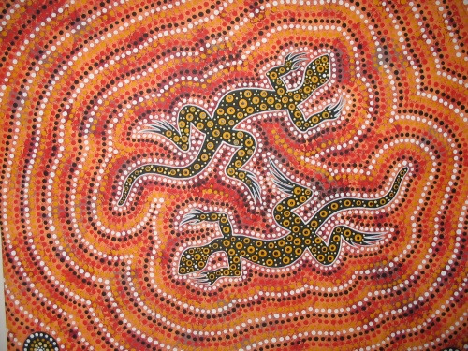
Animals in Aboriginal Art

Slide 6
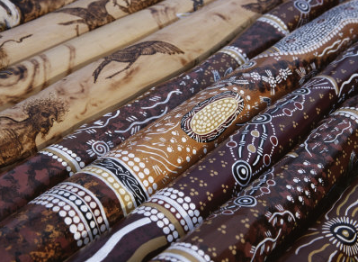
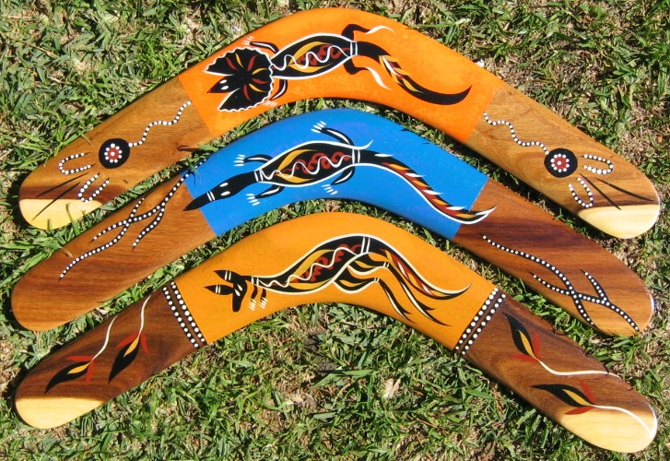
Objects

Slide 7
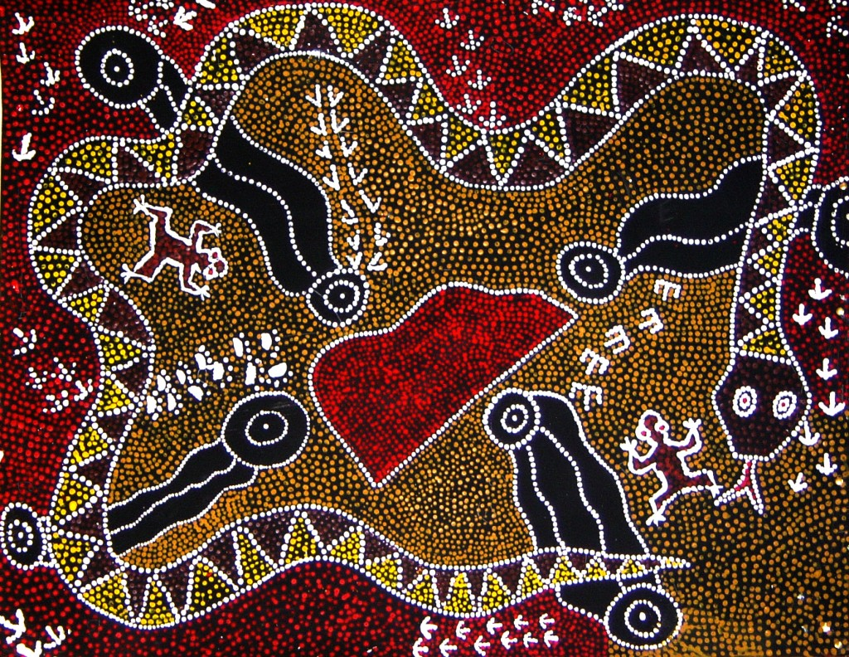
What kind of tools do you think they used to create their patterns?

Slide 8
These patterns and symbols were created using only the colours seen in nature, (for instance soil, was seen in tints of reds, yellows and browns ochres. White, clay and charcoal colours were also used from natural materials. Thousands of years ago, Aboriginals would create their works using only the natural materials left around them, (such as bark, clay, logs, trees, burnt sticks, rocks, etc....

Slide 9
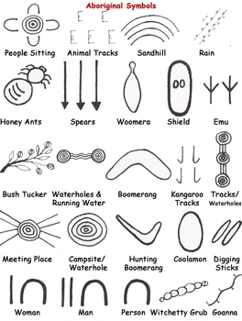
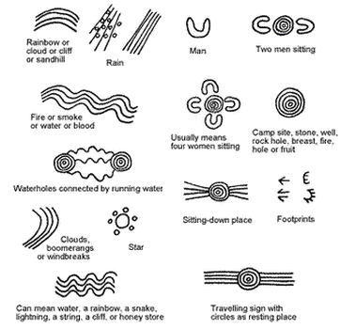

Slide 10
Now it’s your turn
Pretend you are living thousands of years ago and you are going to use symbols to create a piece of art work that you will pass down to your ancestors.
To plan my own design of Aboriginal art
Choose three symbols that will use to create your storyline and art work.
Decide what you will create your design on.
What materials will you use to create your design
Plan your repeated pattern.

