Slide 1
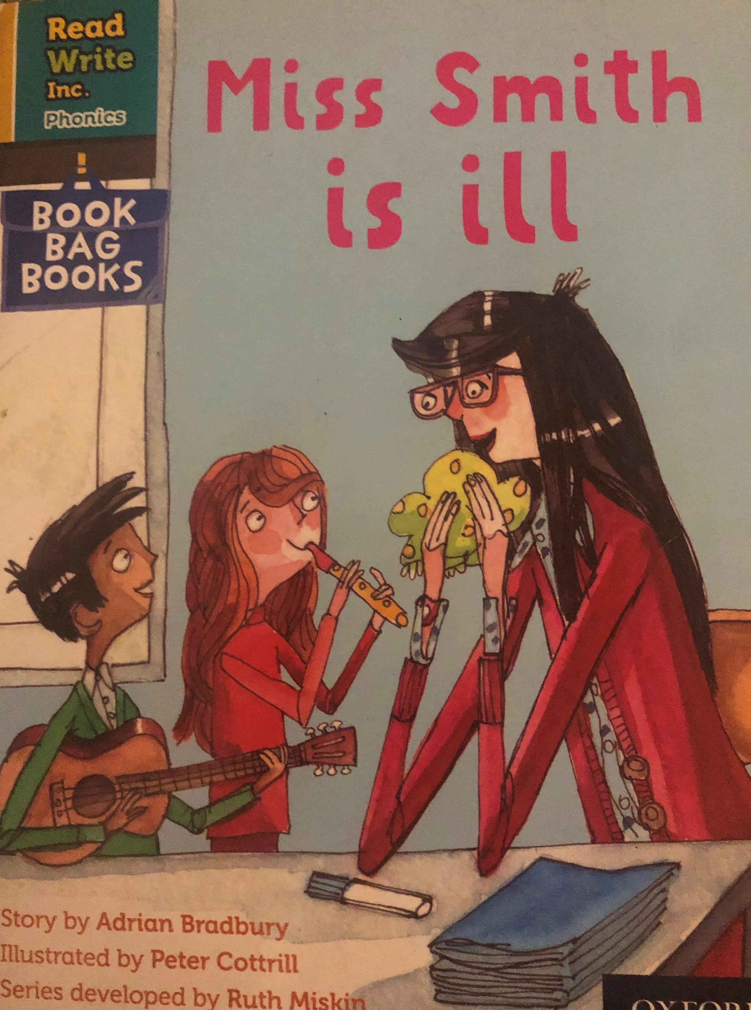
You are going to read the story ‘Miss Smith is ill’.
In this story you will hear words with the sounds:
a
e
i
o
u
Look at the picture. What can you see? What will happen in the story?

Slide 2
Let’s read these words together. These are words you will come across in the story.
Green Words
wrong
hundred
twenty
sorry
chicken
Red Words
her
put

Slide 3
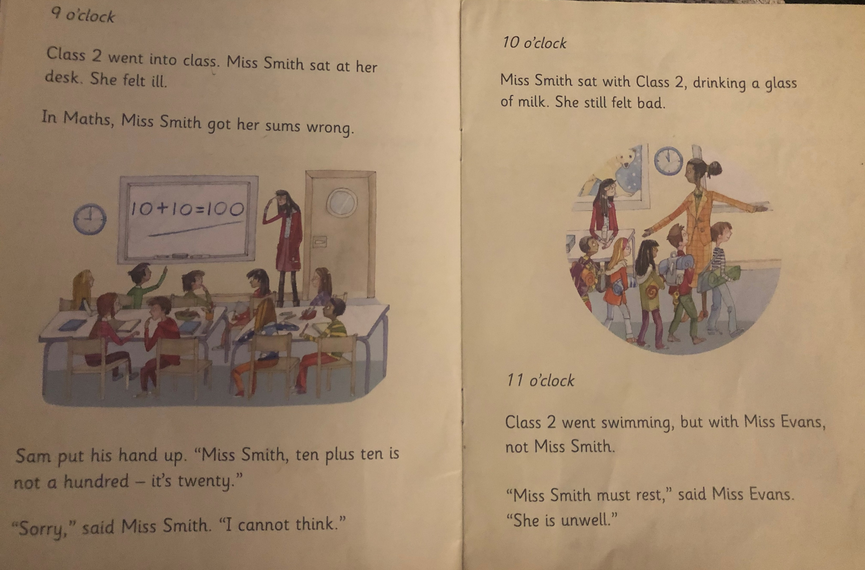
What lesson were the children doing?
What did Miss Smith do wrong?
What happened at 10 o’clock?
What did Miss Evans say Miss Smith must do?

Slide 4
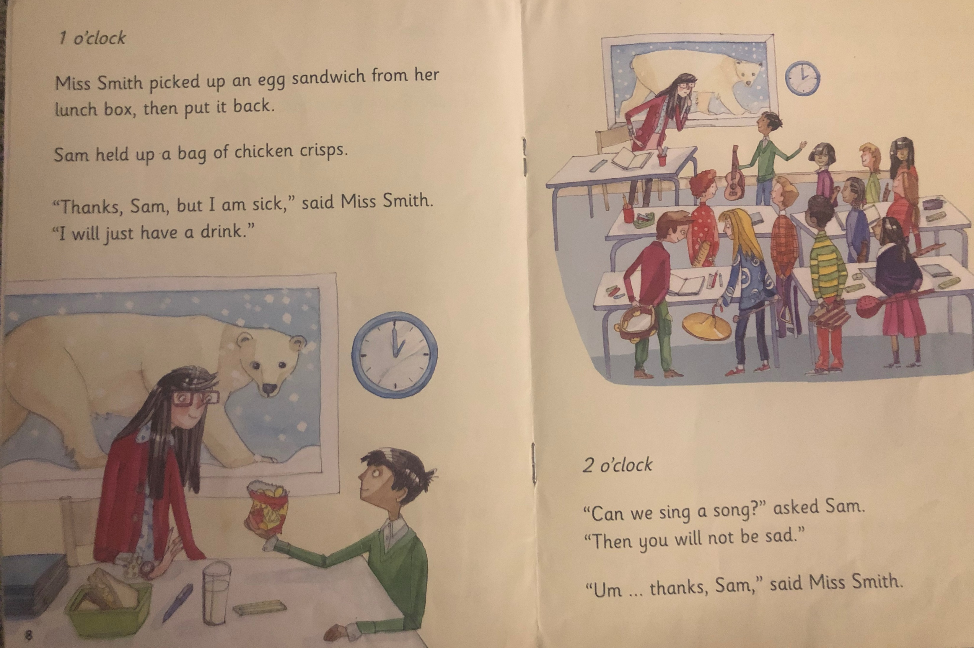
Why did Miss Smith not take the crisps?
Why did the children want to sing a song?

Slide 5
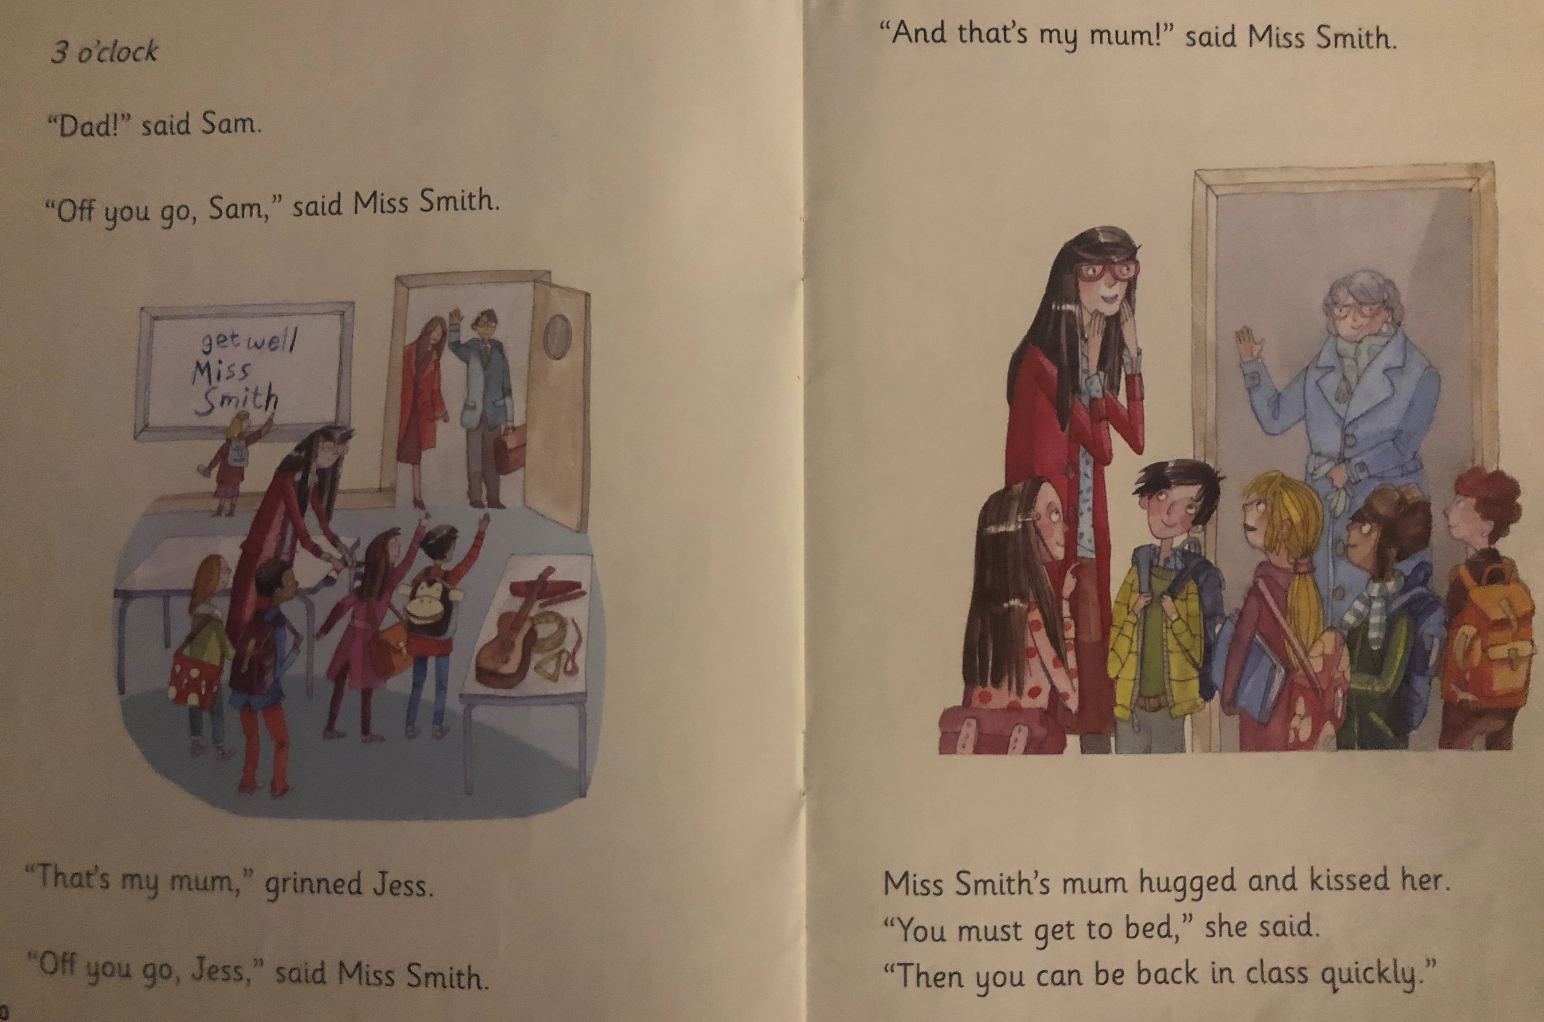
What did Miss Smith do when she saw her mum?
Why did mum say Miss Smith’s mum say she had to get to bed?

Slide 6
Recap questions
When did the class first know that something was wrong with Miss Smith?
Who took Miss Smith’s class swimming?
What did the class want to do to make Miss Smith feel better?
How do you think Miss Smith felt when she saw her mum?

