Slide 1
Learning intention: To represent numbers in different ways.

Slide 2
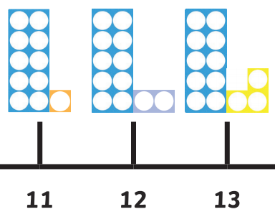
Yesterday we were learning about teen numbers, numbers between 11 and 20 and how to represent them using Numicon.

Slide 3
Today we are going to look at teen numbers in a different way.

Slide 4
Can you count the spots? How many are there?
11

Slide 5
Can you count the spots? How many are there?
12

Slide 6
Can you count the spots? How many are there?
13

Slide 7
Can you count the spots? How many are there?
14

Slide 8
Can you count the spots? How many are there?
15

Slide 9
Can you count the spots? How many are there?
16

Slide 10
Can you count the spots? How many are there?
17

Slide 11
Can you count the spots? How many are there?
18

Slide 12
Can you count the spots? How many are there?
19

Slide 13
Can you count the spots? How many are there?
20

Slide 14
Use the number line to count from 0 to 20.

