Slide 1
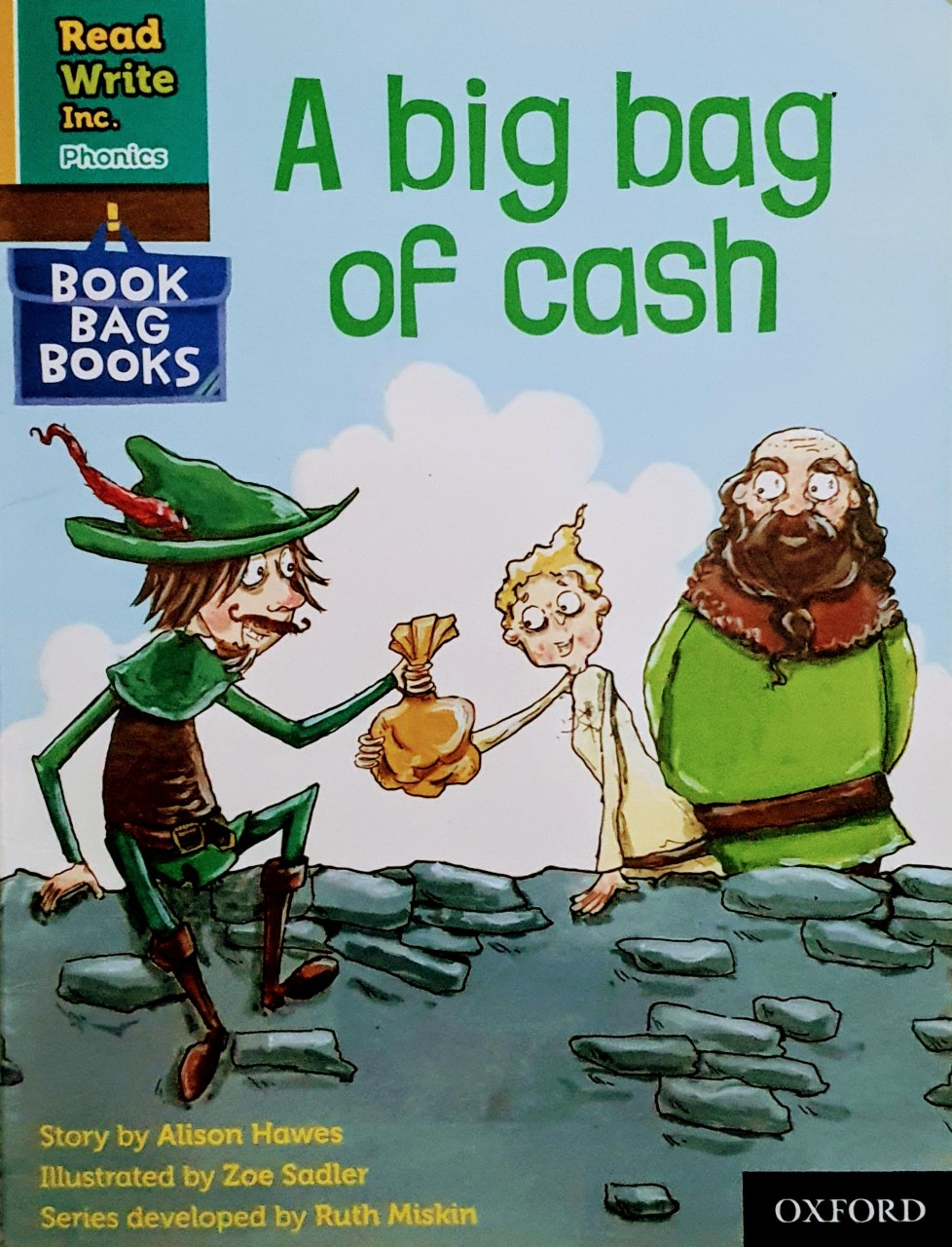

You are going to read the story ‘A Big Bag of Cash’
In this story you will hear words with the sound:
oo
The oo sound is in the word:
zoo
Can you write two words with the oo sound in?
Look at the picture. What can you see? What will happen in the story?

Slide 2
Let’s read these words together. These are words you will come across in the story.
Green Words
woods
robbing
rich
bow
shot
Red Words
are
was
what

Slide 3
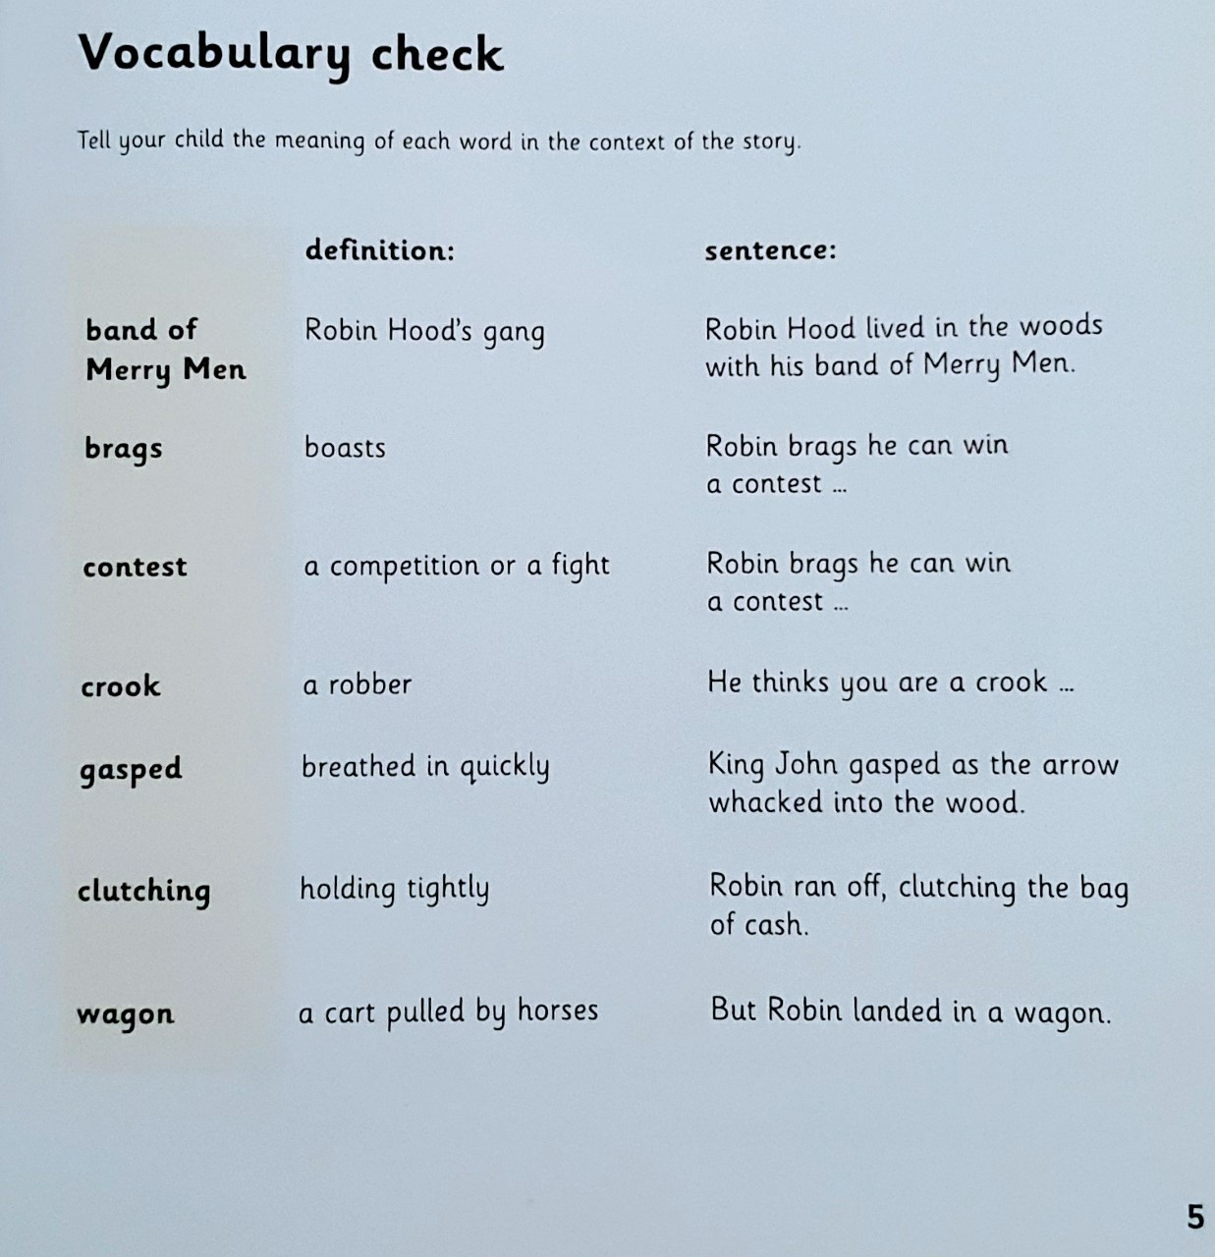

Slide 4
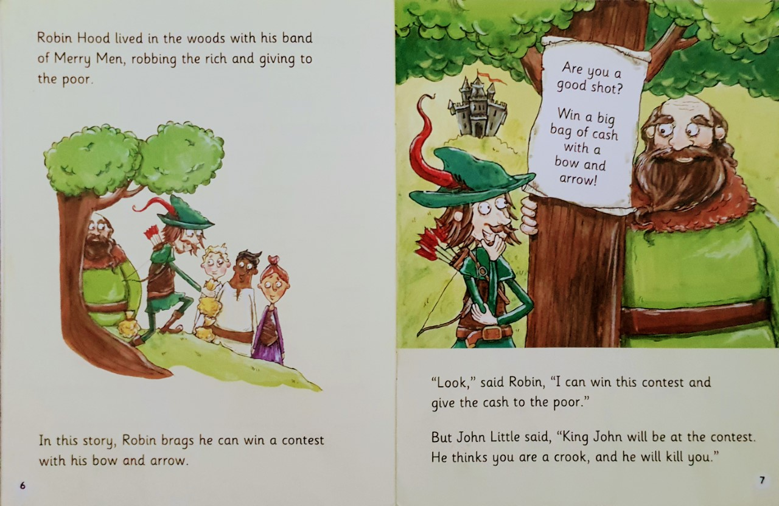
Who did Robin Hood live with?
What does Robin brag about?
What does King John think Robin is?

Slide 5
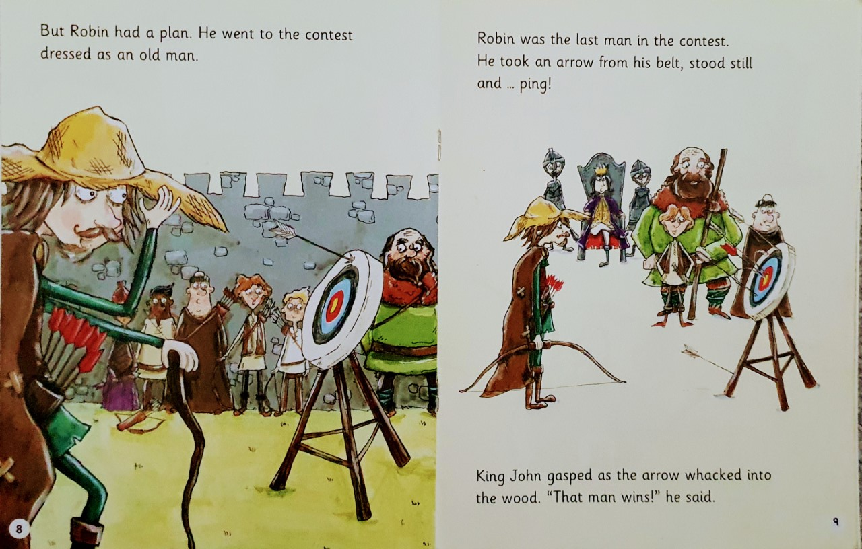
Why do you think Robin went to the contest dressed as an old man?
What position did Robin come in the contest?

Slide 6
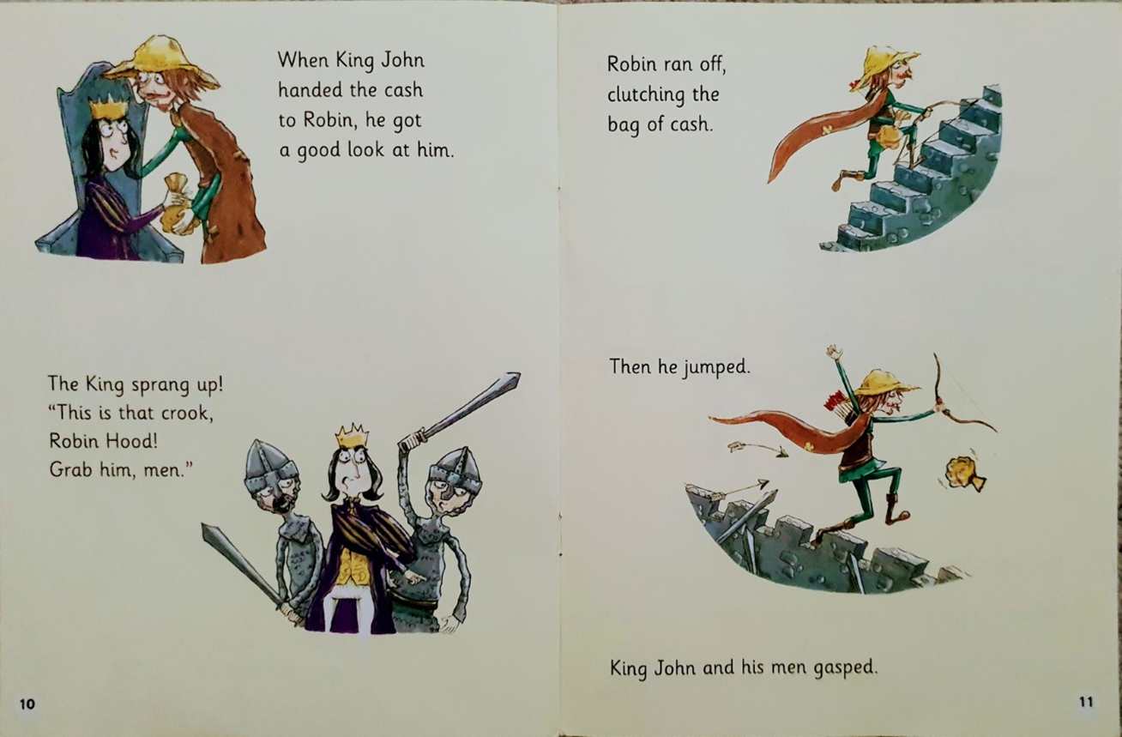
How did King John realise that the old man was really Robin Hood?
What did Robin do?

Slide 7
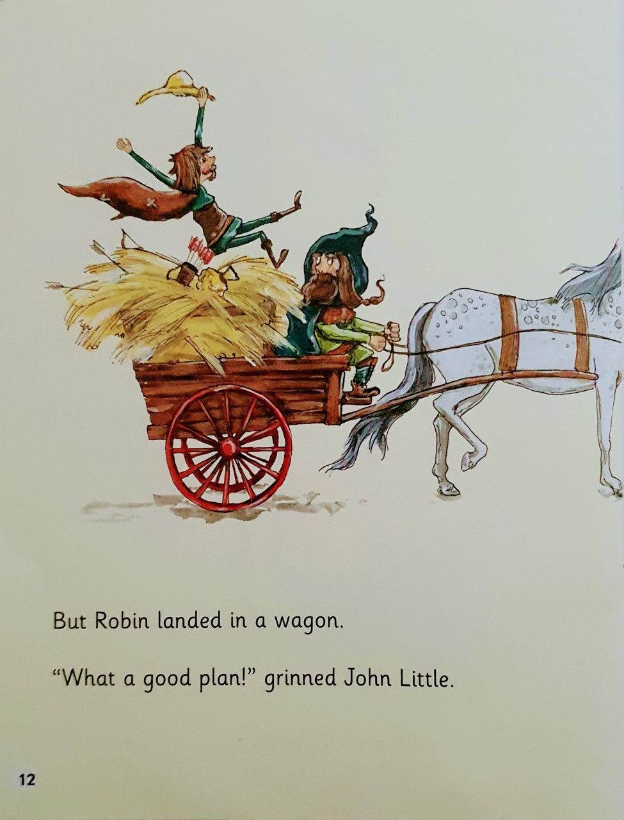
How did John Little help Robin?

Slide 8
