Slide 1
Learning Intention : To listen and explore the music of ‘Peter and the Wolf’
Music

Slide 2
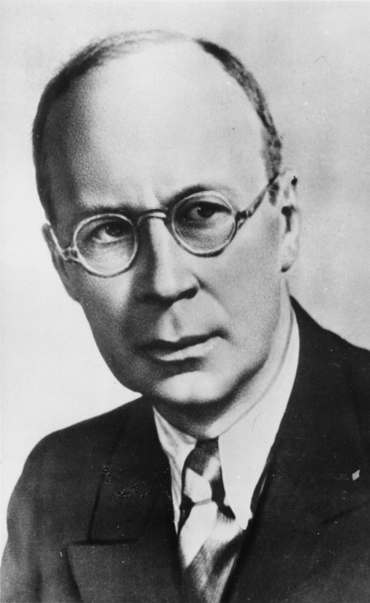
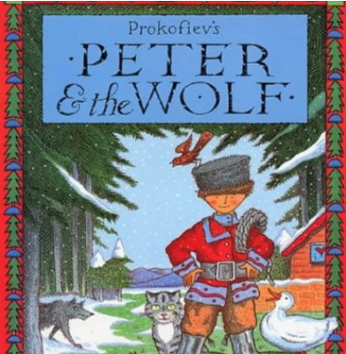
Peter and the Wolf is a piece of music that was written by a composer called Sergei Prokofiev.

Slide 3
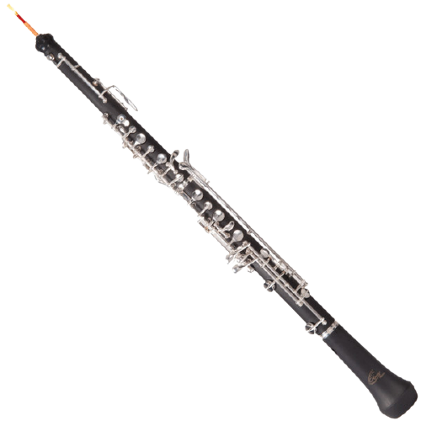
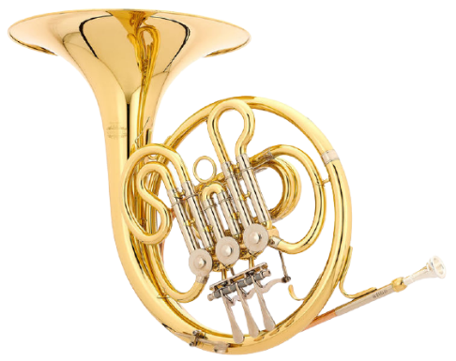
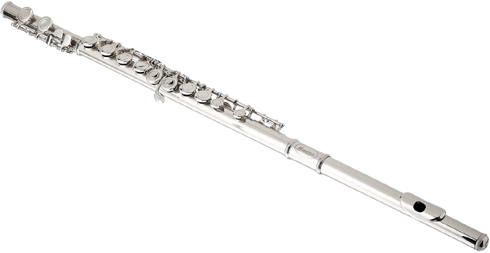
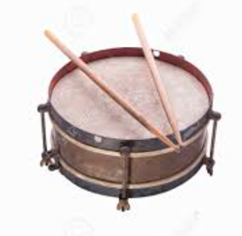
It was used as the background music to tell the story.
Today we are going to listen to some of the instruments from Peter and the Wolf. Here are some of them:

Slide 4
This is a flute. In the story, the sound of the flute means the bird. Let’s have a listen.

Slide 5
This is an oboe. In the story, the sound of the oboe means the duck. Let’s have a listen.

Slide 6
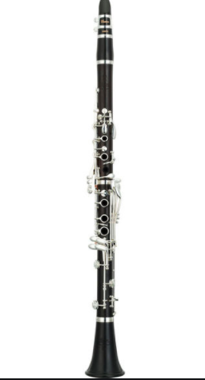
This is a clarinet. In the story, the sound of the clarinet means the cat. Let’s have a listen.

Slide 7
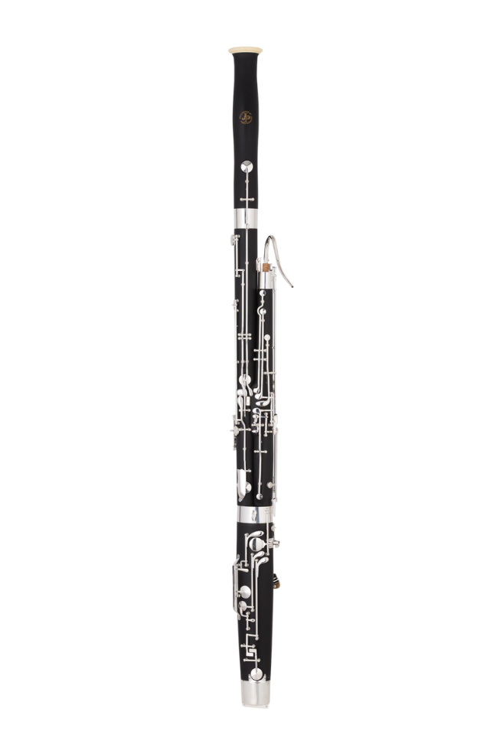
This is a bassoon. In the music, the sound of the bassoon means the Grandfather. Let’s have a listen.

Slide 8
Here are 3 French Horns. In the music, the sound of the French Horns means that the wolf is here! Let’s have a listen.

Slide 9
These are the drums. In the music, the sound of the drums means that the Hunters are here! Let’s have a listen.

Slide 10
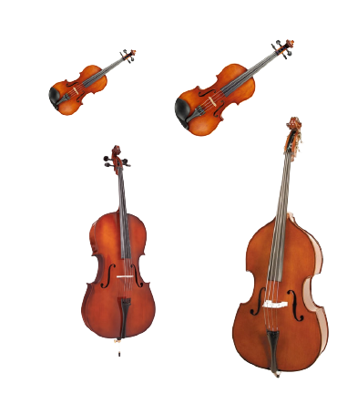
These are stringed instruments: viola, violin, cello and double bass. In the music, the sound of the strings means Peter. Let’s have a listen.

