Slide 1
To find fractions of an amount
Finding ½

Slide 2
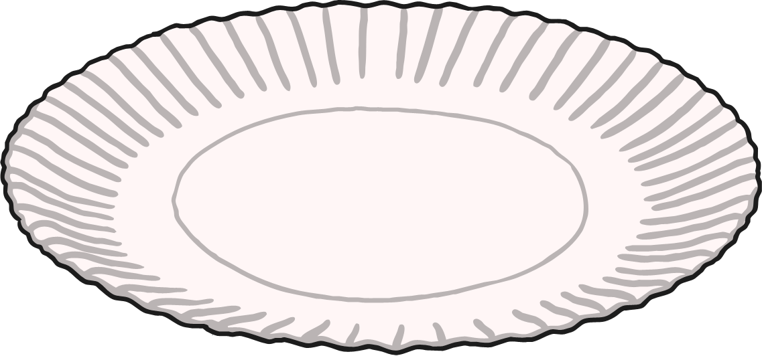
Finding Half (½)
To find half of a number of objects, you need to divide them by two.
Count the number of cakes.
There are 8 cakes.

Slide 3
Finding ½
When we need to find half, we share into 2 equal groups
We can see ½ of 8 = 4

Slide 4
We can use bar models to help us.
For example.
½ of 8.
Draw a bar model, split into 2 equal parts.
Then we share 8 between the 2 parts
We can see that there is 4 on each side so ½ of 8 = 4
. . . . | . . . .

