Slide 1


Set 2 Sounds
oy
Notes:
Lets practise our set 2 sounds, today;’s sound is oy

Slide 2
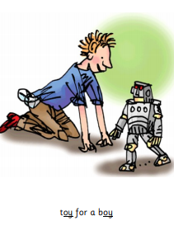
Notes:
Ooh what is this? That’s right, a toy for a boy

Slide 3
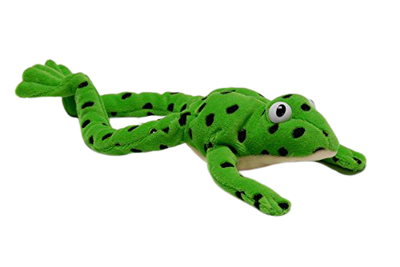
Notes:
Lets fred talk! T-oy, toy, b-oy, boy, e-n-j-oy, enjoy

Slide 4
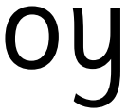
Notes:
This is our new sound oy. It has 2 letters but 1 sound, it’s a special friend

Slide 5
Notes:
Lets practice oy. My turn first…..

Slide 6
Notes:
Now its your turn! Lets go

Slide 7
toy
.
_
boy
.
_
enjoy
.
.
_
.
Notes:
Lets read some green words! First lets use fred talk then read the word

Slide 8

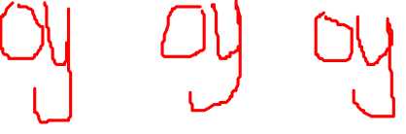
Notes:
Let’s practice writing our sound - oy

Slide 9
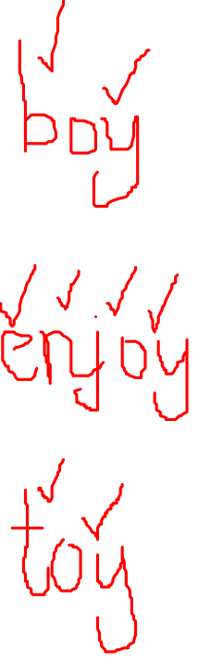
Notes:
Let’s practice writing words with the oy sound in them boy, enjoy, toy

