Slide 1
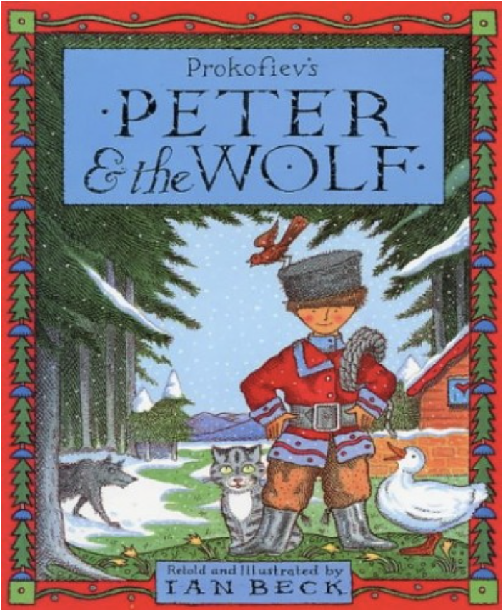
What can you remember about Peter and the Wolf?
Notes:
Before we look at the end of the story, what can you remember about Peter and the Wolf?

Slide 2
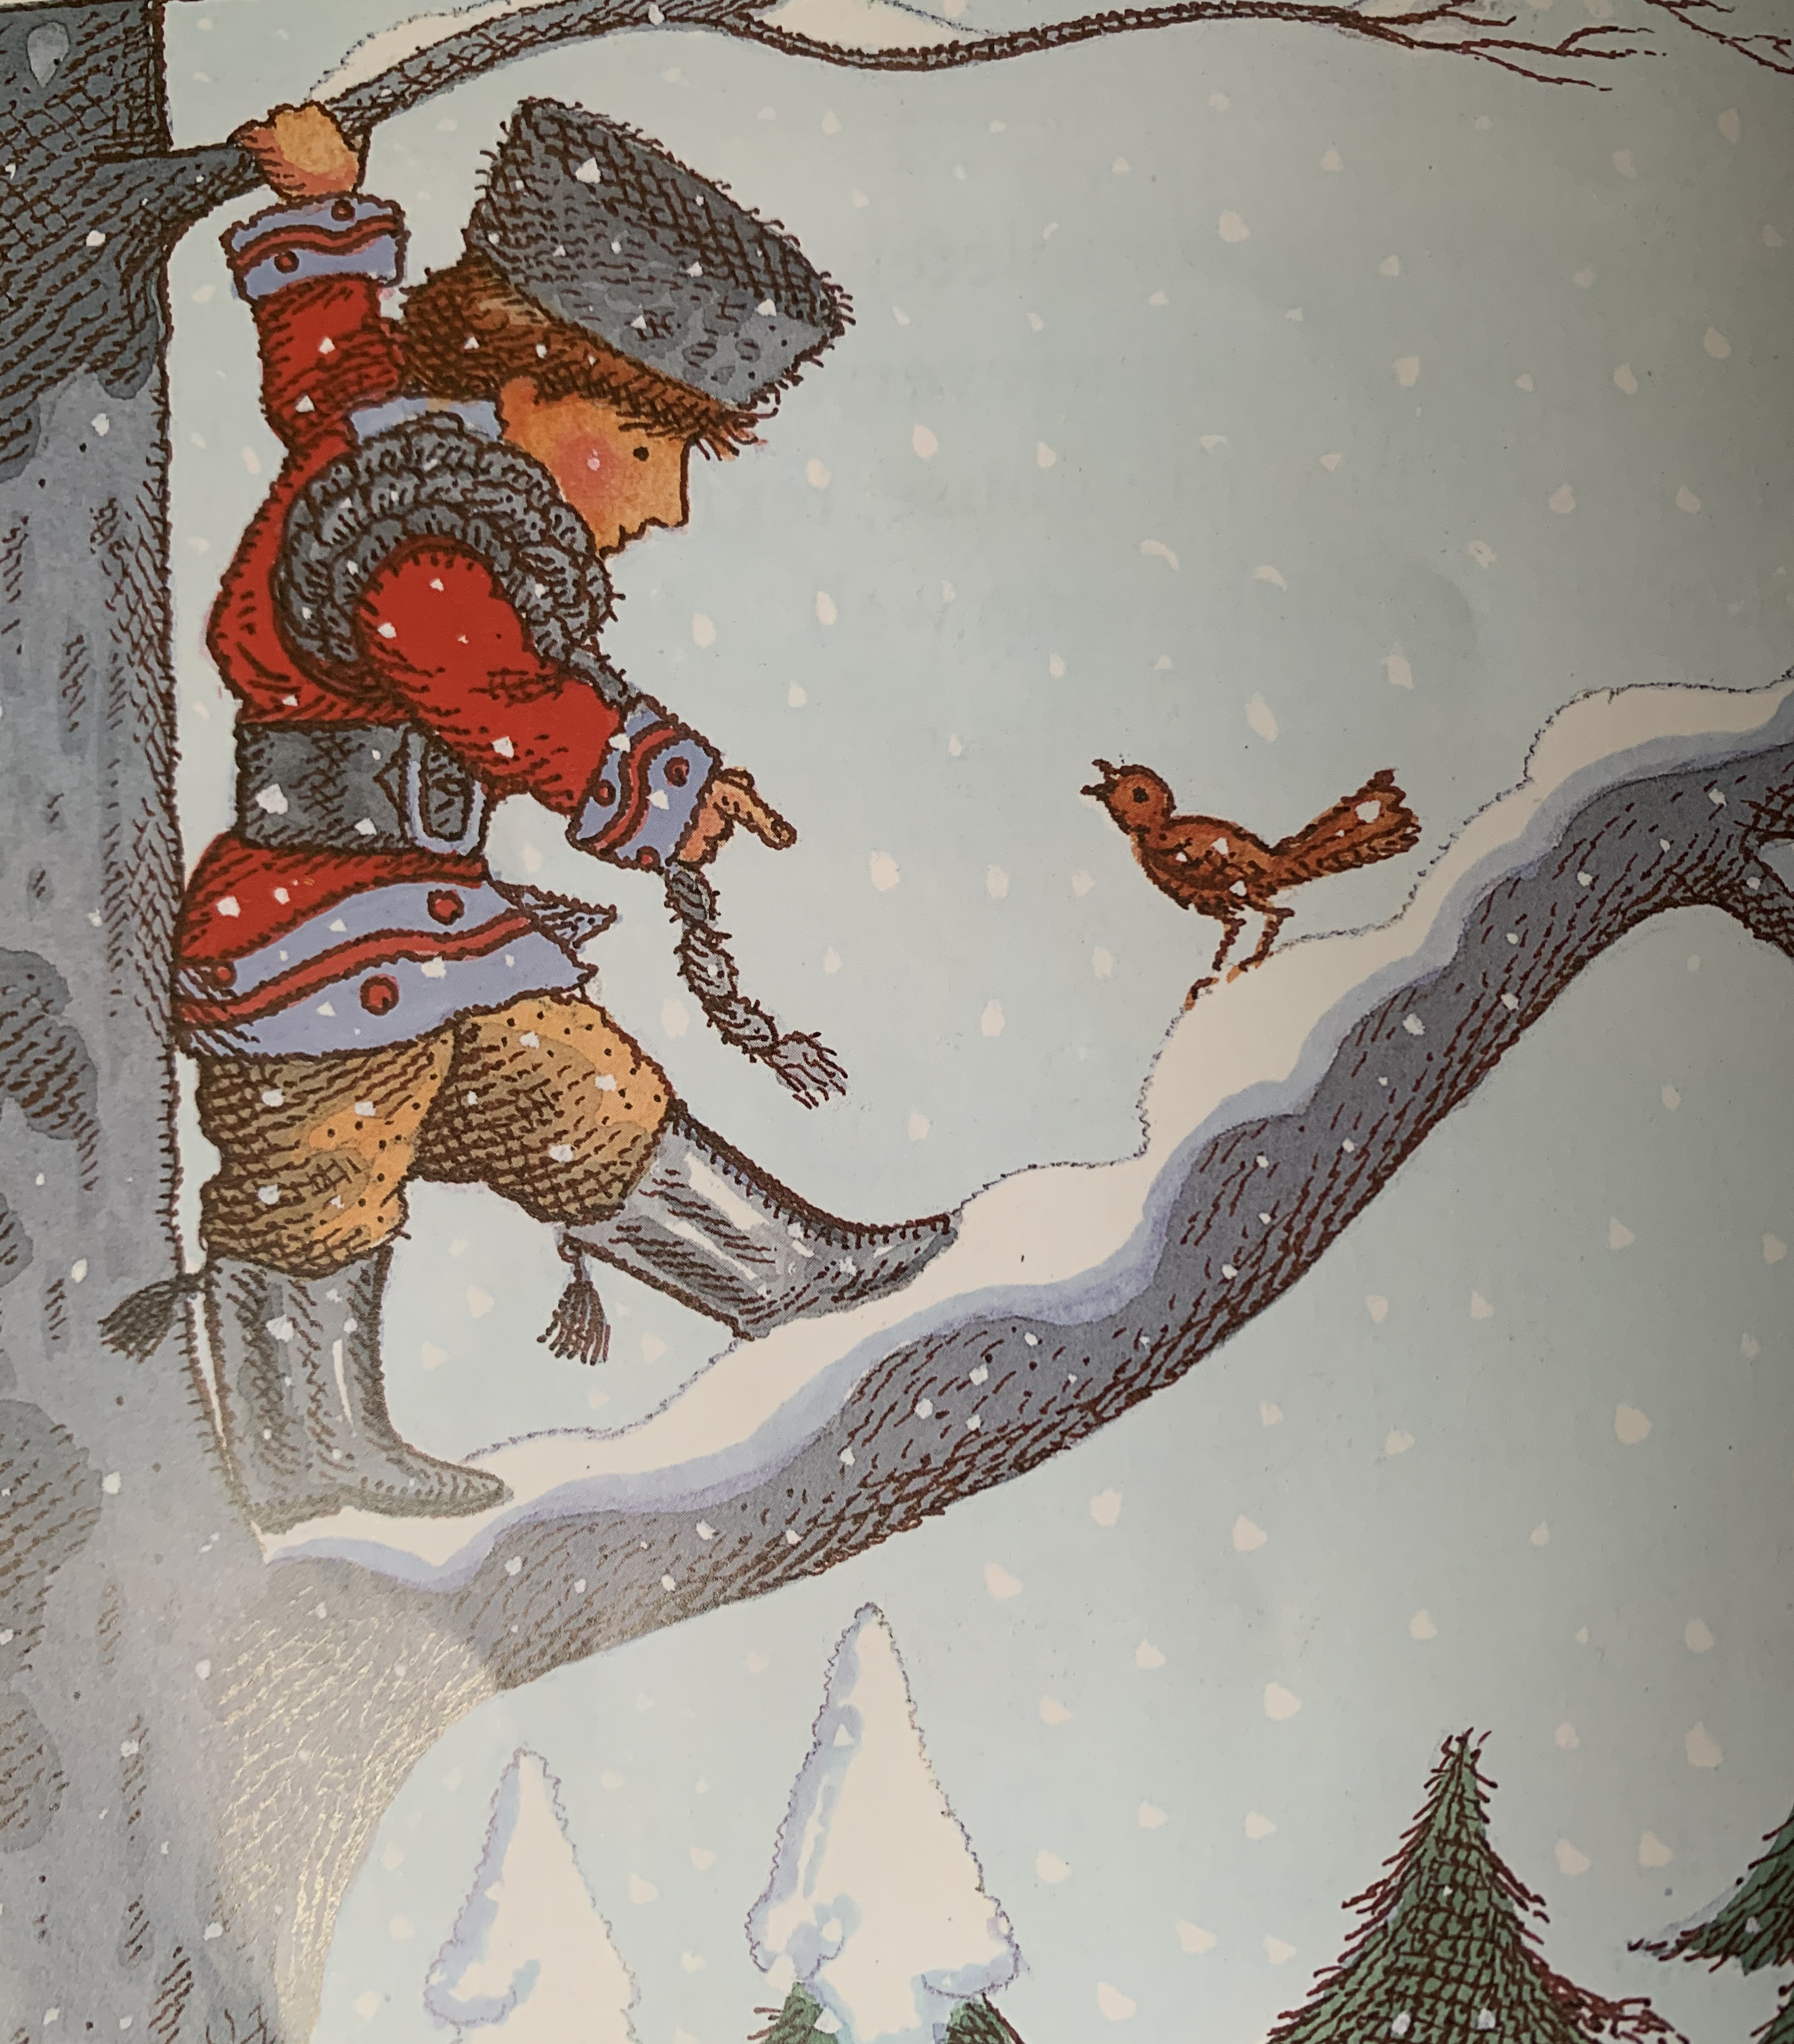
Quick prediction – what will happen next?
Notes:
Quick prediction – what is going to happen next?

Slide 3
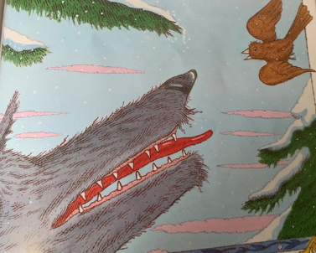
Notes:
The little bird flew as close as he could, almost touching the wolf’s head with his wings, while the wolf snapped angrily at him from this side and that.
How the bird worried the wolf and how the wolf wanted to catch him, but the little bird was too clever and the wolf simply couldn’t do anything about it.

Slide 4
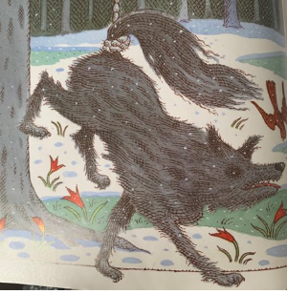
Notes:
Meanwhile, Peter made a lasso out of the strong rope and, very carefully letting it down, he caught the wolf by the tail, and pulled with all his might.
Feeling himself caught, the wolf snarled and jumped wildly, trying to escape. But Peter had tied the other end of the rope to the tree and the wolf’s jumping only made the rope round his tail tighter.

Slide 5
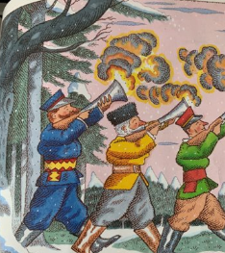
Notes:
Just then, some hunters came out of the dark forest. They were following the wolf’s trail in the snow, shooting their guns as they marched. Peter, high in the tree, called out, “Don’t shoot! The bird and I have caught the wolf. Now we can take him to the zoo.”

Slide 6
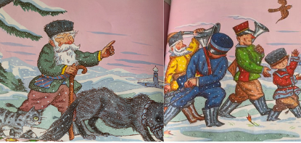
Notes:
Imagine the triumphant procession… Peter at the front, then the hunters leading the wolf, then Grandfather. And, right at the end, the cat. Grandfather shook his head. “Ah it’s all very well… but what if Peter hadn’t caught the wolf, what then, eh?”
Above them flew the little bird, singing happily, “My, what brave fellows we are, Peter and I. Look what we’ve caught!”

Slide 7
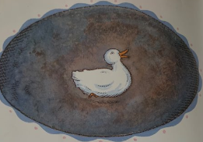
Notes:
And, if you listen very carefully you might hear the fat duck quacking inside the wolf because the wolf, in his hurry, swallowed her whole!

Slide 8
Glossary:
triumphant – proud
procession – a number of people moving forward
lasso – a loop made out of rope
Notes:
Glossary:
Triumphant – proud
Procession – a number of people moving forward
Lasso – a loop made out of rope

Slide 9
How did you feel about the ending?
Are you glad that they caught the wolf?
What was your favourite part of the story and why?
Notes:
How did you feel about the ending? Are you glad that they caught the wolf? What was your favourite part of the story and why?

Slide 10
Commentary:
Slide 1: Before we look at the end of the story, what can you remember about Peter and the Wolf?
Slide 2: Quick prediction – what is going to happen next? Slide 3: The little bird flew as close as he could, almost touching the wolf’s head with his wings, while the wolf snapped angrily at him from this side and that. How the bird worried the wolf and how the wolf wanted to catch him, but the little bird was too clever and the wolf simply couldn’t do anything about it.
Slide 4: Meanwhile, Peter made a lasso out of the strong rope and, very carefully letting it down, he caught the wolf by the tail, and pulled with all his might. Feeling himself caught, the wolf snarled and jumped wildly, trying to escape. But Peter had tied the other end of the rope to the tree and the wolf’s jumping only made the rope round his tail tighter. Slide 5: Just then, some hunters came out of the dark forest. They were following the wolf’s trail in the snow, shooting their guns as they marched. Peter, high in the tree, called out, “Don’t shoot! The bird and I have caught the wolf. Now we can take him to the zoo.”

Slide 11
Commentary:
Slide 6: Imagine the triumphant procession… Peter at the front, then the hunters leading the wolf, then Grandfather. And, right at the end, the cat. Grandfather shook his head. “Ah it’s all very well… but what if Peter hadn’t caught the wolf, what then, eh?” Above them flew the little bird, singing happily, “My, what brave fellows we are, Peter and I. Look what we’ve caught!”
Slide 7: And, if you listen very carefully you might hear the fat duck quacking inside the wolf because the wolf, in his hurry, swallowed her whole!
Slide 8: Glossary: Triumphant – proud. Procession – a number of people moving forward. Lasso – a loop made out of rope
Slide 9: How did you feel about the ending? Are you glad that they caught the wolf? What was your favourite part of the story and why?

