Slide 1
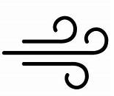
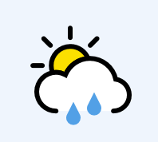

Slide 2
What is the weather like today? Draw a symbol to show the weather.

Slide 3
What did the forecast predict?
Was it right?

Slide 4
Can you remember my experiment?
What did I want to test?

Slide 5
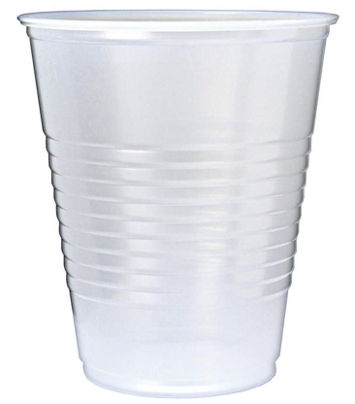
My Experiment:
Predict: How much water will be in my cup next Friday?

Slide 6
Last Friday…

Slide 7
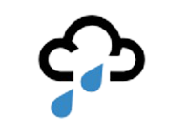
Results:

Slide 8
What will happen next?

Slide 9
The snow will melt!

Slide 10
Commentary:
Slide 1: What does each weather symbol mean?
Slide 6: Last Friday, I put a cup outside in the playground. What do you think happened?
Slide 7: After a week, was my cup empty, full of water or full of snow?
Slide 8: That’s right, it was full of snow. What will happen next when the snow melts?
Slide 9: I will have a cup full of water. Can you think of an experiment to see how much snow we get next week?

