Slide 1
To be able to change the present to the past tense

Slide 2
Tenses
The present tense tells us that things are happing right now.
‘The snake is slithering down the tree.’
The past tense tells us that things have already happened, in the past.
‘The snake slithered down the tree.’
Can you see how the sentences are almost the same, the only part that has changed is the verb.

Slide 3
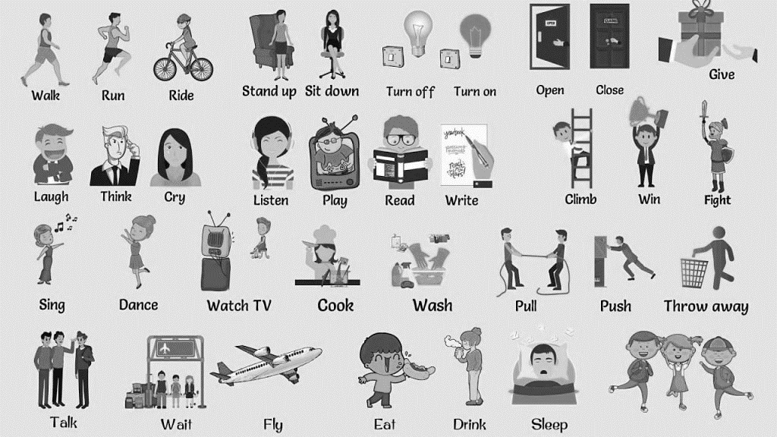
How to change from present to past
When changing a sentence from the present to the past the main thing you have to look for is the verbs, the action words. These are the main parts of the sentence that you will be changing.

Slide 4
Lets try some together
1) The bird is flying down from up high. (The verb is flying)
So we would change this verb to its past tense, which is flew. We would also remove the is because ‘is’ tells us it’s the present and we want the past.
The bird flew down from up high.
2) The man is chopping and banging on the great tree. (The verbs are chopping and banging)
So we change these words to their past tense.
The man chopped and banged on the great tree.

