Slide 1
Investigate music from the past- research

Slide 2
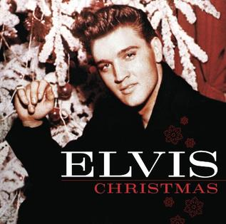
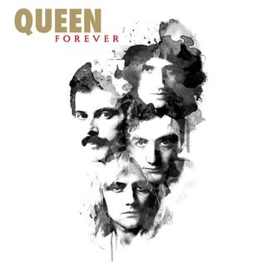
Music History in the 1970s Here are some of the different musicians:
Stevie Wonder

Slide 3
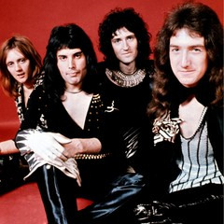
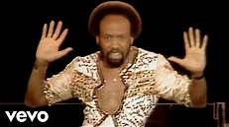
There were many different styles of music in the 1970s. Some of these were: Funk, Soul, R&B, Pop, Hard Rock, Soft Rock and Disco.
Soul Music
Funk Music
Hard Rock Music

Slide 7
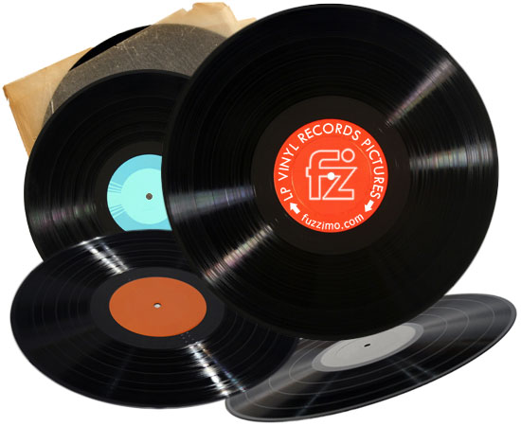
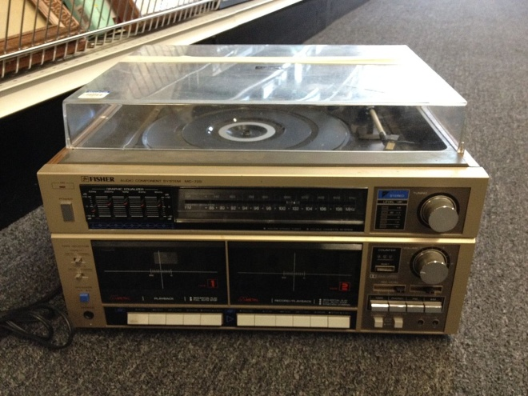
In the 1970s there were different ways of listening to music like using the a radio and by playing vinyl records.
What is a vinyl record?
Vinyl records were used to play music, like using music downloads now. Vinyl's are played on a record player.
Vinyl record
Record Player

Slide 8
Musical instruments in the 1970’s were some of the best. They were made to last a long time. In fact there are still a lot of the 1970’s equipment still used today. These include Drums, Bass Guitar and Paino.

Slide 9
In this decade songs were recorded by different artists. Some of the songs are now being re-released by new artists.

Slide 10
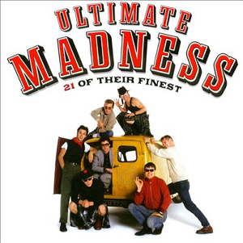
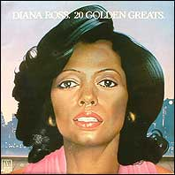
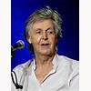
Can you now see if you can find any information about the different artist’s music?
-What style of music did these artists play?
-When did these artists create the most music?
-Which is your favourite artist? Why?
-How popular do you think these artists were?
-Do you or anyone at home recognise the music?
Listen to some of the artists music on the next slide, with the help of someone at home.
What do you like about the music? Why?
Which is your favourite song? Why?
Do you recognise any of the songs?
Describe each song in the 3 words.
- How do the different songs make you feel?
Diana Ross
Paul Mccartney

Slide 11
1970’s artists
Diana Ross- Endless love
Paul McCartney- Mull of Kintyre
Madness- Baggy trousers
Police- Walking on the moon
Elton John- Rocket man
The Beach Boys- Surfin USA
Kenny Rogers and Dolly Parton- Islands in the Stream

